Slide 1

Week 1:
Assess & Review
www.arithmagicians.com

Slide 2


-1
-1
-1
-1
-1
-1
-1
-1
-1
-1
0
1
2
3
4
5
6
7
8
9
10
Get ready to count back in 1s

Slide 3

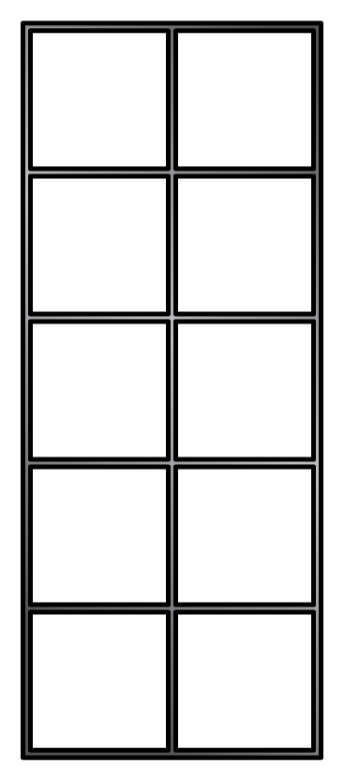
7
+
1
=
8

Slide 4
7
-
1
=
6

Slide 5
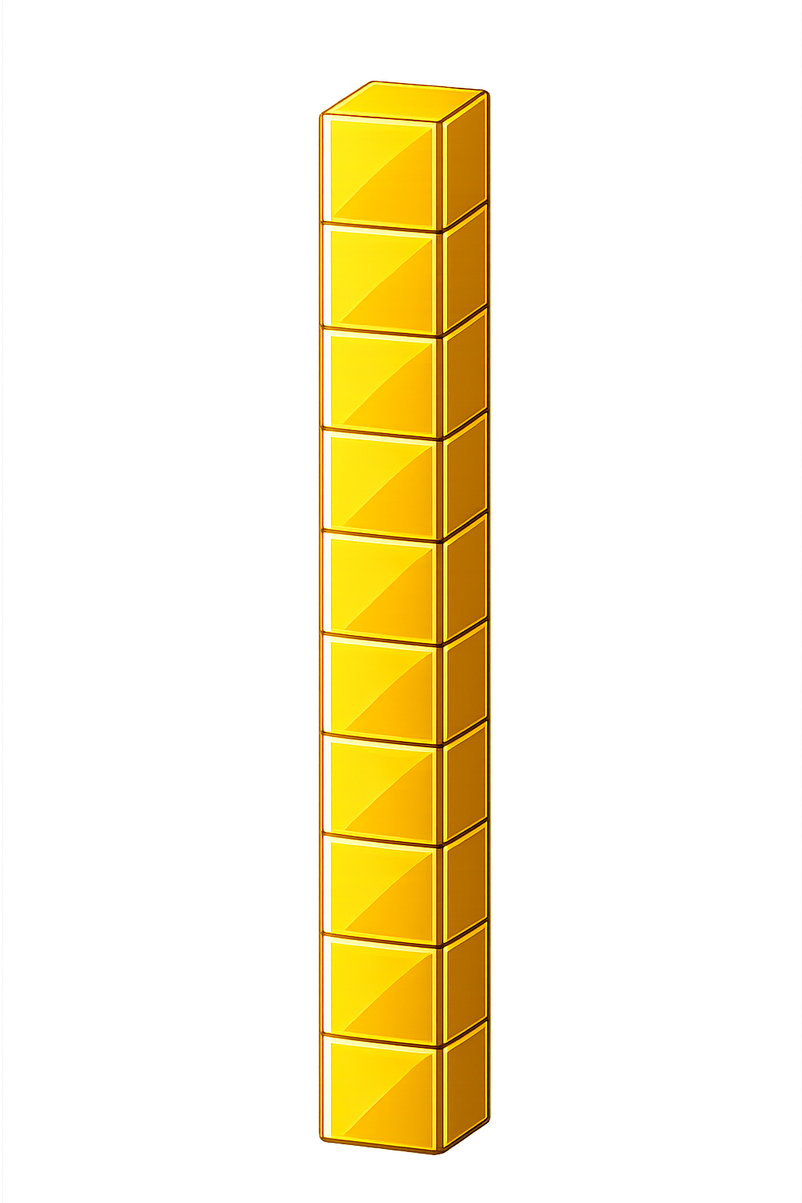

What number is shown below?
25
27
+ 2 = ?

Slide 6
What number is shown below?
35
33
- 2 = ?

Slide 7

60
61
62
63
64
65
66
?
?
67
68
69
70
64
+
2
=
66

Slide 8
60
61
62
63
?
65
64
?
66
67
68
69
70
66
-
2
=
64

Slide 9


Your Turn
26 + 1 = ?
27
39
2) 37 + 2 = ?
17
3) 18 - 1 = ?
82
4) 84 - 2 = ?
5) 90 + 2 = ?
92

