Slide 1


Lesson 5:
Assess and Review
www.arithmagicians.com

Slide 2

Get ready to
count up in tenths
0
1
$\frac{\text{0}}{\text{10}}$
$\frac{\text{1}}{\text{10}}$
$\frac{\text{2}}{\text{10}}$
$\frac{\text{3}}{\text{10}}$
$\frac{\text{4}}{\text{10}}$
$\frac{\text{5}}{\text{10}}$
$\frac{\text{6}}{\text{10}}$
$\frac{\text{7}}{\text{10}}$
$\frac{\text{8}}{\text{10}}$
$\frac{\text{9}}{\text{10}}$
$\frac{\text{10}}{\text{10}}$

Slide 3


Decimals show parts of a whole.
= 1 whole
= 1.0

Slide 4
Decimals are numbers between whole numbers
one part out of 10
=
= 0.1

Slide 5
Decimals are numbers between whole numbers
one part out of 100
=
= 0.01

Slide 6



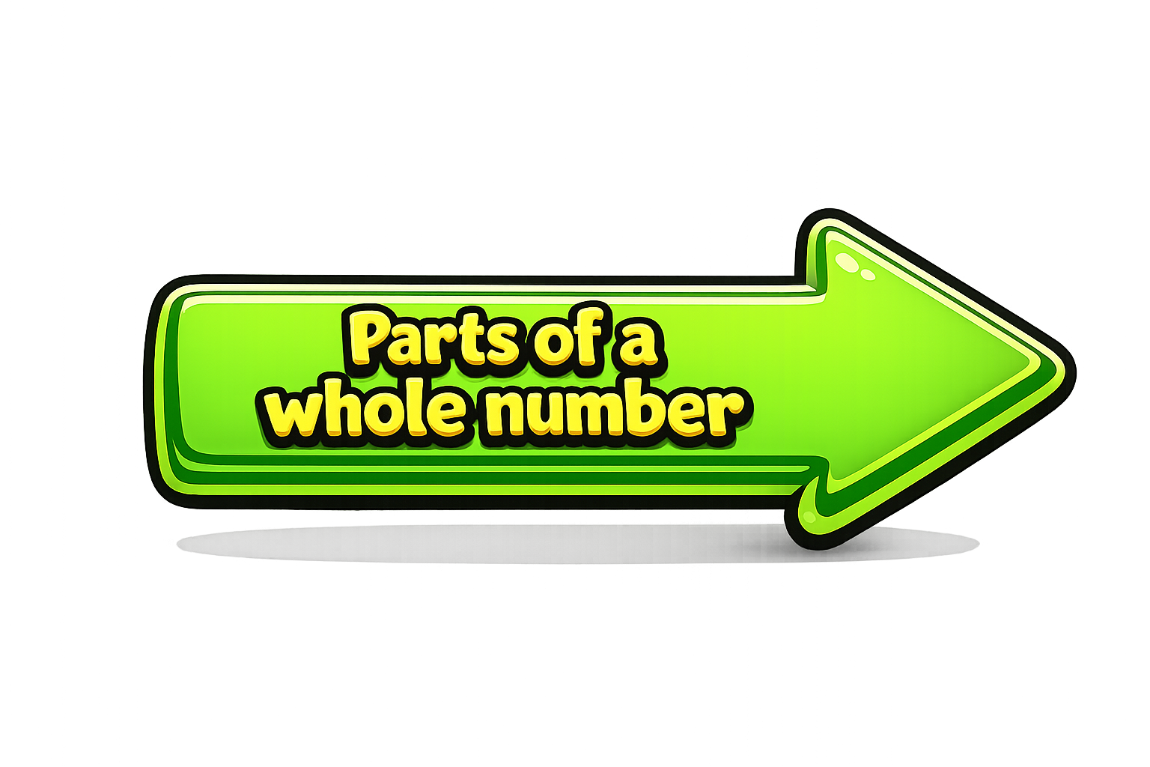

The decimal point separates:
Whole numbers (left)
Parts (right)
Ones | Tenths | Hundredths

Slide 7

Tenths
?
$\frac{\text{4}}{\text{10}}$
What fraction is shaded?

Slide 8
Tenths
?
$\frac{\text{9}}{\text{10}}$
What fraction is shaded?

Slide 9


Your Turn
Match the equivalent fractions and decimals.
9/10
0.1
1/10
0.7
4/10
1
7/10
0.9
10/10
0.4

