Slide 1

Lesson 1:
Add 1 to any number
www.arithmagicians.com

Slide 2

+1
+1
+1
+1
+1
+1
+1
+1
+1
+1
10
11
12
13
14
15
16
17
18
19
20
Get ready to count up in 1s

Slide 3

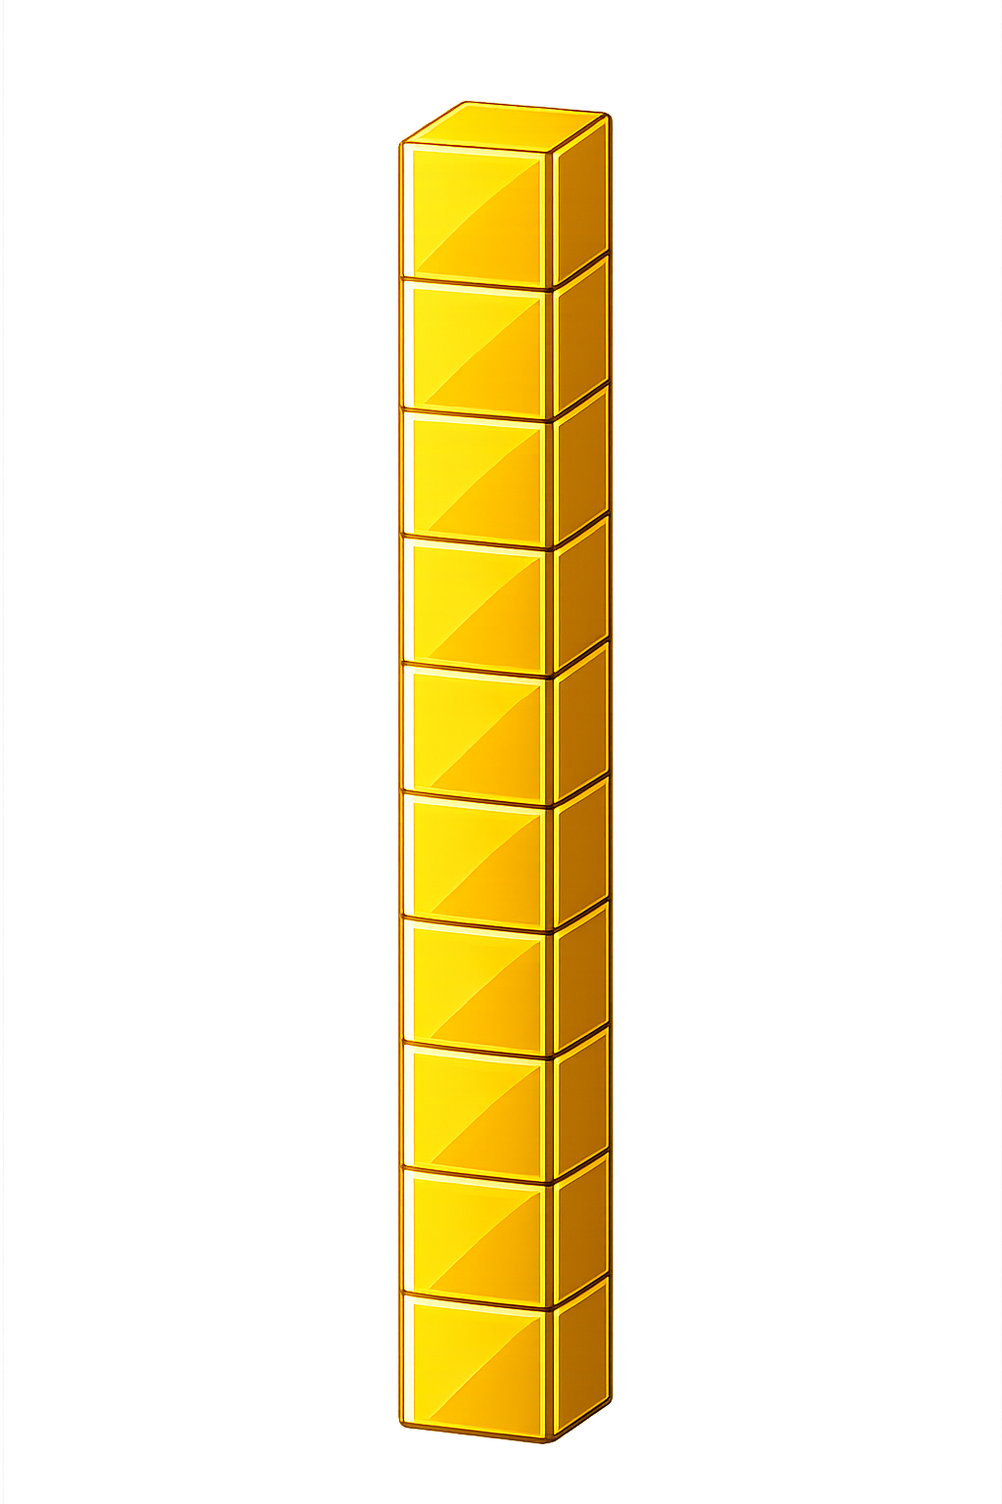

What number is shown below?
25
26
+ 1 = ?

Slide 4
What number is shown below?
What happens if the number has 9 ones and we add 1 more??
We exchange 10 ones
for 1 ten
29
30
+ 1 = ?

Slide 5
What number is shown below?
49
50
+ 1 = ?

Slide 6

65
66
67
68
69
?
71
72
73
74
75
70
69
+
1
=
70

Slide 7


Your Turn
9 + 1 = ?
10
40
2) 39 + 1 = ?
20
3) 19 + 1 = ?
60
4) 59 + 1 = ?
5) ? + 1 = 30
29

Slide 8

True or False
When you add 1 to a number, the tens digit never changes.
False: Can you explain why?

