Slide 1
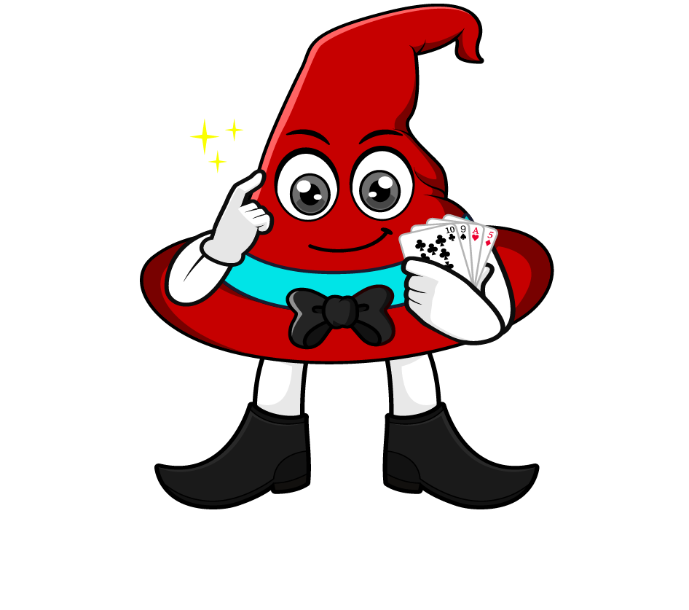

Lesson 1:
Convert units of length
(kg & g)
www.arithmagicians.com

Slide 2

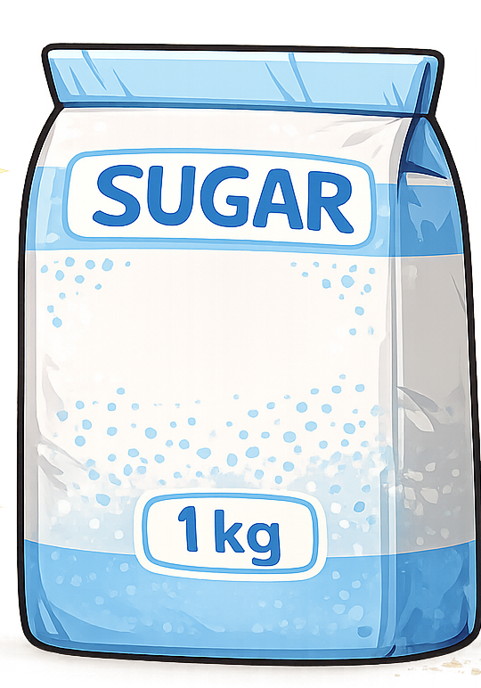
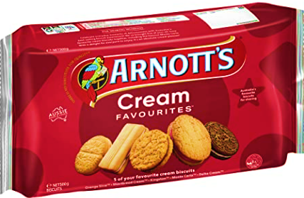
1 kg = ? g
1000 g
=
500g
500g
Tip: Use the diagram to help you

Slide 3
1kg = 1000 g
To change kg into g, ______ by 1000.
multiply
To change g into kg, ______ by 1000.
divide

Slide 4

x 1000
1 kg = 1000 g
8.2 kg = ? g
8200
x 1000

Slide 5
÷ 1000
1 kg = 1000 g
0.45
? kg = 450 g
÷ 1000

Slide 6

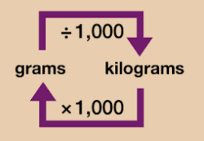
Your Turn
Solve:
6000 g
6 kg = ? g
4000 g = ? kg
2.5 kg = ? g
5500 g = ? kg
Use the conversion chart to help you.
4 kg
2500 g
5.5 kg

Slide 7
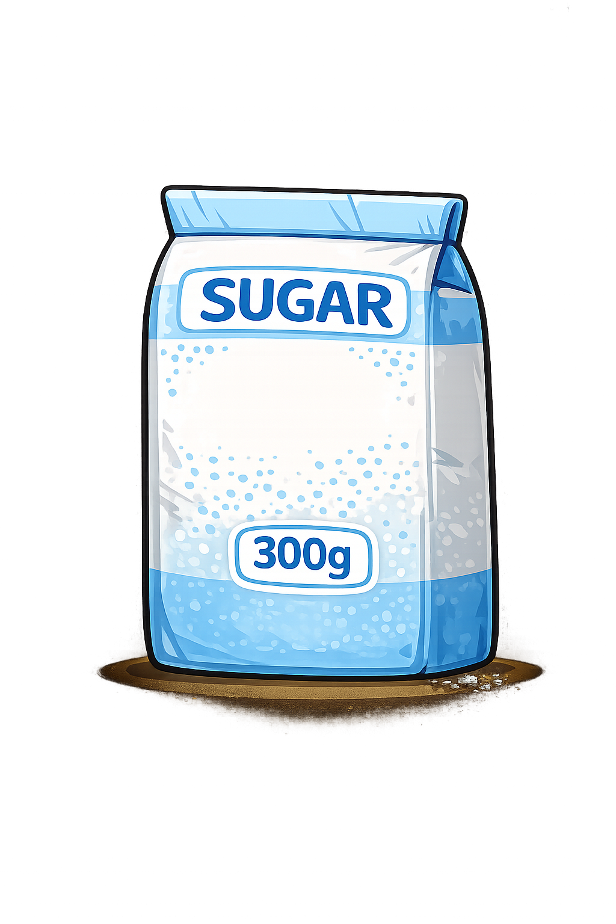
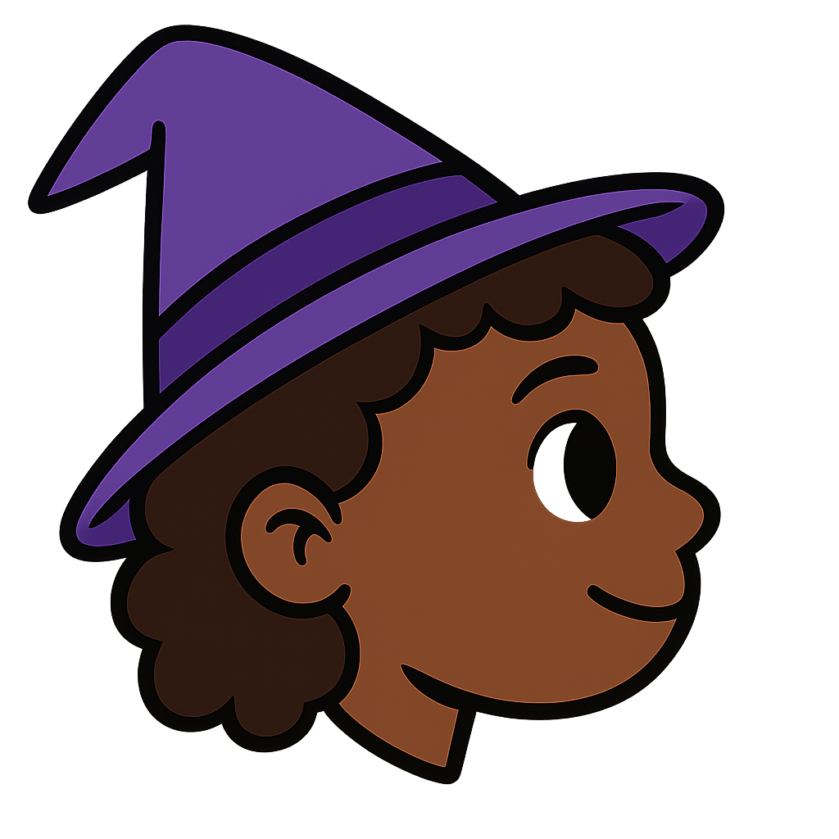


What is the
total weight of the two bags?
Amy:
1 kilo and 300g
Ben:
1.3kg
Lucy:
1300g
Who is correct?
They are all correct! Why?

