Slide 1


Lesson 1:
Convert between seconds, minutes and hours
www.arithmagicians.com

Slide 2

How many seconds in one minute?
How many minutes in one hour?
60 seconds
60 minutes

Slide 3


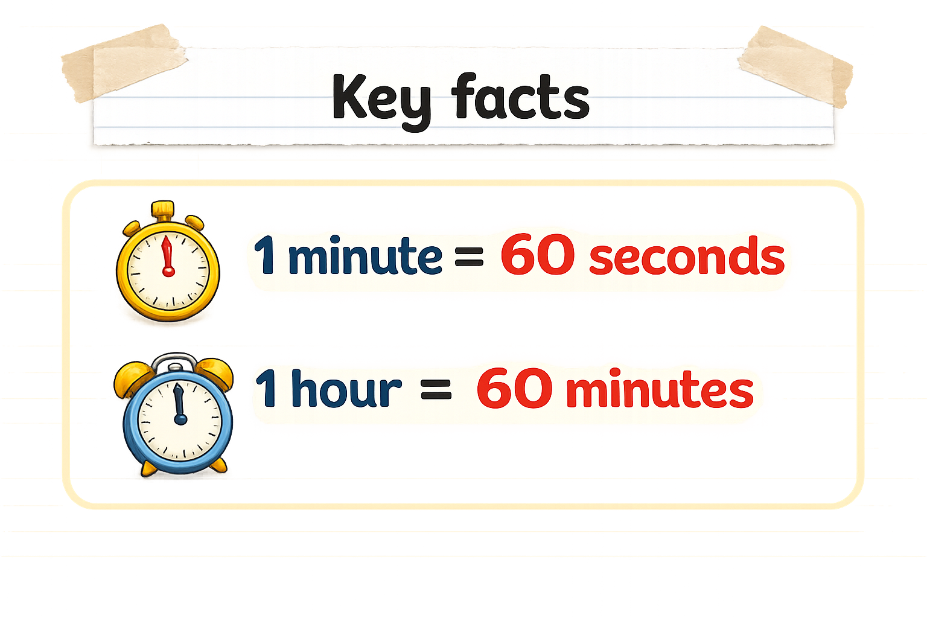
How many seconds are there in 2 minutes?
So, 2 minutes would be:
2 x 60 = 60 + 60 = 120
I know that:
1 minute = 60 seconds
120 seconds
60 seconds
60 seconds
1 minute
1 minute

Slide 4
How many minutes are there in 3 hours?
I know that:
1 hour = 60 minutes
So, 3 hours would be:
3 x 60 = 60 + 60 + 60 = 180
180 minutes
60 minutes
60 minutes
60 minutes
1 hour
1 hour
1 hour

Slide 5


Your Turn
3 minutes = ___ seconds
120 seconds = ___ minutes
2 hours = ___ minutes
180 minutes = ___ hours
180
2
120
3
Tip: Use bar models to help you.

Slide 6
True or False
130 seconds is the same as 1 minutes and 30 seconds
False:
Can you explain why?

