Slide 1


Lesson 1:
Hundredths as fraction
www.arithmagicians.com

Slide 2

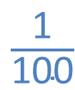
1
100
When a whole is split into _____ equal parts, one of those parts is worth _____
$\frac{\text{1}}{\text{100}}$

Slide 3

Get ready to
count up in hundredths
0
1
$\frac{\text{0}}{\text{100}}$
$\frac{\text{10}}{\text{100}}$
$\frac{\text{20}}{\text{100}}$
$\frac{\text{30}}{\text{100}}$
$\frac{\text{40}}{\text{100}}$
$\frac{\text{50}}{\text{100}}$
$\frac{\text{60}}{\text{100}}$
$\frac{\text{70}}{\text{100}}$
$\frac{\text{80}}{\text{100}}$
$\frac{\text{90}}{\text{100}}$
$\frac{\text{100}}{\text{100}}$

Slide 4

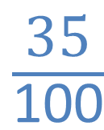
Hundredths
What fraction is shaded?
$\frac{\text{35}}{\text{100}}$

Slide 5
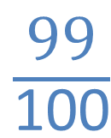
Hundredths
What fraction is shaded?
$\frac{\text{99}}{\text{100}}$

Slide 6

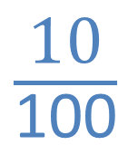
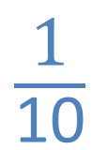
Hundredths
What fraction is shaded?
$\frac{\text{10}}{\text{100}}$
$\frac{\text{1}}{\text{10}}$
or
?

Slide 7









Your Turn
What fractions are shown?
A
B
C
$\frac{\text{74}}{\text{100}}$
$\frac{\text{80}}{\text{100}}$
$\frac{\text{8}}{\text{10}}$
$\frac{\text{50}}{\text{100}}$
$\frac{\text{5}}{\text{10}}$
$\frac{\text{1}}{\text{2}}$
or
or
or

Slide 8


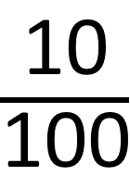
True or False
$\frac{\text{10}}{\text{100}}$
$\frac{\text{1}}{\text{10}}$
<
False: Can you explain why?

