Slide 1

Lesson 2:
Add 1 to any number
www.arithmagicians.com

Slide 2

+1
+1
+1
+1
+1
+1
+1
+1
+1
+1
70
71
72
73
74
75
76
77
78
79
80
Get ready to count up in 1s

Slide 3

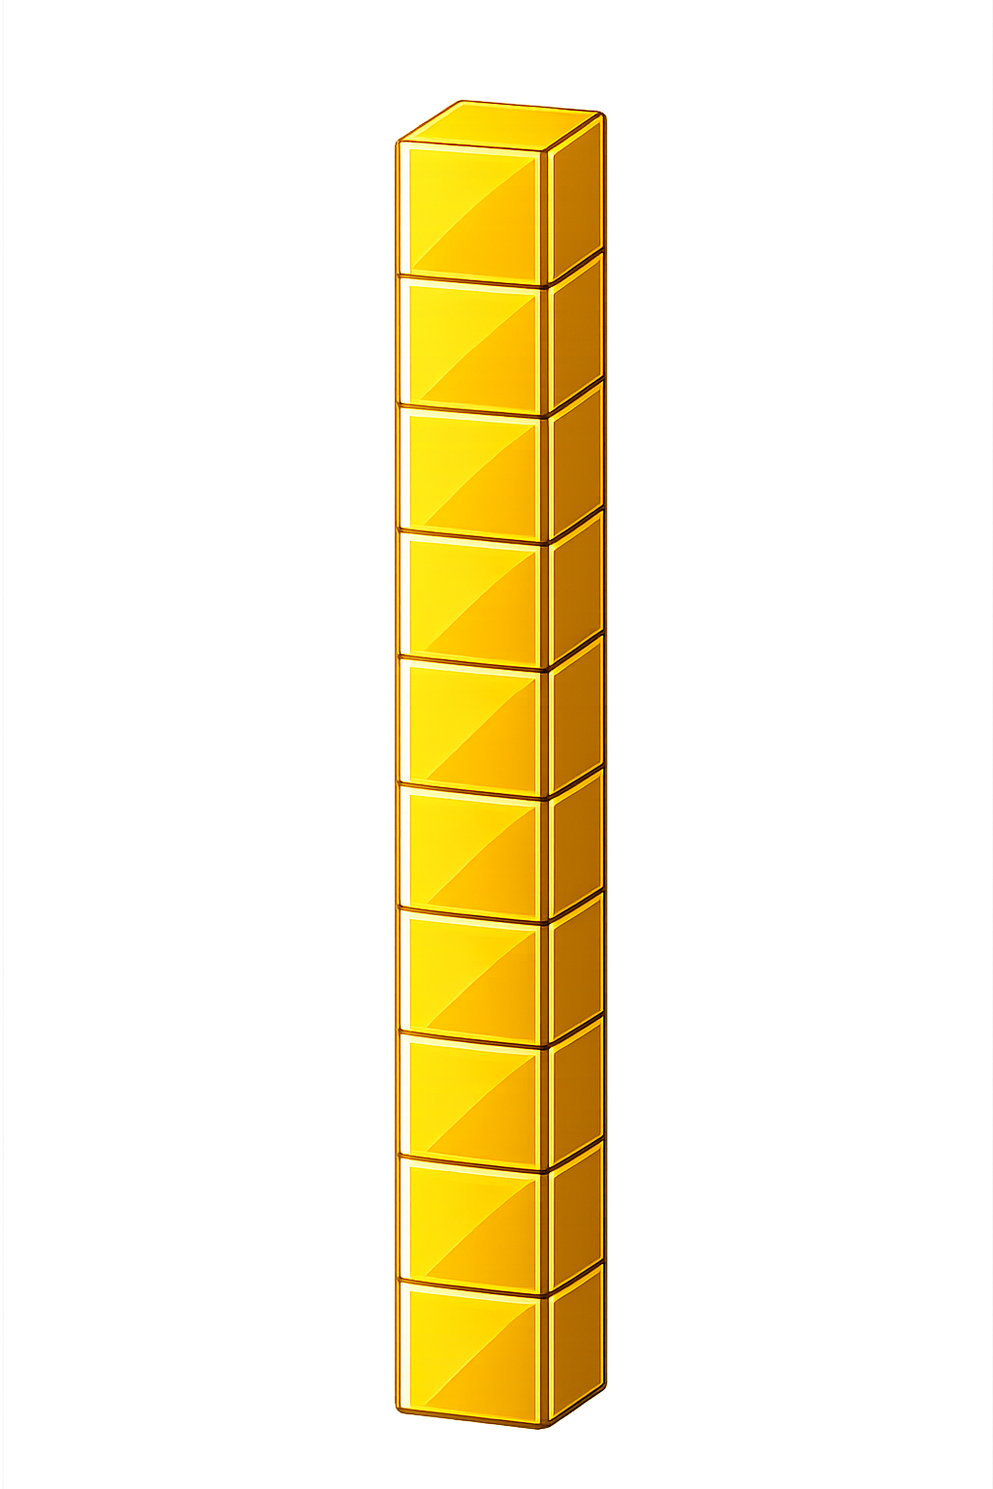

What number is shown below?
18
19
+ 1 = ?

Slide 4
What number is shown below?
We exchange 10 ones
for 1 ten
What happens if the number has 9 ones and we add 1 more??
19
20
+ 1 = ?

Slide 5
What number is shown below?
39
40
+ 1 = ?

Slide 6

85
86
87
88
89
?
91
92
93
94
95
90
89
+
1
=
90

Slide 7


Your Turn
29 + 1 = ?
30
80
2) 79 + 1 = ?
50
3) 49 + 1 = ?
100
4) 99 + 1 = ?
5) ? + 1 = 70
69

Slide 8

True or False
When you add 1 to 29, only the ones digit changes.
False: Can you explain why?

