Slide 1
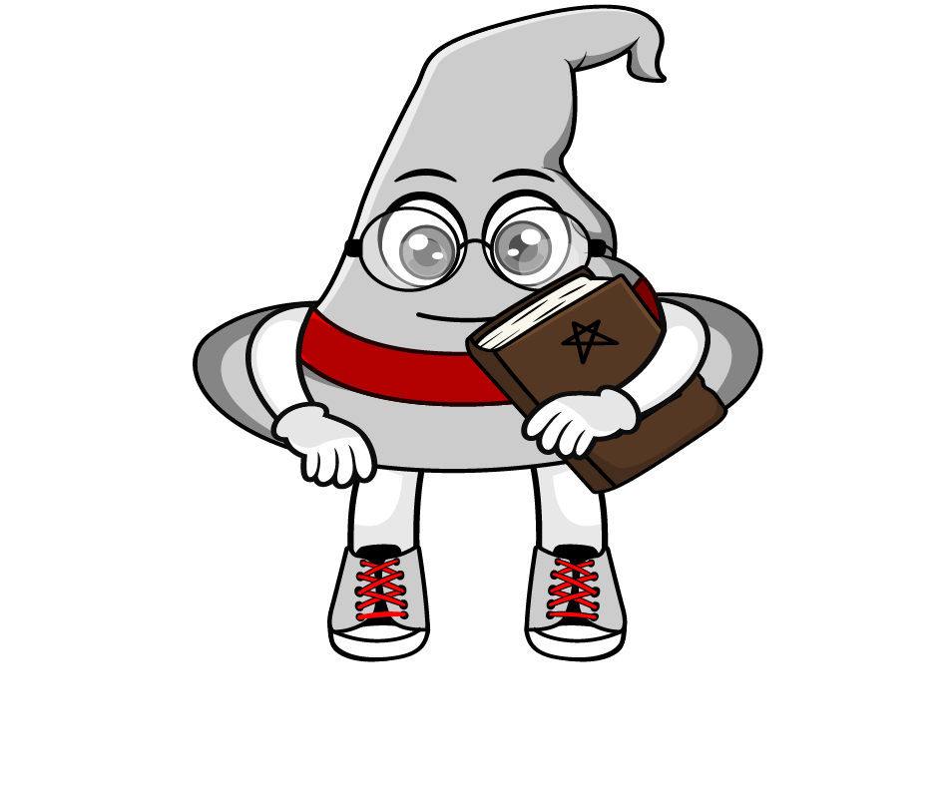

Lesson 2:
Convert units of length
(kg & tonne)
www.arithmagicians.com

Slide 2

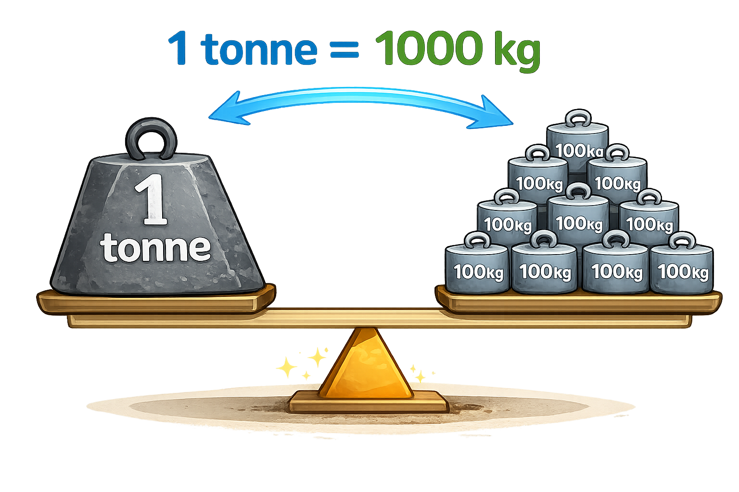

1000 kg
1 tonne = ? kg
Tip: Use the diagram to help you

Slide 3
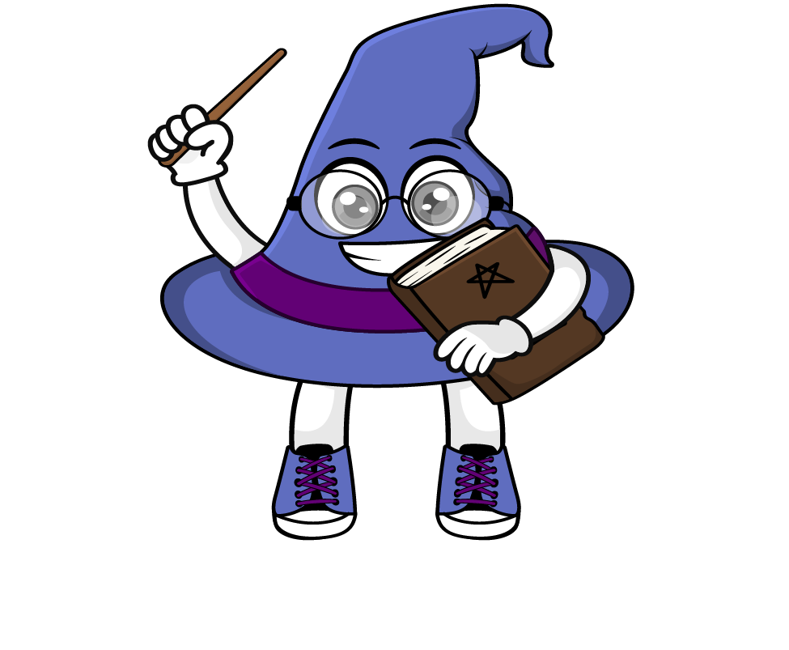
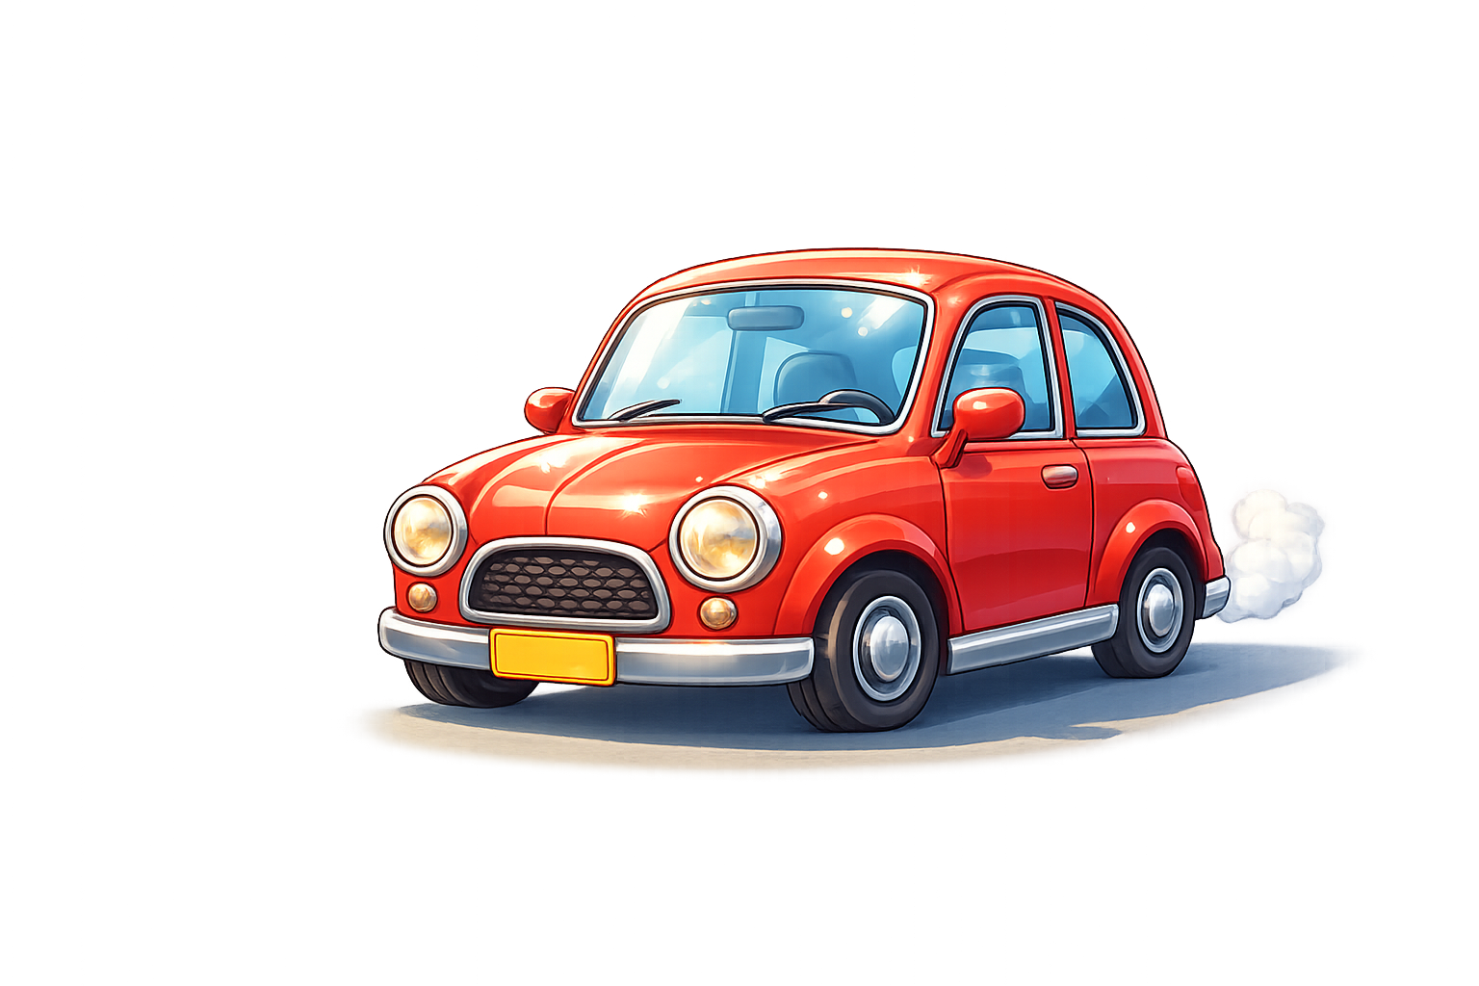
How heavy is 1 tonne?
As a rough guide, an average car
has a mass of about 2 tonnes.

Slide 4
1 tonne = 1000 kg
To change t into kg, _______ by 1000.
multiply
To change kg into t, _______ by 1000.
divide

Slide 5

x 1000
1 t = 1000 kg
9.5 t = ? kg
9500
x 1000

Slide 6
÷ 1000
1 t = 1000 kg
0.65
? t = 650 kg
÷ 1000

Slide 7

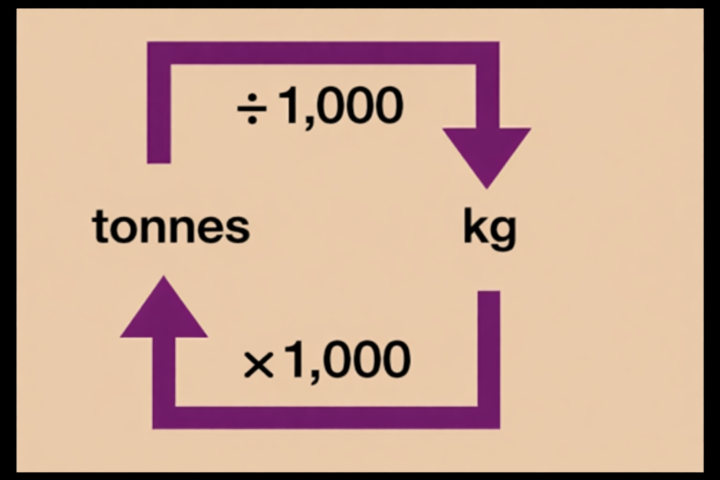


Your Turn
Solve:
8000 kg
8 t = ? kg
4000 kg = ? t
2.5 t = ? kg
5500 kg = ? t
Use the conversion chart to help you.
4 t
2500 kg
5.5 t

Slide 8
True or False
When changing tonnes into
kilograms, the number gets smaller.
False: can you explain why?

