Slide 1


Lesson 2:
Measuring time in seconds
www.arithmagicians.com

Slide 2

Recap:
How many seconds in one minute?
How many minutes in one hour?
60 seconds
60 minutes

Slide 3


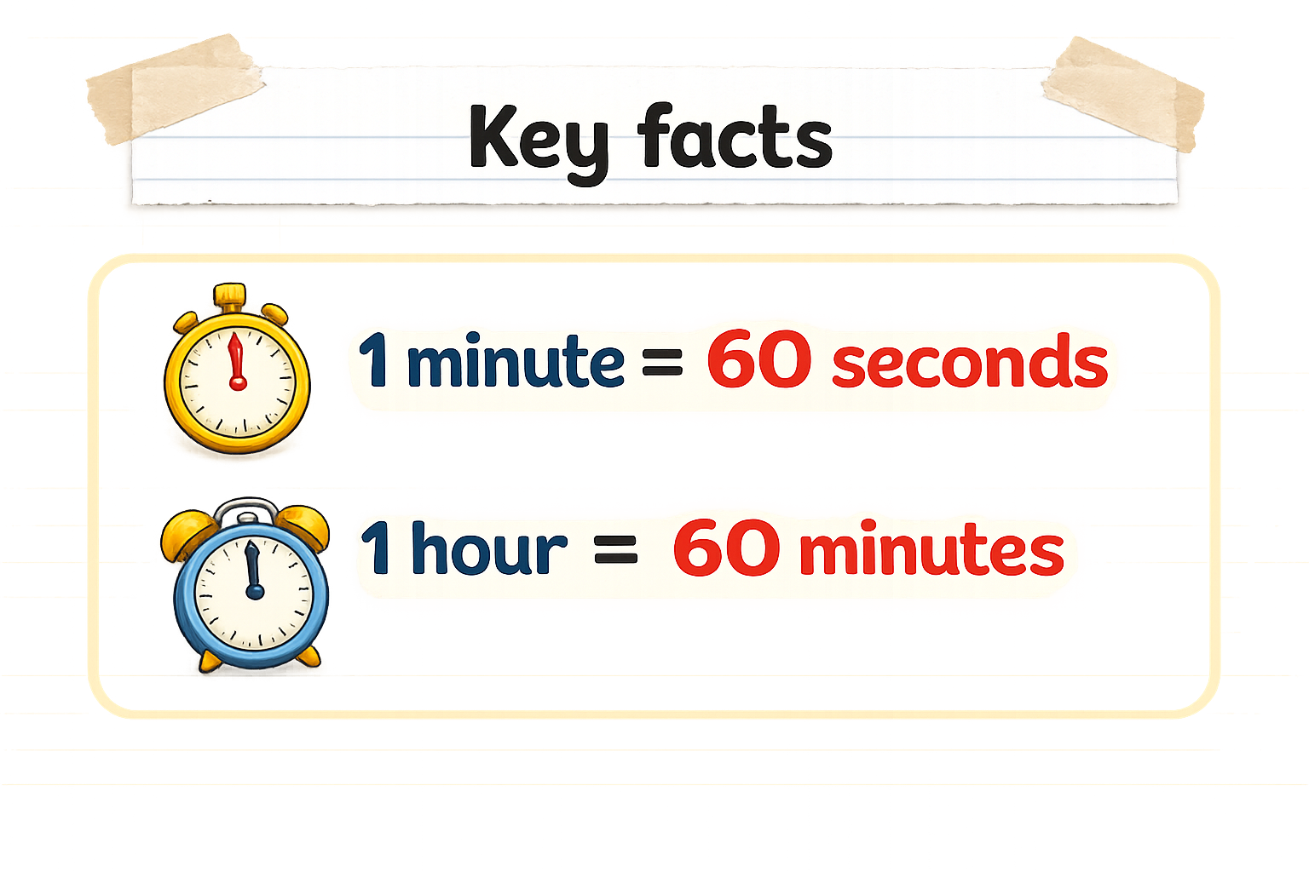
Convert 2 minutes and 13 seconds into seconds
I know that:
1 minute = 60 seconds
Finally, I add 13:
120 + 13 = 133 seconds
So, 2 minutes would be:
2 x 60 = 60 + 60 = 120
133 seconds
120 seconds
60 seconds
60 seconds
13 seconds
1 minute
1 minute

Slide 4


Your Turn
Child | Time
Ali | 2 minutes 4 seconds
Sam | 2 minutes 40 seconds
Rosie | 2 minutes 34 seconds
Zainab | 2 minutes 3 seconds
124
154
Ali _______ seconds
Rosie ______ seconds
160
123
Sam ______ seconds
Zainab ______ seconds
Tip: Use bar models to help you.

Slide 5
True or False
110 seconds is the same as 1 minutes and 10 seconds
False:
Can you explain why?

