Slide 1


Lesson 2:
Hundredths as decimals
www.arithmagicians.com

Slide 2

Get ready to
count up in hundredths
0
1
$\frac{\text{0}}{\text{100}}$
$\frac{\text{10}}{\text{100}}$
$\frac{\text{20}}{\text{100}}$
$\frac{\text{30}}{\text{100}}$
$\frac{\text{40}}{\text{100}}$
$\frac{\text{50}}{\text{100}}$
$\frac{\text{60}}{\text{100}}$
$\frac{\text{70}}{\text{100}}$
$\frac{\text{80}}{\text{100}}$
$\frac{\text{90}}{\text{100}}$
$\frac{\text{100}}{\text{100}}$

Slide 3

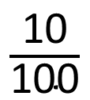
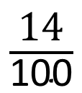
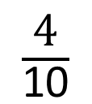
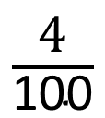
Match the representations to the numbers.
A
B
C
D
E
$\frac{\text{10}}{\text{100}}$
$\frac{\text{4}}{\text{100}}$
1
$\frac{\text{4}}{\text{10}}$
$\frac{\text{14}}{\text{100}}$

Slide 4
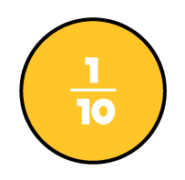



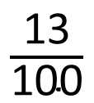
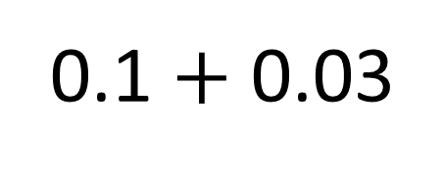
What is 13/100 as a decimal?
$\frac{\text{13}}{\text{100}}$
0.1 $+$ 0.03
0.13

Slide 5
Match the equivalent fractions and decimals.
10/100
0.5
50/100
0.09
37/100
0.37
9/100
0.1

Slide 6


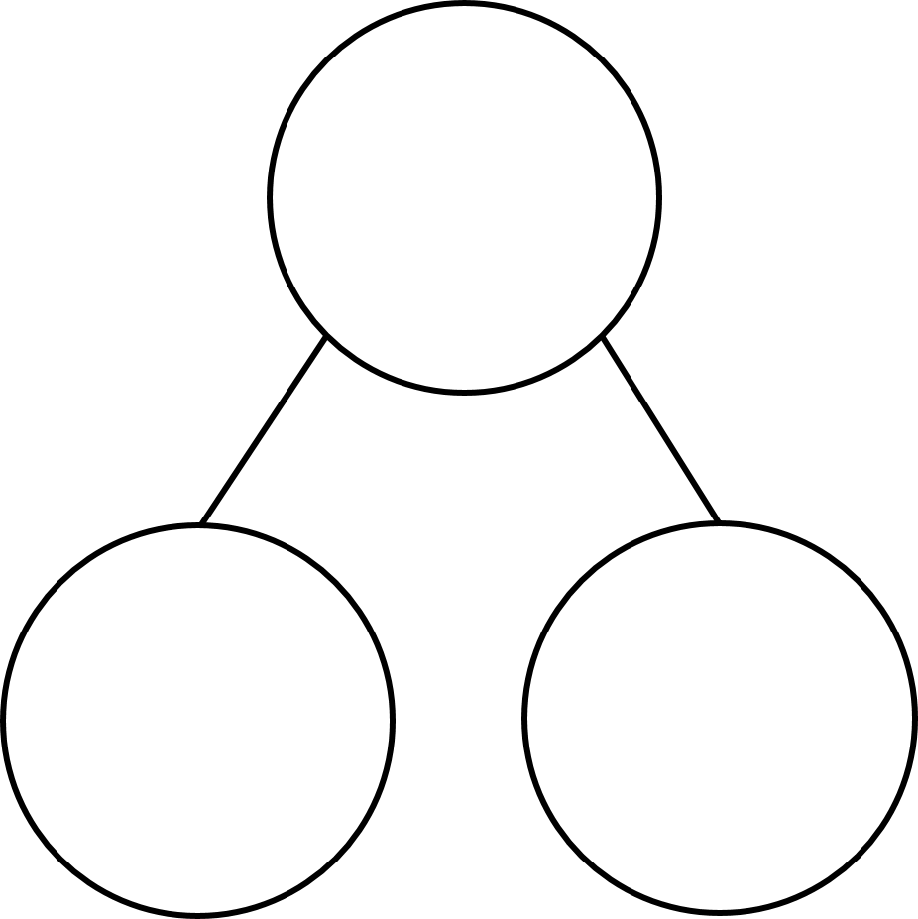
Your Turn
Partition 44 hundredths as
decimals in at least 4 different ways.
One example has been done for you.
0.44
0.44
0.44
0.44
0.4
0.04
0.3
0.14
0.2
0.24
0.1
0.34

Slide 7

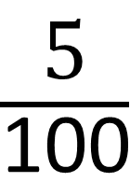
True or False
$\frac{\text{5}}{\text{100}}$
=
0.5
False: Can you explain why?

