Slide 1

Lesson 3:
Add 2 to any number
www.arithmagicians.com

Slide 2

+1
+1
+1
+1
+1
+1
+1
+1
+1
+1
30
31
32
33
34
35
36
37
38
39
40
Get ready to count up in 1s

Slide 3

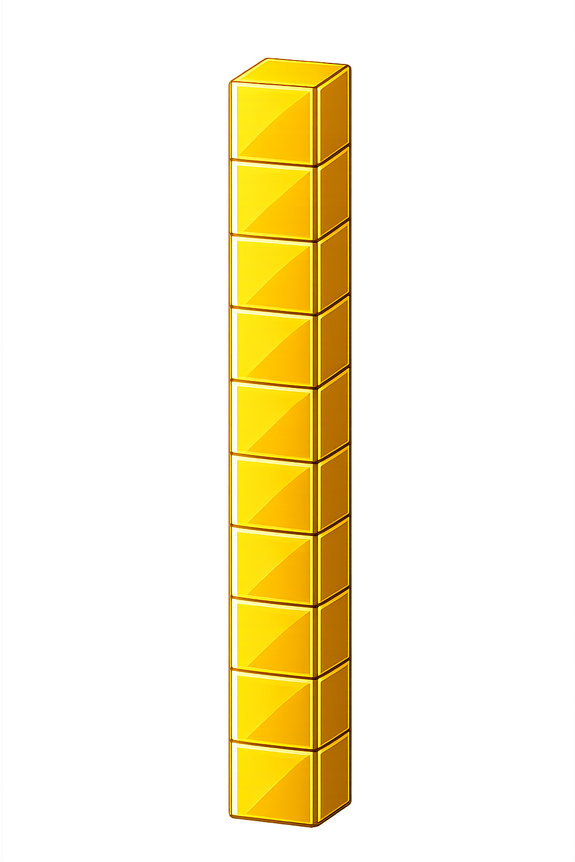

What number is shown below?
36
38
+ 2 = ?

Slide 4
What number is shown below?
What happens if the number has 8 ones and we add 2 more??
We exchange 10 ones
for 1 ten
18
20
+ 2 = ?

Slide 5
What number is shown below?
Remember: exchange 10 ones
for 1 ten
39
41
+ 2 = ?

Slide 6

45
46
47
48
49
50
51
?
?
52
53
54
55
+
=
49
2
51

Slide 7


Your Turn
11
9 + 2 = ?
30
2) 28 + 2 = ?
31
3) 29 + 2 = ?
50
4) 48 + 2 = ?
5) 59 + 2 = ?
61

Slide 8

True or False
When you add 2, the number gets smaller.
False

