Slide 1
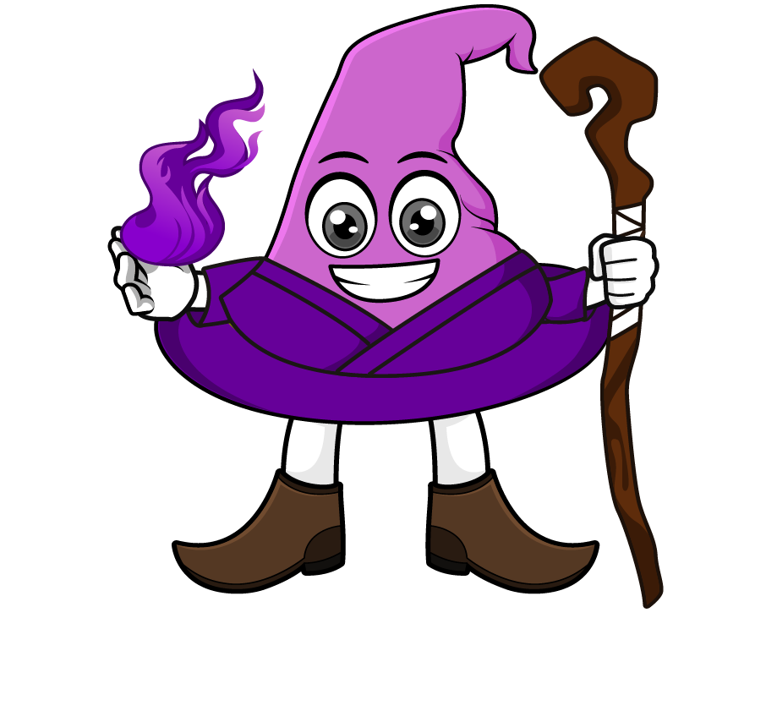

Lesson 3:
Convert units of length
(L & ml)
www.arithmagicians.com

Slide 2

1000 ml
1 L = ? ml
Tip: Use the diagram to help you

Slide 3
1 L = 1000 ml
To change L into ml, ______ by 1000.
multiply
To change ml into L, ______ by 1000.
divide

Slide 4

x 1000
1 L = 1000 ml
3500
3.5 L = ? ml
x 1000

Slide 5
÷ 1000
1 L = 1000 ml
0.48
? L = 480 ml
÷ 1000

Slide 6

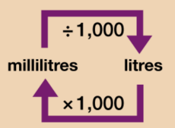
Your Turn
Solve:
4000 ml
4 L = ? ml
2000 ml = ? L
1.5 L = ? ml
9500 ml = ? L
Use the conversion chart to help you.
2 L
1500 ml
9.5 L

Slide 7
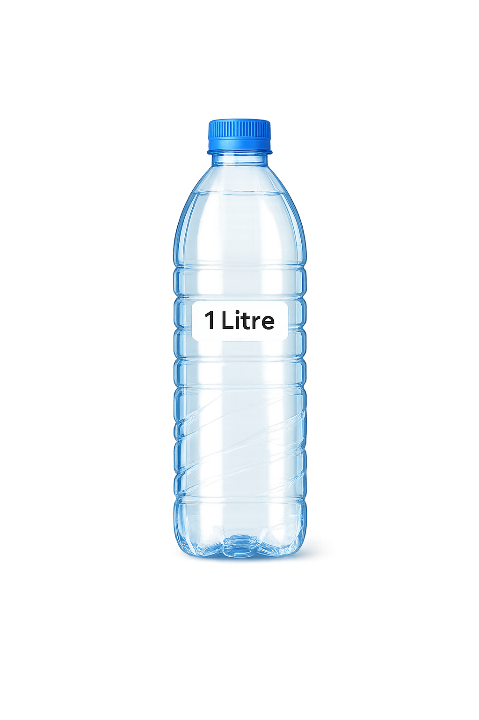
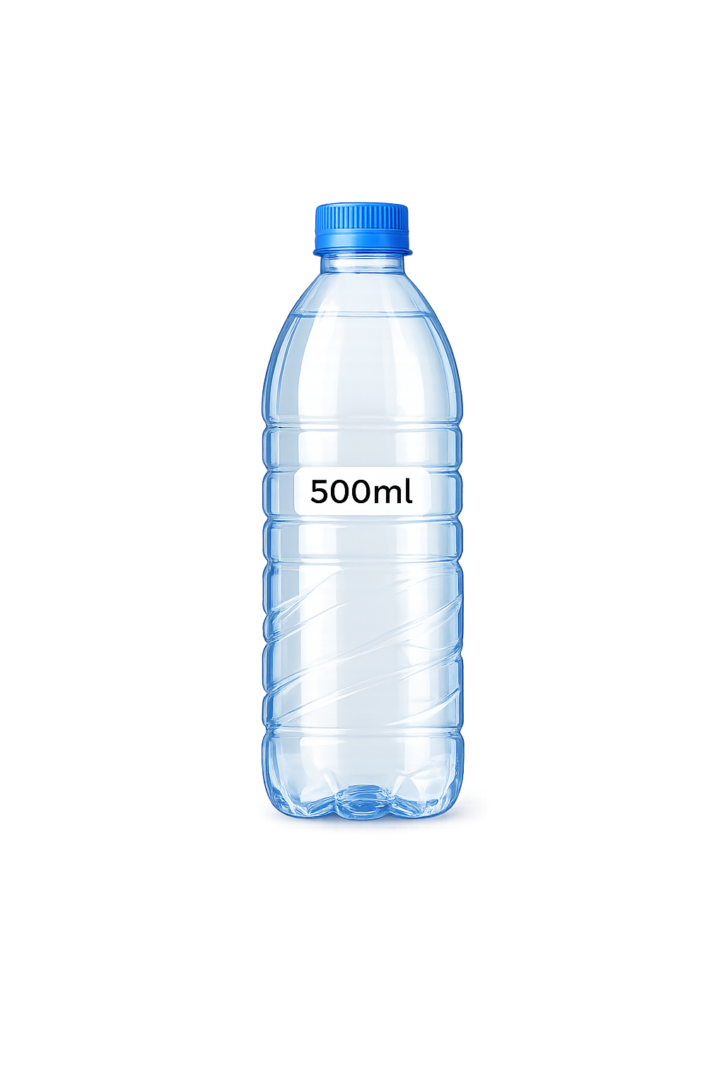



What is the
total capacity of the two bottles?
Amy:
1 Litre and 500ml
Ben:
1.5 L
Lucy:
1500ml
Who is correct?
They are all correct! Why?

