Slide 1


Lesson 3:
Convert between days and hours
www.arithmagicians.com

Slide 2

24
There are _______ hours in one day.
7
There are _______ days in one week.

Slide 3


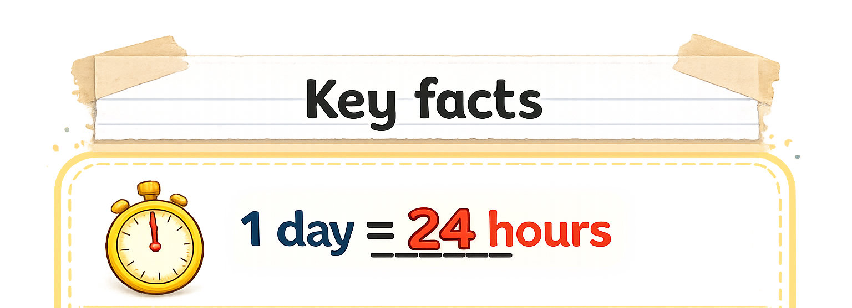
Convert 2 days into hours
So, 2 days would be:
2 x 24 = 24 + 24 = 48
I know that:
1 day = 24 hours
48 hours
24 hours
24 hours
1 day
1 day

Slide 4
How many days in 72 hours?
3 x 24 = 72 hours
So, 72 hours = 3 days
I know that:
1 day = 24 hours
3 days
24 hours
24 hours
24 hours
1 day
1 day
1 day

Slide 5


Your Turn
5 days = ____ hours
10 days = ____ hours
96 hours = ___ days
960 hours = ___ days
120
240
4
40
Tip: Use bar models to help you.

Slide 6
True or False
12 hours = 1 day
False

