Slide 1


Lesson 3:
Hundredths on a place value chart
www.arithmagicians.com

Slide 2

Get ready to
count up in hundredths
0
1
$\frac{\text{0}}{\text{100}}$
$\frac{\text{10}}{\text{100}}$
$\frac{\text{20}}{\text{100}}$
$\frac{\text{30}}{\text{100}}$
$\frac{\text{40}}{\text{100}}$
$\frac{\text{50}}{\text{100}}$
$\frac{\text{60}}{\text{100}}$
$\frac{\text{70}}{\text{100}}$
$\frac{\text{80}}{\text{100}}$
$\frac{\text{90}}{\text{100}}$
$\frac{\text{100}}{\text{100}}$

Slide 3

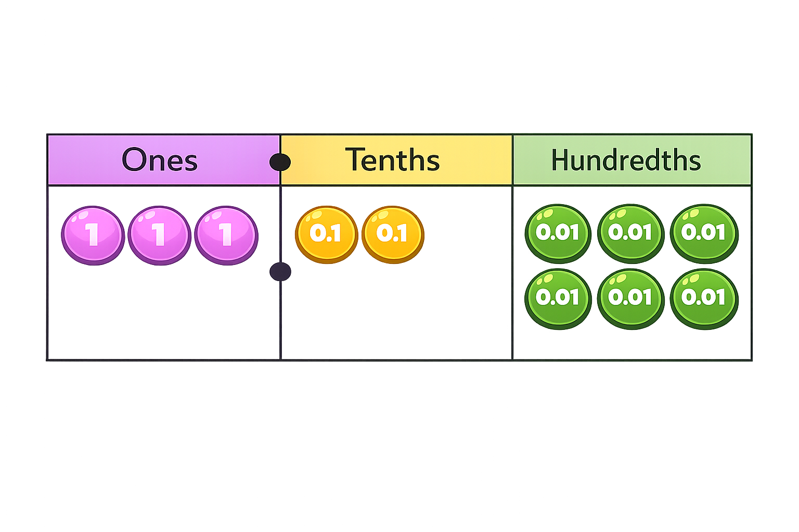
There are ones.
There are tenths.
There are hundredths.
The number represented is
3
2
6
3.26

Slide 4
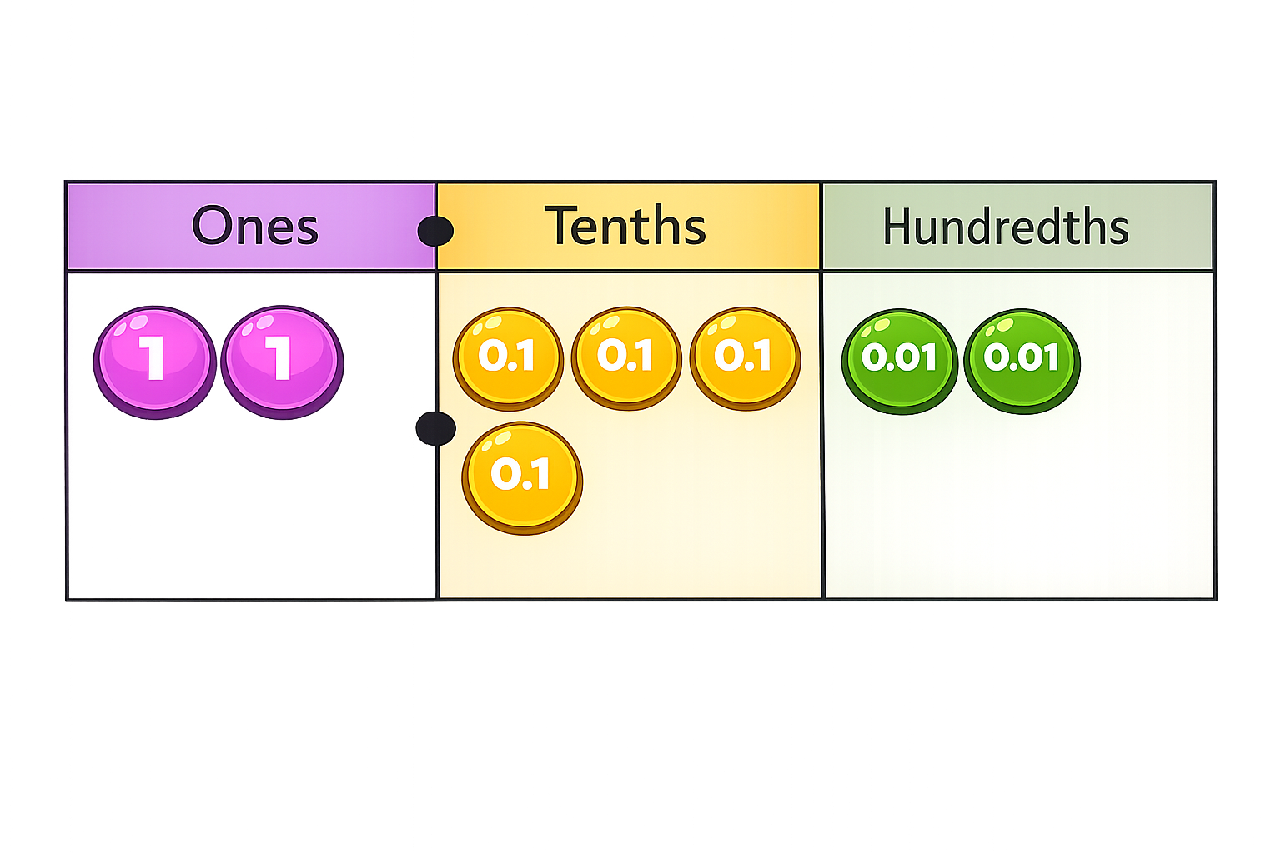

There are ones.
There are tenths.
There are hundredths.
The number represented is
2
4
1
2.41

Slide 5
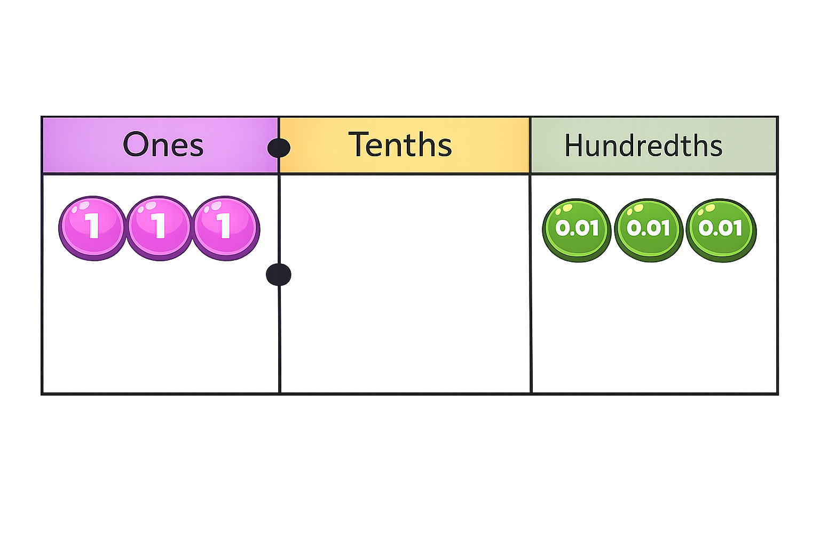
There are ones.
There are tenths.
There are hundredths.
The number represented is
3
0
3
3.03

Slide 6

What number is represented in the place value chart?
There are ones.
There are tenths.
There are hundredths.
The number represented is
0
0
6
0.06

Slide 7


Your Turn
Match the labels to the place value charts.
3 Hundredths
Ones | Tenths | Hundredths
0 | 1 | 3
13 Hundredths
Ones | Tenths | Hundredths
0 | 3 | 3
30 Hundredths
Ones | Tenths | Hundredths
0 | 0 | 3
33 Hundredths
Ones | Tenths | Hundredths
0 | 3

Slide 8


Here is a hundred square.
Which statement is correct?
4 tenths of the hundred square is shaded
0.40 of the hundred square is shaded.
40 hundredths of the hundred square is shaded.
0.4 of the hundred square is shaded.

