Slide 1
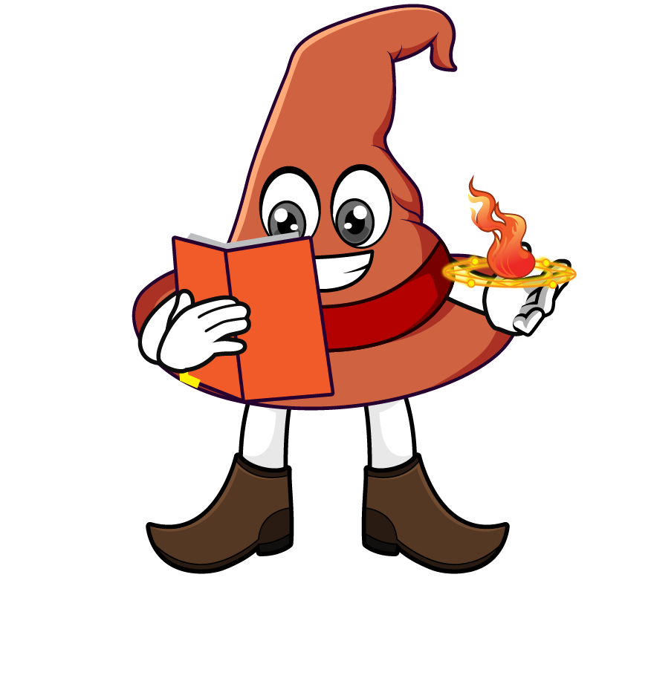

Lesson 4:
Recap: Convert units of length
www.arithmagicians.com

Slide 2

Recap:
10
1 cm = ? mm
Tip: Use the ruler to help you

Slide 3

Recap:
100
1m = ? cm
10 cm
1m
Tip: Use the diagram to help you

Slide 4
Recap:
1000 m
1 km = ? m
100m
Tip: Use the diagram to help you

Slide 5

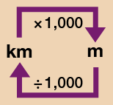
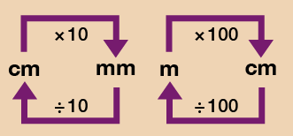
a) 9.3 cm = ? mm
b) 120 mm = ? cm
c) 4.7 m = ? cm
d) 11.5 km = ? m
e) 460 m = ? km
93 mm
12 cm
Use the conversion chart to help you.
470 cm
11500 m
0.46 km

Slide 6

True or False
5 m > 0.5 km
5 m is greater than 0.5 km because 5 is a greater number.
False: can you explain why?

