Slide 1


Lesson 4:
Convert between weeks, days and hours.
www.arithmagicians.com

Slide 2

24
There are _______ hours in one day.
7
There are _______ days in one week.
365
There are _______ days in a year.
366
There are _______ days in a leap year.

Slide 3


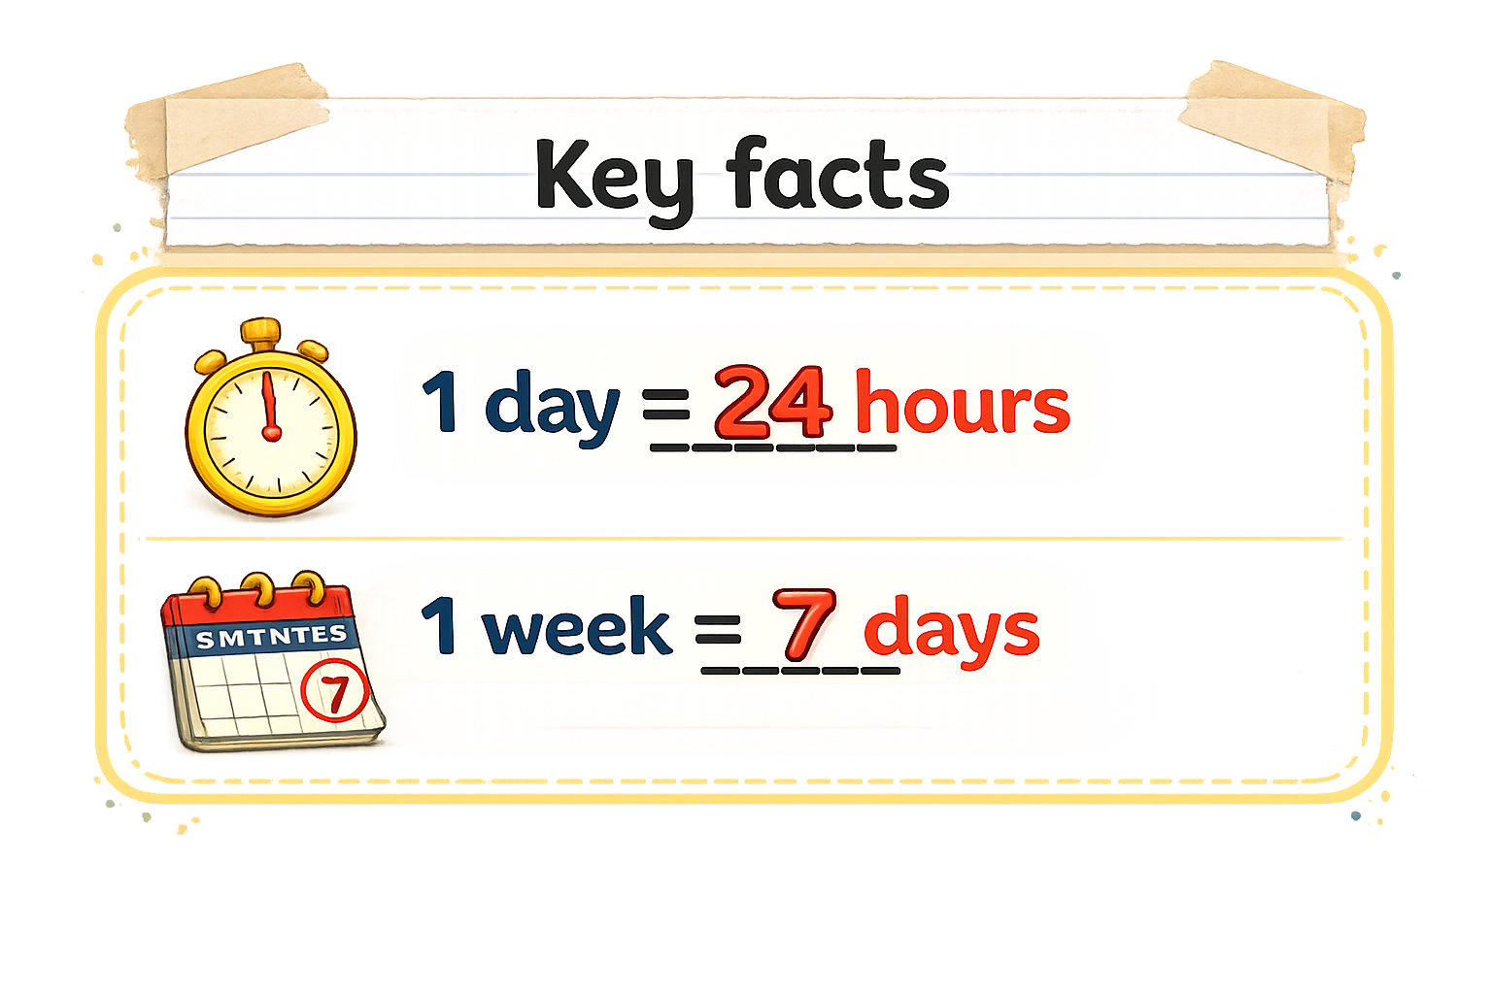
Convert 2 days into hours
So, 2 days would be:
2 x 24 = 24 + 24 = 48
I know that:
1 day = 24 hours
48 hours
24 hours
24 hours
1 day
1 day

Slide 4
Convert 3 weeks into days
I know that:
1 week = 7 days
So, 3 weeks would be:
3 x 7 = 21 days
21 days
7 days
7 days
7 days
1 week
1 week
1 week

Slide 5


Your Turn
72 hours = ___ days
28 days = ___ weeks
4 days = ___ hours
10 weeks = ___ days
3
4
96
70
Tip: Use bar models to help you.

Slide 6
True or False
35 days is the same as 5 weeks
True

