Slide 1


Lesson 5:
Assess and Review
www.arithmagicians.com

Slide 2

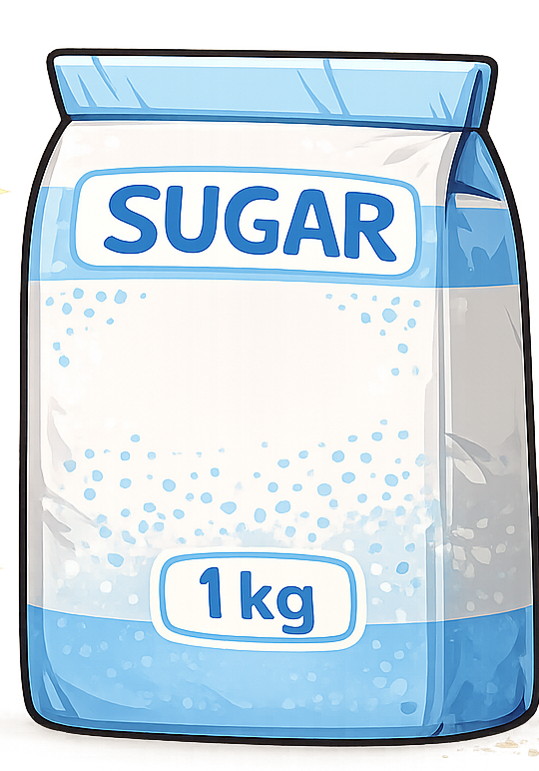
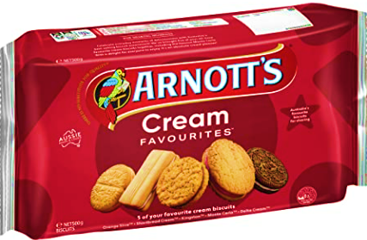
1 kg = ? g
1000 g
=
500g
500g
Tip: Use the diagram to help you

Slide 3
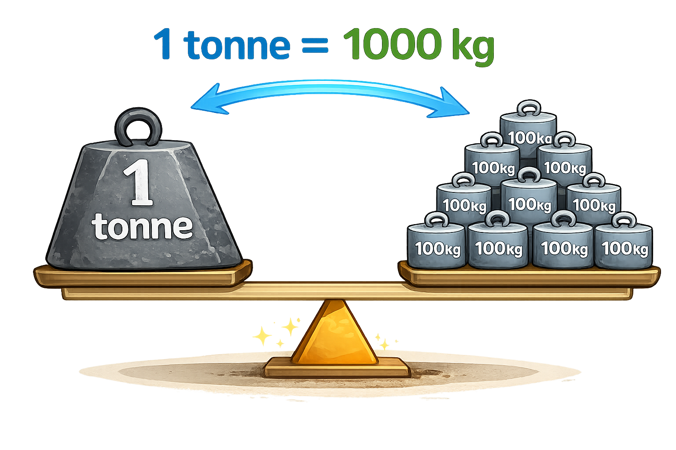

1000 kg
1 tonne = ? kg
Tip: Use the diagram to help you

Slide 4
1000 ml
1 L = ? ml
Tip: Use the diagram to help you

Slide 5

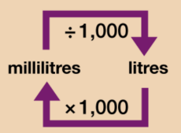
Your Turn
Solve:
5000 ml
5 L = ? ml
8000 ml = ? L
4.5 L = ? ml
2500 ml = ? L
Use the conversion chart to help you.
8 L
4500 ml
2.5 L

Slide 6
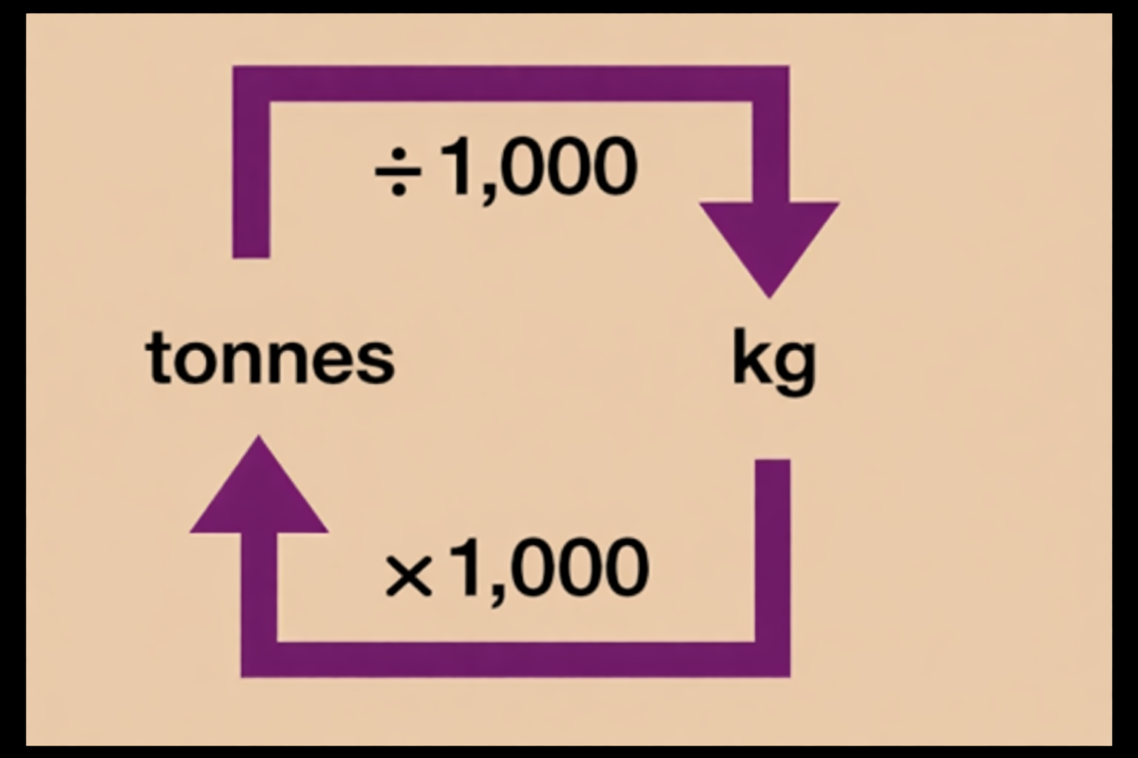
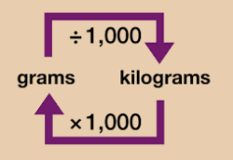


9000 g
9 kg = ? g
4000 g = ? kg
2.5 t = ? kg
8500 kg = ? t
Use the conversion chart to help you.
4 kg
2500 kg
8.5 t

