Slide 1

Week 2:
Assess & Review
www.arithmagicians.com

Slide 2

+1
+1
+1
+1
+1
+1
+1
+1
+1
+1
80
81
82
83
84
85
86
87
88
89
90
Get ready to count up in 1s

Slide 3

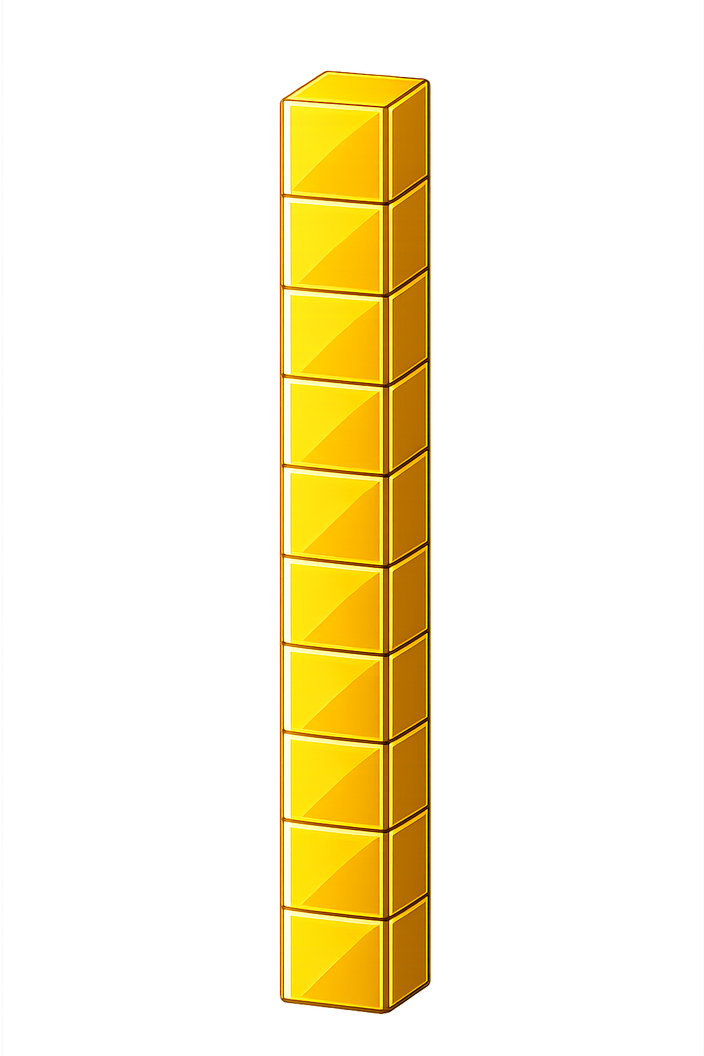

What number is shown below?
What happens if the number has 9 ones and we add 1 more??
We exchange 10 ones
for 1 ten
29
30
+ 1 = ?

Slide 4
What number is shown below?
What happens if the number has 8 ones and we add 2 more??
We exchange 10 ones
for 1 ten
18
20
+ 2 = ?

Slide 5
What number is shown below?
Remember: exchange 10 ones
for 1 ten
39
41
+ 2 = ?

Slide 6

65
66
67
68
69
?
71
72
73
74
75
70
69
+
1
=
70

Slide 7
45
46
47
48
49
50
51
?
?
52
53
54
55
+
=
49
2
51

Slide 8


Your Turn
49
48 + 1 = ?
50
2) 48 + 2 = ?
51
3) 49 + 2 = ?
4) ? + 2 = 60
58
5) ? + 2 = 51
49

