Slide 1


Lesson 5:
Assess and Review
www.arithmagicians.com

Slide 2


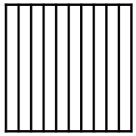

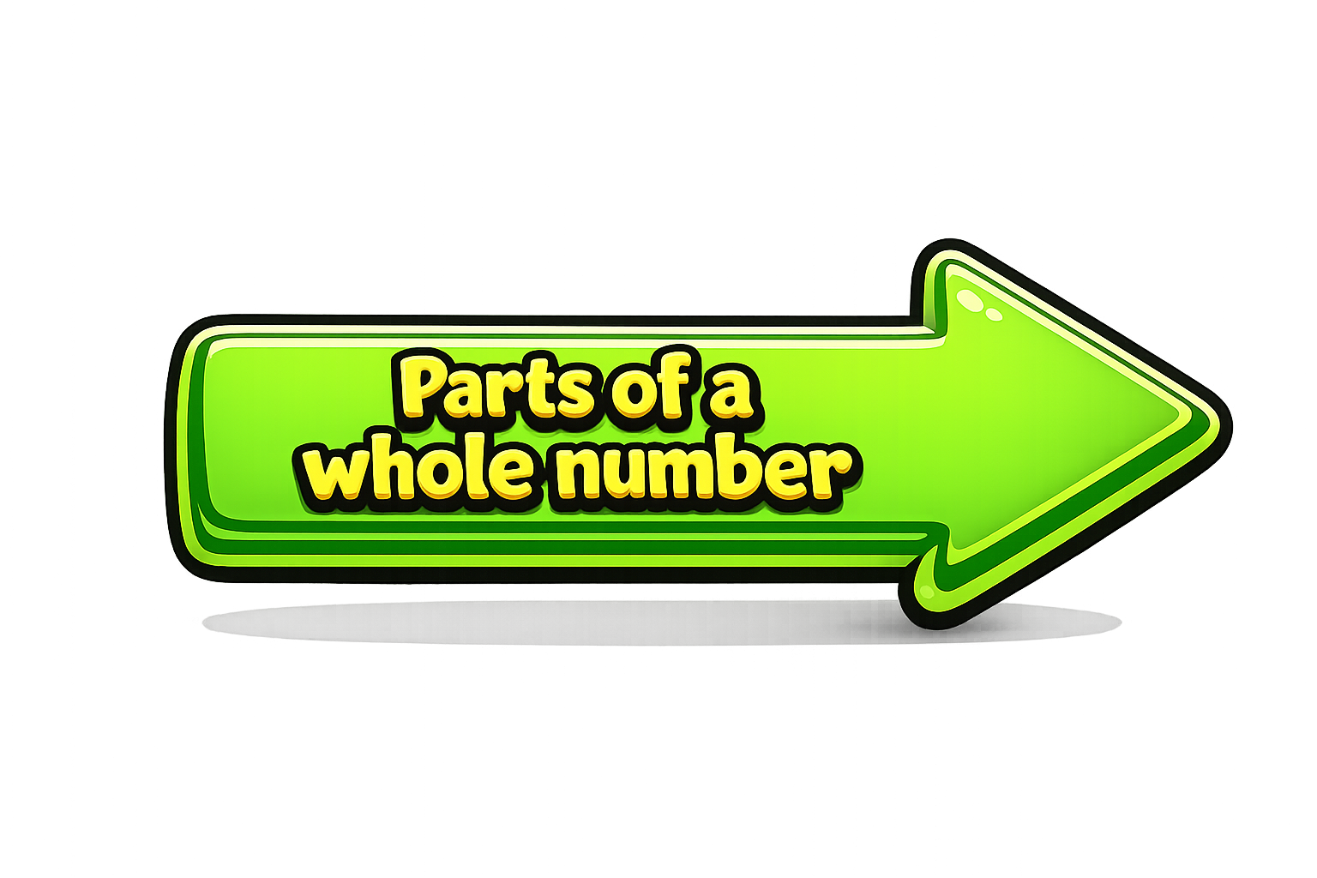
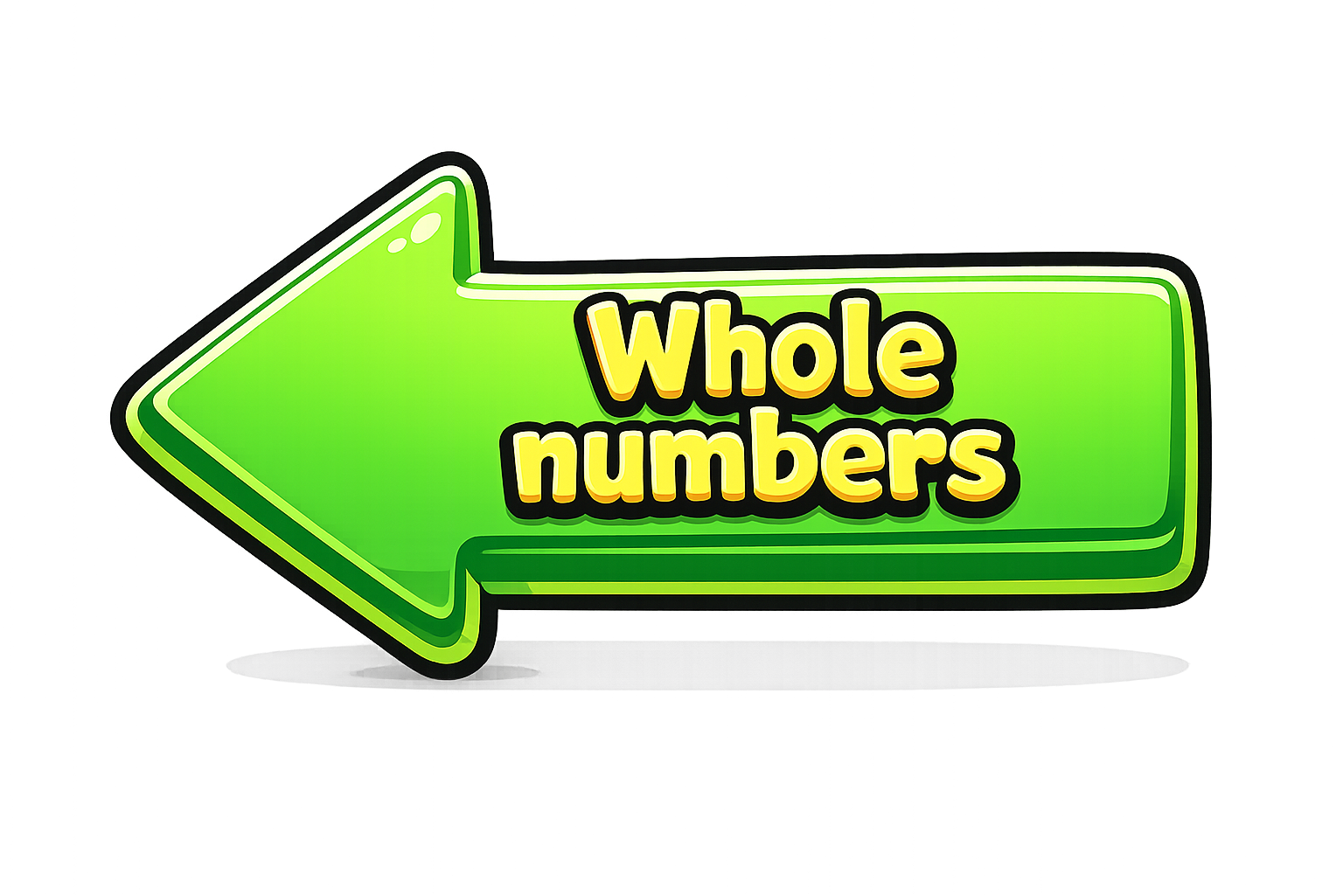
The decimal point separates:
Whole numbers (left)
Parts (right)
Ones | Tenths | Hundredths

Slide 3
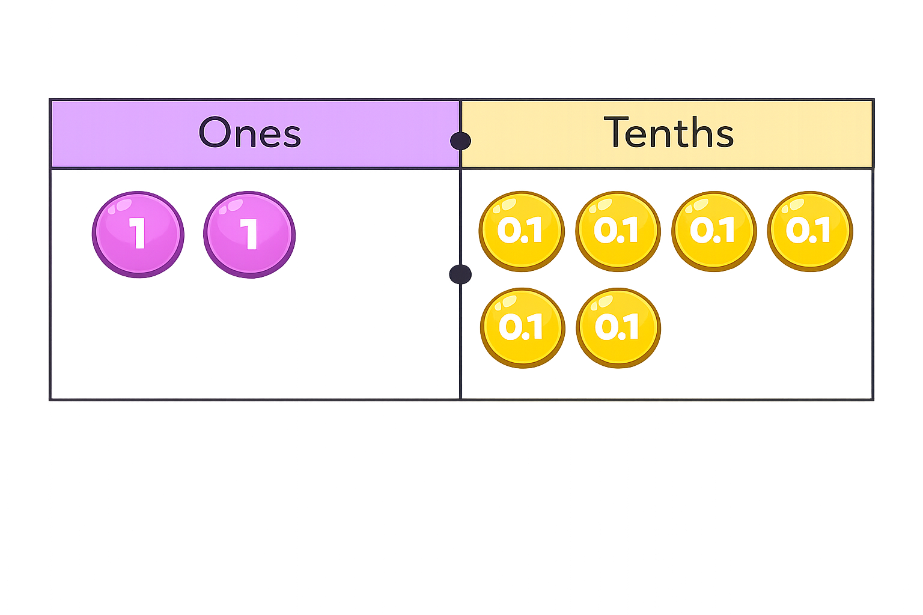

There are wholes and tenths.
The number is
2
6
2.6

Slide 4
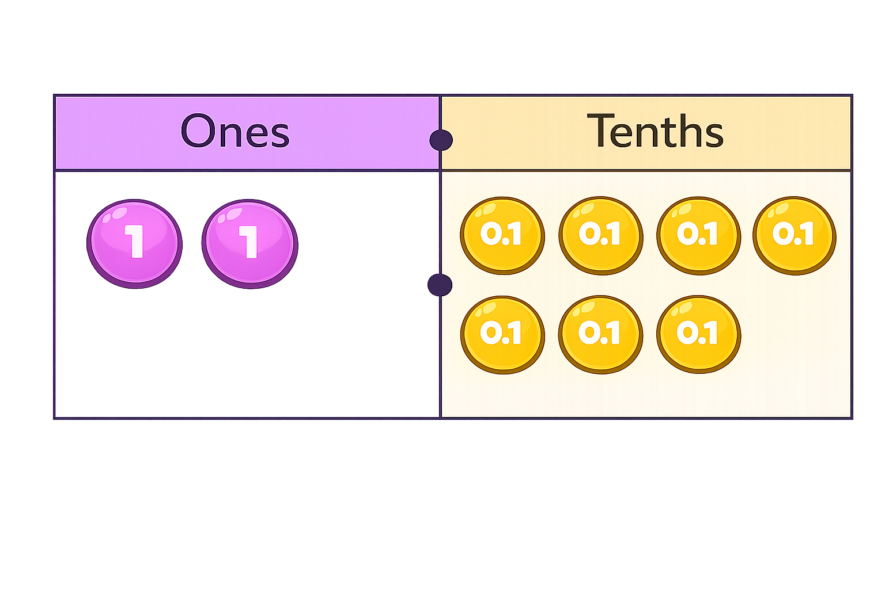

There are ones and tenths.
ones $+$ tenths $=$ $+$ $=$
0
7
0
7
0
0.7
0.7

Slide 5
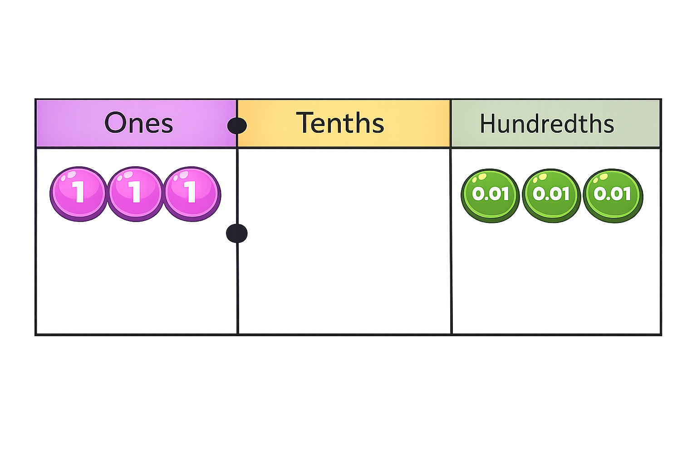
What number is represented in the place value chart?
There are ones.
There are tenths.
There are hundredths.
The number represented is
3
0
3
3.03

Slide 6

What number is represented in the place value chart?
There are ones.
There are tenths.
There are hundredths.
The number represented is
0
0
6
0.06

Slide 7


Your Turn
Match the equivalent fractions and decimals.
1/10
0.01
1/100
0.35
40/100
1
35/100
0.1
10/10
0.4

