Slide 1

Lesson 1:
Subtract 1 from
any number
www.arithmagicians.com

Slide 2


-1
-1
-1
-1
-1
-1
-1
-1
-1
-1
20
21
22
23
24
25
26
27
28
29
30
Get ready to count back in 1s

Slide 3

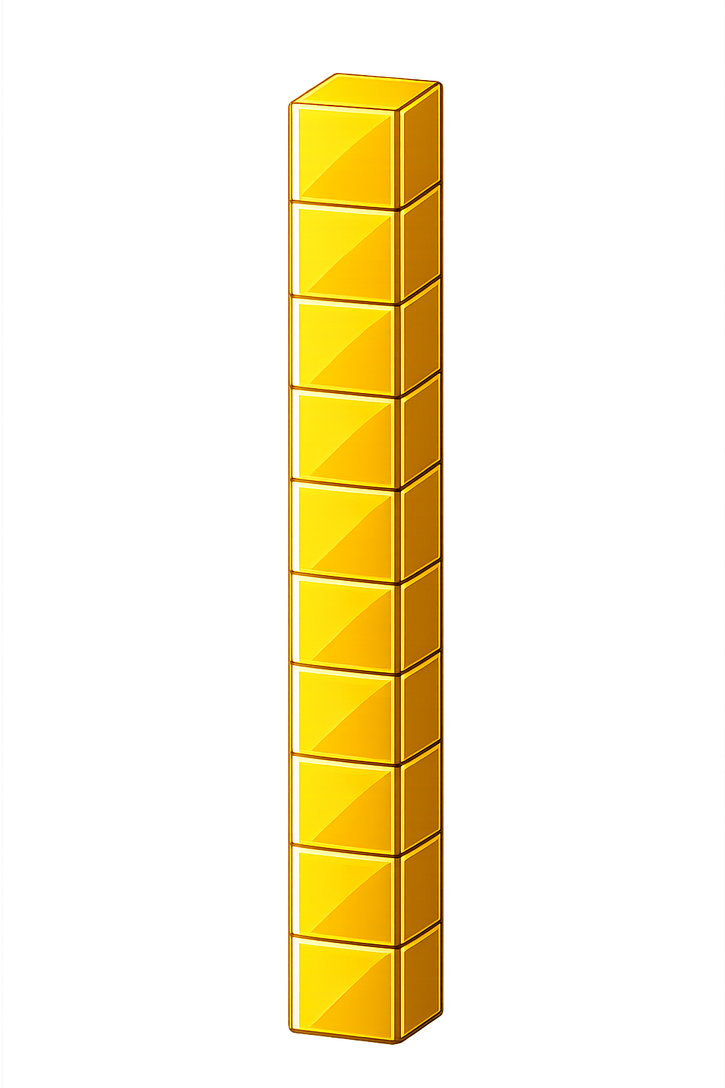

What number is shown below?
25
24
- 1 = ?

Slide 4
What number is shown below?
We exchange one ten for ten ones.
What happens if we have no ones to remove?
30
29
- 1 = ?

Slide 5

54
55
56
57
58
?
60
61
62
63
64
59
60
-
1
=
59

Slide 6


Your Turn
10 - 1 = ?
9
49
2) 50 - 1 = ?
29
3) 30 - 1 = ?
69
4) 70 - 1 = ?
5) 60 - 1 = ?
59

Slide 7

True or False
When you subtract 1 from a number ending in 0, you need to exchange 1 ten for 10 ones.
True

