Slide 1


Lesson 1:
Adding lengths in different units (m, cm and mm)
www.arithmagicians.com

Slide 2

Recap:
10
1 cm = ? mm
Tip: Use the ruler to help you

Slide 3

Recap:
100
1m = ? cm
10 cm
1m
Tip: Use the diagram to help you

Slide 4

True or False
20cm + 10mm = 30cm
What are the two ways that I can do this?
False:
What should we do before adding different units?
We must convert them into the same units first.

Slide 5

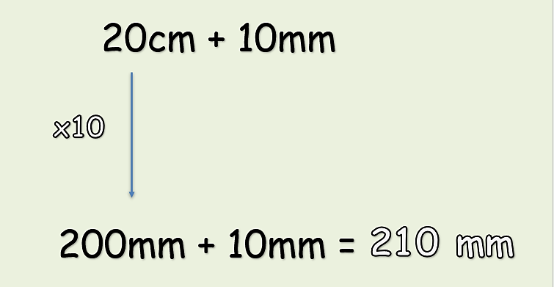
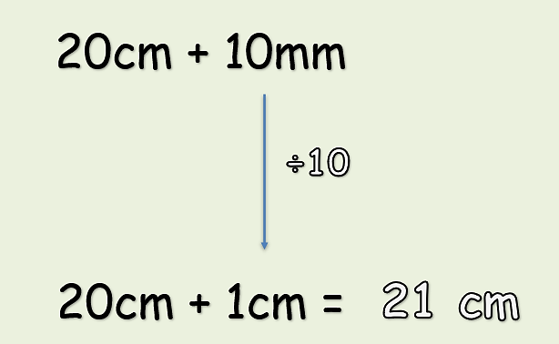
Option 1:
Convert all units into mm
Option 2:
Convert all units into cm

Slide 6
Solve:
3m + 40cm = ? cm
x100
= 340cm
300cm + 40cm
First, convert the units into cm. Then add.

Slide 7


Your Turn
425 cm
1) 4 m + 25 cm = ? cm
92 mm
2) 8 cm + 12 mm = ? mm
9.5 cm
3) 45 mm + 5 cm = ? cm
2150 mm
4) 2 m + 150 mm = ? mm
120 cm
5) 1 m + 10 cm + 100mm = ? cm

Slide 8

True or False
You must convert the lengths into the same unit before adding them.
True: Can you explain why?

