Slide 1
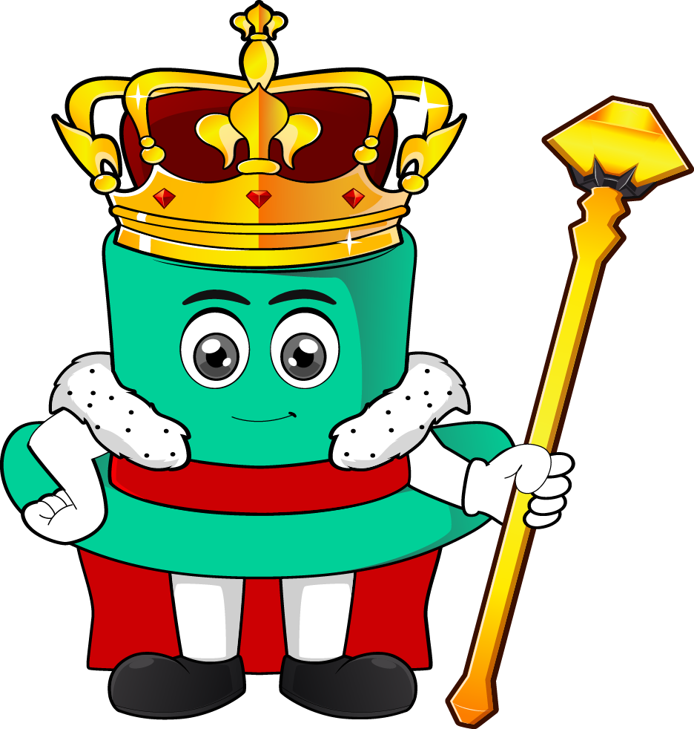
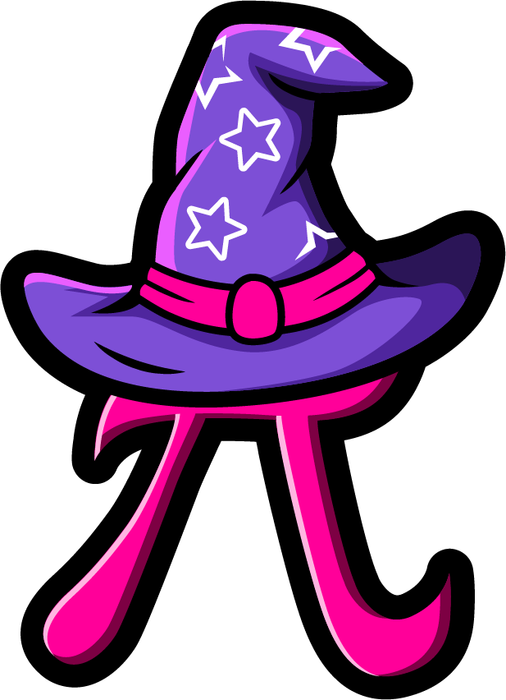
Lesson 1:
Use a.m. and p.m
www.arithmagicians.com

Slide 2

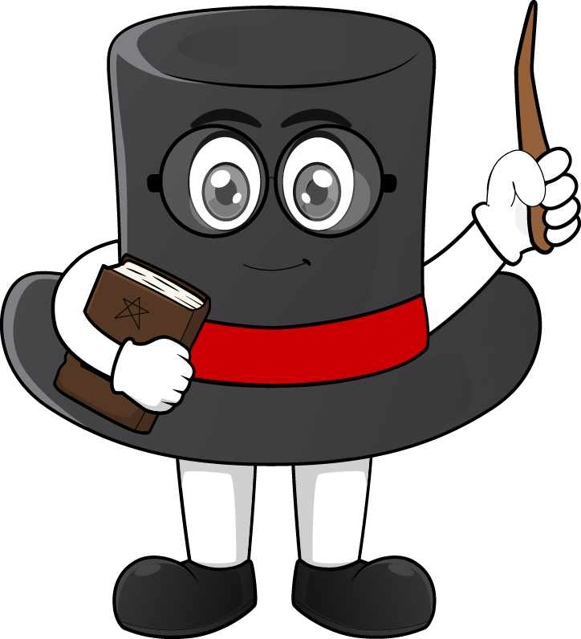
I do my homework at 7:00
How do we know if this is
morning or evening?

Slide 3

We use am and pm so we know whether the time is in the morning or later in the day.
Key Fact: am = before midday (morning / before lunch) pm = after midday (afternoon, evening / after lunch)
Key Fact: am = before midday
(morning / before lunch) pm = after midday
(afternoon, evening / after lunch)

Slide 4
am or pm
Breakfast at 7:30 ___
School finishes at 3:15 ___
Going to sleep at 8:00 ___
Brushing teeth before school at 7:45 ___
am
pm
pm
am

Slide 5


Your Turn
Write the times in order from
earliest to latest
a)
11:12 am
10:02 pm
6:15 am
12:10 pm
b)
2:22 am
12:42 pm
7:51 pm
8:17 am

Slide 6
True or False
12:15 pm is later than 3:00 pm because 12 is greater than 3.
False: Can you explain why?

