Slide 1


Lesson 1:
Make a whole with tenths
www.arithmagicians.com

Slide 2

Get ready to
count up in tenths
0
1
$\frac{\text{0}}{\text{10}}$
$\frac{\text{1}}{\text{10}}$
$\frac{\text{2}}{\text{10}}$
$\frac{\text{3}}{\text{10}}$
$\frac{\text{4}}{\text{10}}$
$\frac{\text{5}}{\text{10}}$
$\frac{\text{6}}{\text{10}}$
$\frac{\text{7}}{\text{10}}$
$\frac{\text{8}}{\text{10}}$
$\frac{\text{9}}{\text{10}}$
$\frac{\text{10}}{\text{10}}$

Slide 3

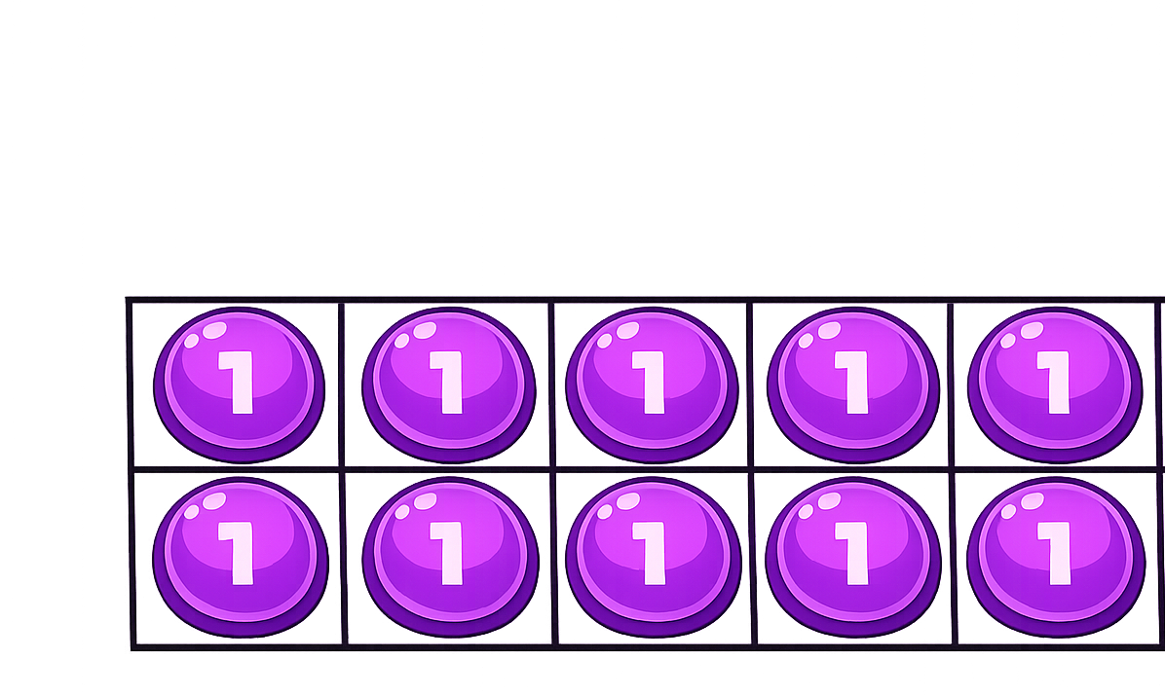

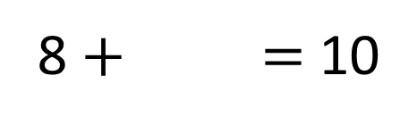
How many more ones are needed to make ten?
2
8 $+$ $=$ 10

Slide 4
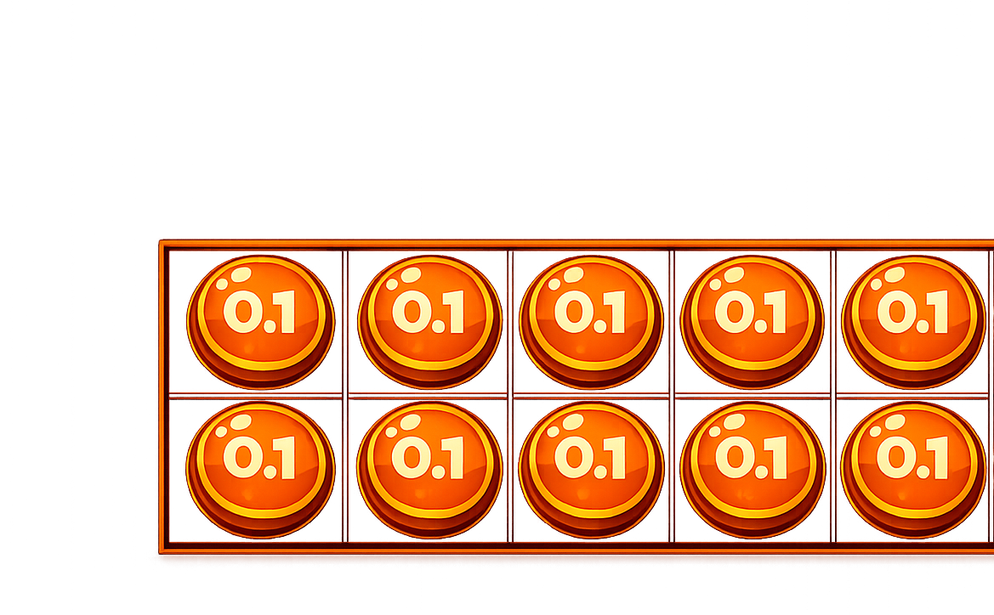
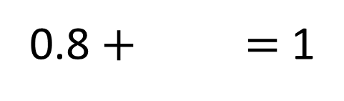
How many more tenths are needed to make one whole?
0.2
0.8 $+$ $=$ 1

Slide 5
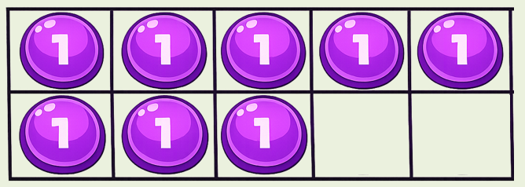
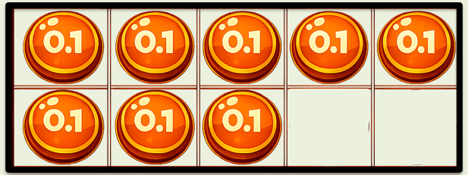
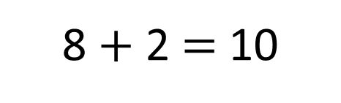
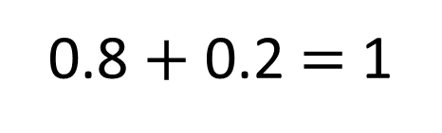
8 $+$ 2 $=$ 10
0.8 $+$ 0.2 $=$ 1
What’s the same about the calculations?
What is different?

Slide 6



The square represents 1 whole.
tenth
Each column represents 1 .
How much of the whole is shaded?
Fraction | Decimal
$$\frac{\text{3}}{\text{10}}$$
0.3
How much needs to be shaded
to fill the whole?
Fraction | Decimal
$\frac{\text{7}}{\text{10}}$
0.7

Slide 7


The square represents 1 whole.
tenth
Each column represents 1 .
tenth
Each row represents 1 .
How much of the whole is shaded?
Fraction | Decimal
$$\frac{\text{2}}{\text{10}}$$
0.2
How much needs to be shaded
to fill the whole?
Fraction | Decimal
$\frac{\text{8}}{\text{1}\text{0}}$
0.8

Slide 8



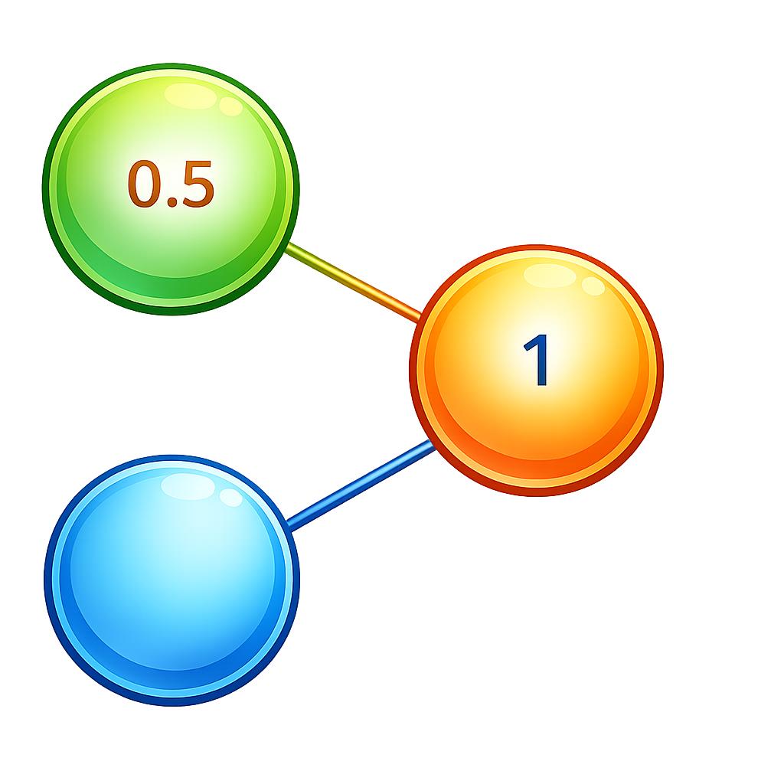
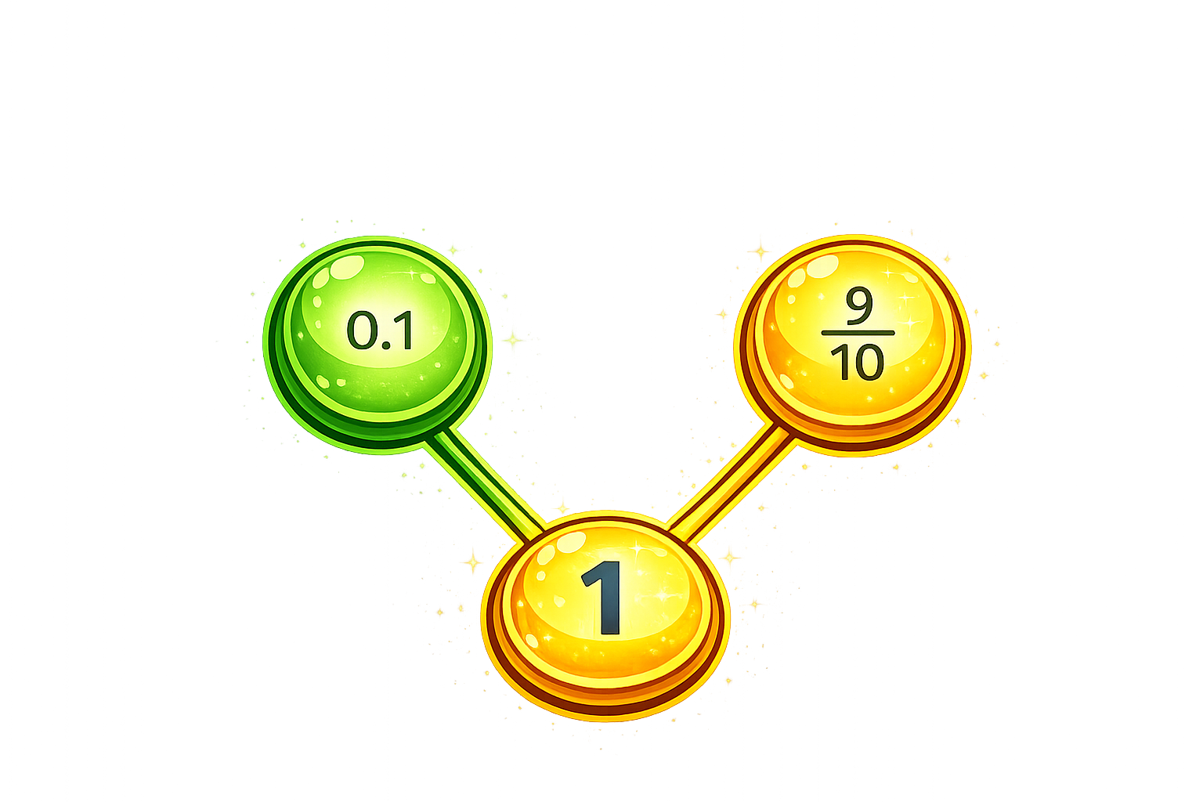



Your Turn
Complete the part-whole models.
A
B
$\frac{3}{10}$
0.5
C
D
0.6
1

Slide 9

True or False
0.9 + 0.1 = 0.10
False: Can you explain why?

