Slide 1


Lesson 2 :
Adding lengths in different units (km and m)
www.arithmagicians.com

Slide 2

Recap:
1000 m
1 km = ? m
100m
Tip: Use the diagram to help you

Slide 3
Recap:
1km = 1000 m
To change km into m, ______ by 1000.
multiply
To change m into km, ______ by 1000.
divide

Slide 4

True or False
2km + 200m = 202m
What are the two ways that I can do this?
False:
What should we do before adding different units?
We must convert them into the same units first.

Slide 5

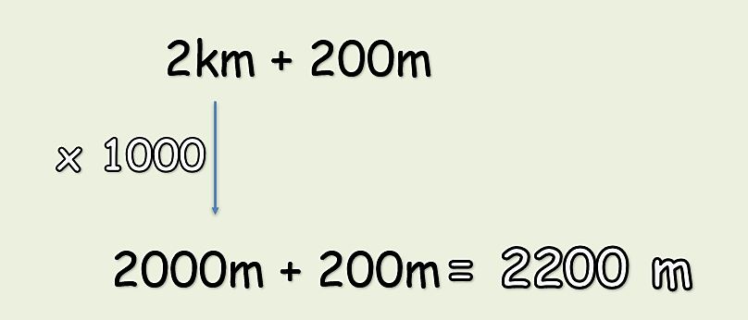
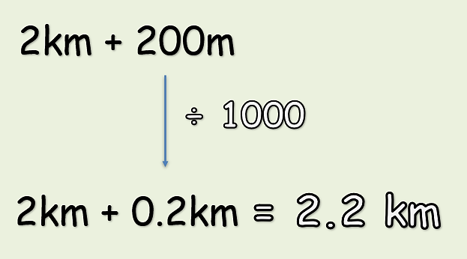
Option 1:
Convert all units into m
Option 2:
Convert all units into km

Slide 6
Solve:
5km + 50m = ? m
x1000
= 5050m
5000m + 50m
First, convert the units into m. Then add.

Slide 7


Your Turn
1) 4 km + 250 m = ? m
4250 m
2) 120 m + 8 km = ? m
8120 m
5.45 km
3) 450 m + 5 km = ? km
3500 m
4) 2 km + 1500 m = ? m
2.1 km
5) 1 km + 100 m + 1000 m = ? km

Slide 8

True or False
3km + 40m = 340km
False: Can you explain why?

