Slide 1


Lesson 2:
Read time on a
digital clock
www.arithmagicians.com

Slide 2

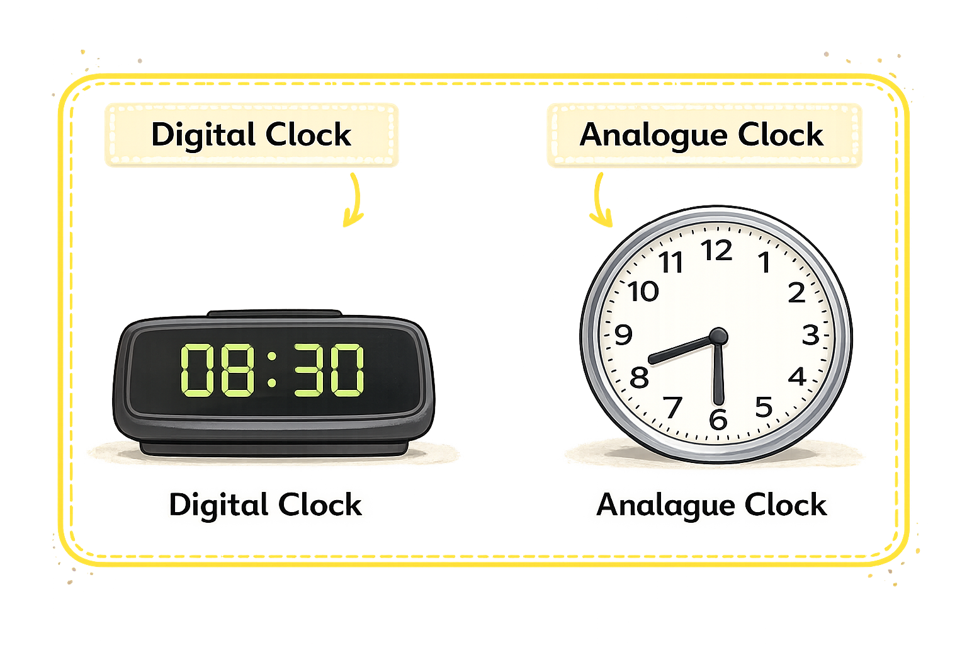
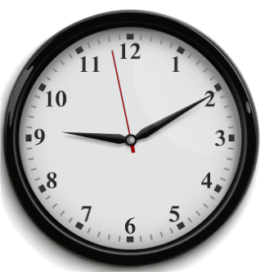

What are these types of clocks called?
?
?

Slide 3

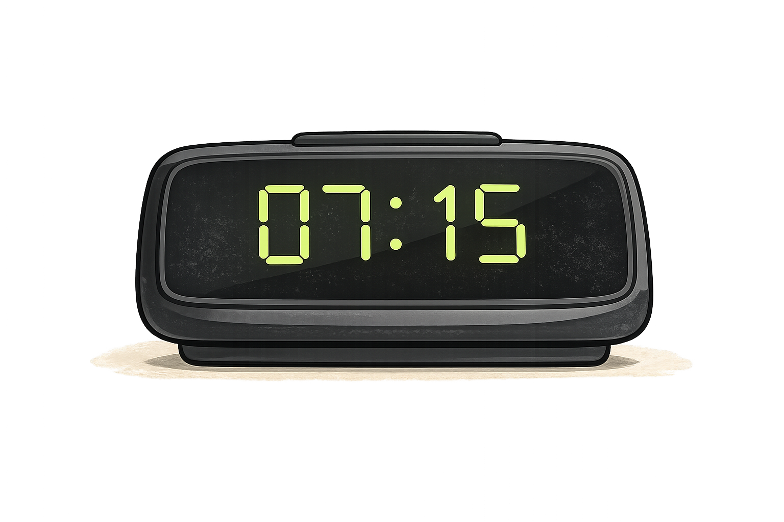
How to read a digital clock
Hour : Minutes
07:15
07 = hour
15 = minutes
Read as: seven fifteen

Slide 4
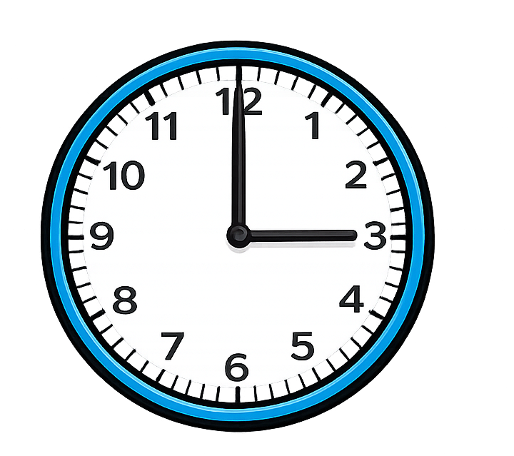
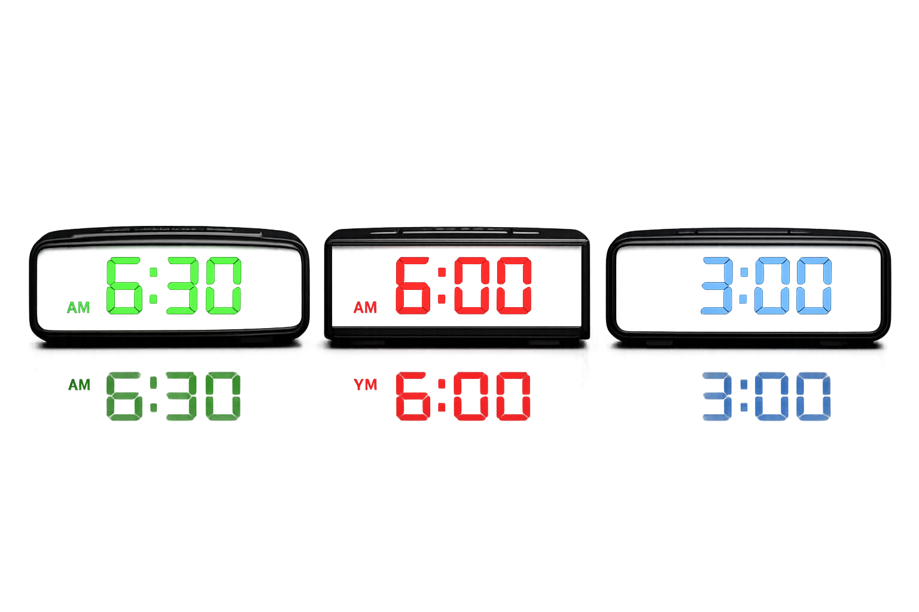

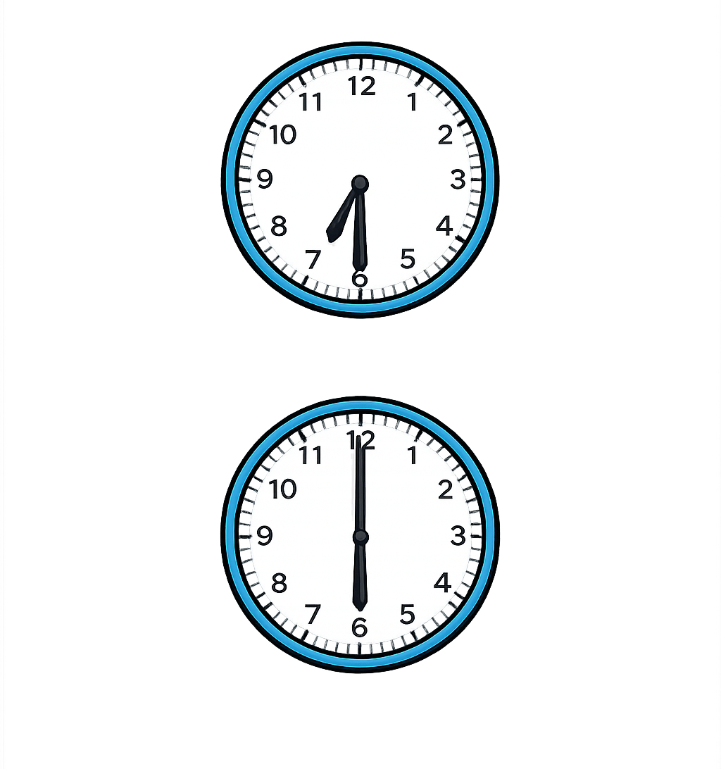
Match the analogues clock to the digital time.
A.
1.
B.
2.
C.
3.

Slide 5


Your Turn
Write these times:
08:00 = ? 03:15 = ? 11:30 = ? 06:45 = ?
8 o’clock
quarter past 3
half past 11
quarter to 7

Slide 6

True or False
07:30 means
7 hours and
3 minutes
False: Can you explain why?

