Slide 1


Lesson 2:
Make a whole with tenths
www.arithmagicians.com

Slide 2

Get ready to
count up in tenths
0
1
$\frac{\text{0}}{\text{10}}$
$\frac{\text{1}}{\text{10}}$
$\frac{\text{2}}{\text{10}}$
$\frac{\text{3}}{\text{10}}$
$\frac{\text{4}}{\text{10}}$
$\frac{\text{5}}{\text{10}}$
$\frac{\text{6}}{\text{10}}$
$\frac{\text{7}}{\text{10}}$
$\frac{\text{8}}{\text{10}}$
$\frac{\text{9}}{\text{10}}$
$\frac{\text{10}}{\text{10}}$

Slide 3

What is the missing part?
1
1
0.3
0.7
?

Slide 4
What is the missing part?
1
1
0.6
0.4
?

Slide 5

What is the missing part?
?
1
1
$$\frac{2}{10}$$
0.8

Slide 6

Your Turn
How many ways can you complete the part-whole model?
1
1
?
?
0.1
Can you find at least 4 different examples?

Slide 7
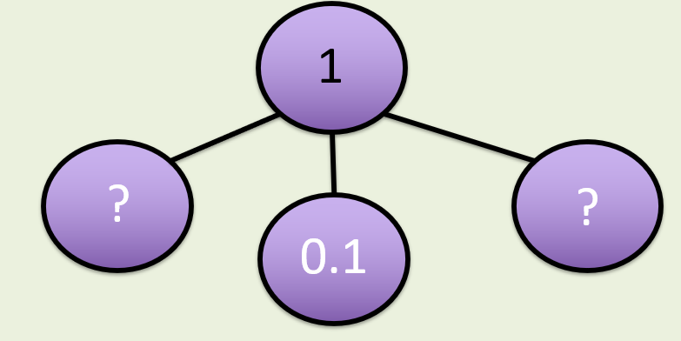
How many ways can you complete the part-whole model?
1
1
0.8
0.1
0.2
0.7
0.1
0.1
1
1
0.5
0.4
0.3
0.6
0.1
0.1

Slide 8



True or False
$\frac{\text{9}}{\text{10}}$
+
0.1
=
1
True

