Slide 1

Lesson 3:
X10 Tables
www.arithmagicians.com

Slide 2

+10
+10
+10
+10
+10
+10
+10
+10
+10
+10
0
10
20
30
40
50
60
70
80
90
100
Get ready to count up in 10s

Slide 3




4
There are ____ groups.
4
10
There are ____ equal groups of ____
10
There are ____ in each group.
10
10
10
10
40
____ $+$ ____ $+$ ____ + ___$=$ ____
40
There are ____ altogether.
40
____ $×$ ____ $=$ ____
4
10

Slide 4
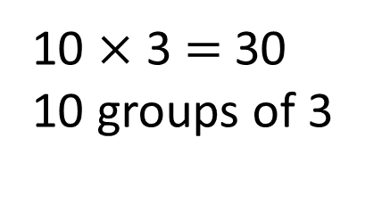
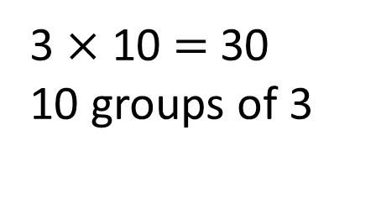
Which way is quicker when using skip counting? Why?
10 $×$ 3 $=$ 30
10 groups of 3
3
3
3
3
3
3
3
3
3
3
0
3
6
9
12
15
18
21
24
27
30
10
10
10
3 $×$ 10 $=$ 30
10 groups of 3
0
10
20
30

Slide 5








Your Turn
1) 10 $×$ 5 =
4) 12 $×$ 10 =
50
120
2) 10 $×$ 7 =
5) 10 $×$ 11 =
70
110
3) 9 $×$ 10 =
6) 10 $×$ 10 =
90
100

Slide 6
True or False
When you multiply a number by 10, the answer always ends in zero.
True

