Slide 1

Lesson 3 :
Subtract 2 from
any number
www.arithmagicians.com

Slide 2


-1
-1
-1
-1
-1
-1
-1
-1
-1
-1
40
41
42
43
44
45
46
47
48
49
50
Get ready to count back in 1s

Slide 3

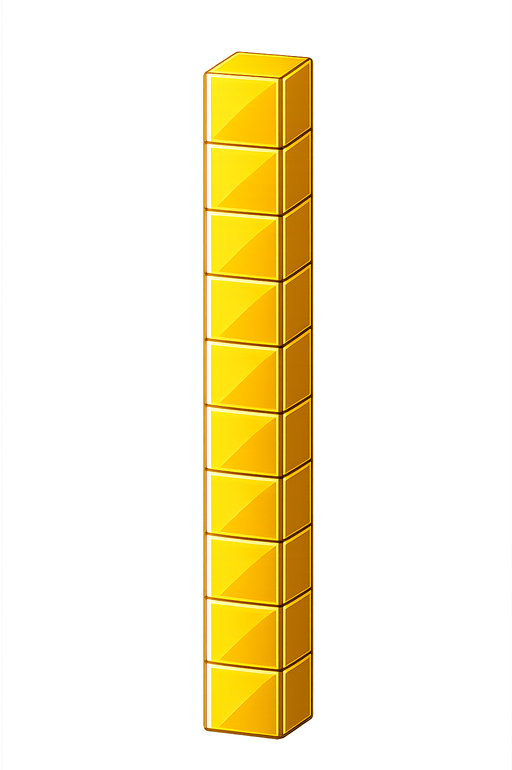

What number is shown below?
23
21
- 2 = ?

Slide 4
What number is shown below?
We exchange one ten for ten ones.
What happens if there are not enough ones to take away 2?
31
29
- 2 = ?

Slide 5

80
74
75
76
77
78
?
?
81
82
83
84
79
2
81
-
=
79

Slide 6


Your Turn
20 - 2 = ?
18
50
2) 52 - 2 = ?
59
3) 61 - 2 = ?
4) 41 - 2 = ?
39
31
5) ? - 2 = 29

Slide 7

True or False
When you subtract 2, you always count back two steps on the number line.
True

