Slide 1
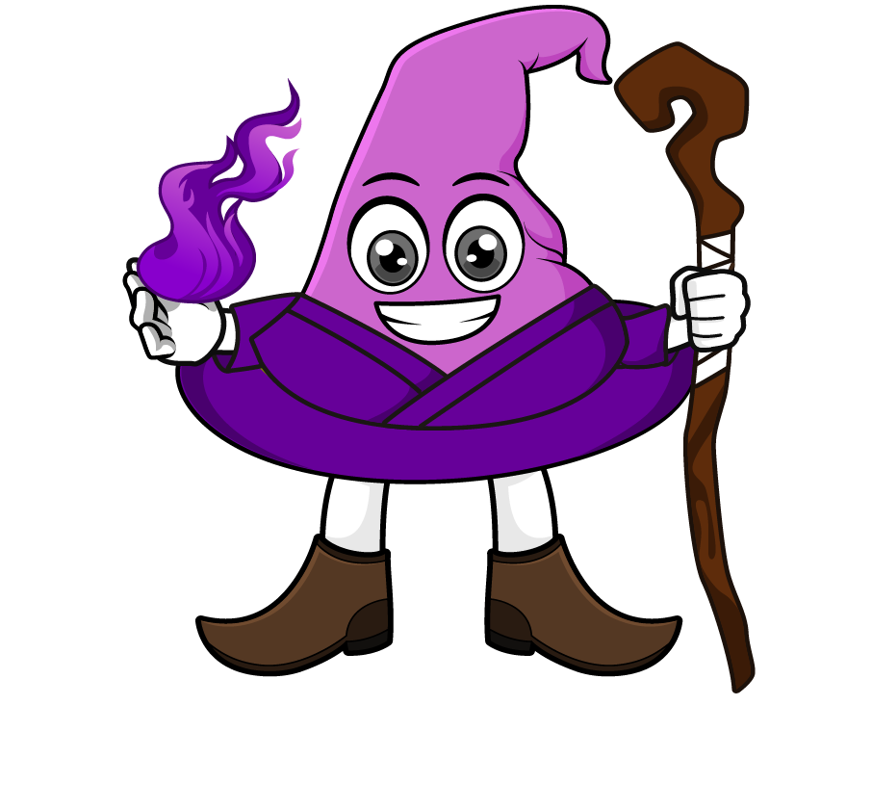

Lesson 3:
Adding mass in different units (kg and g)
www.arithmagicians.com

Slide 2

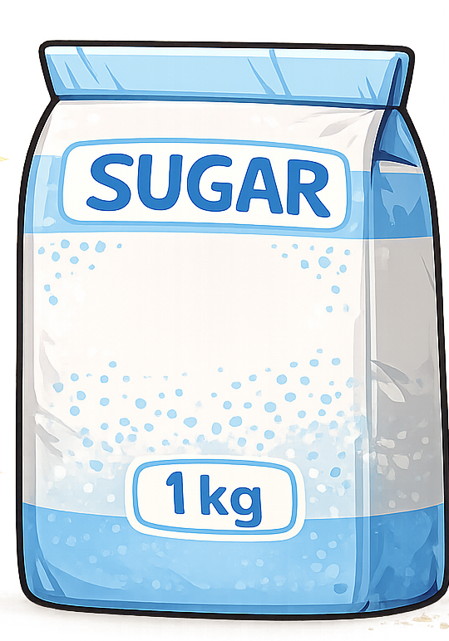
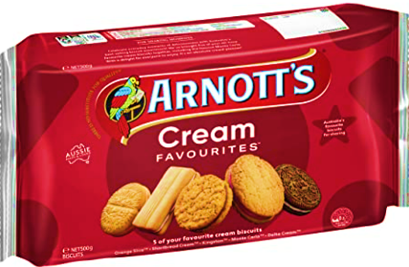
Recap:
1 kg = ? g
1000 g
=
500g
500g
Tip: Use the diagram to help you

Slide 3
Recap:
1kg = 1000 g
To change kg into g, ______ by 1000.
multiply
To change g into kg, ______ by 1000.
divide

Slide 4
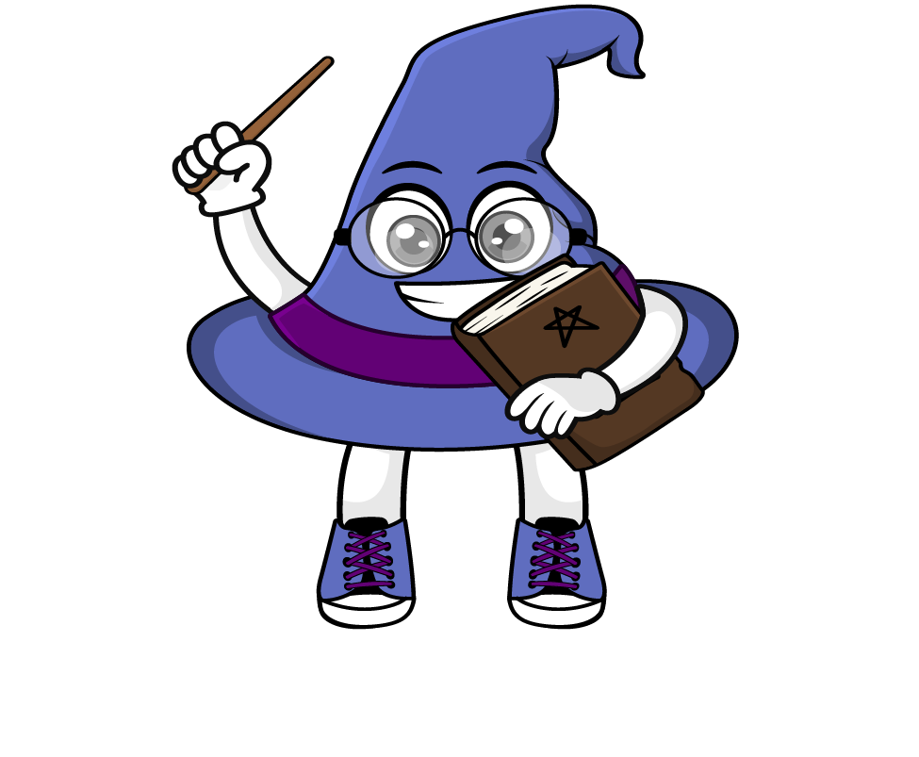
True or False
4kg + 40g = 44g
What are the two ways that I can do this?
False:
What should we do before adding different units?
We must convert them into the same units first.

Slide 5

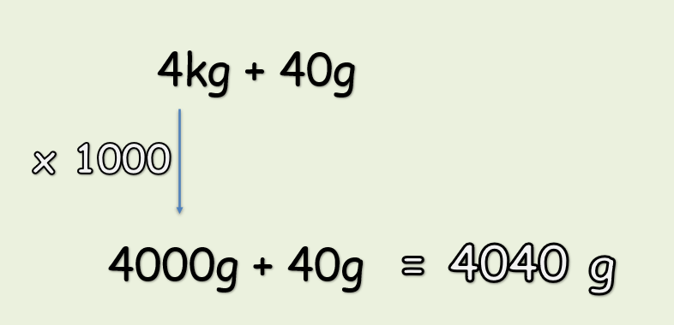
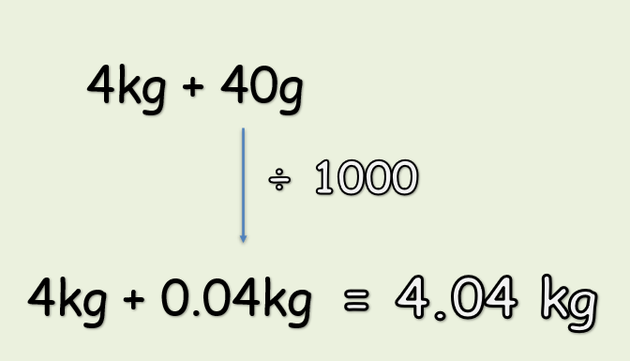
Option 1:
Convert all units into g
Option 2:
Convert all units into kg

Slide 6
Solve:
2kg + 80g = ? g
x1000
= 2080g
2000g + 80g
First, convert the units into g. Then add.

Slide 7


Your Turn
1) 5 kg + 250 g = ? g
5250 g
2) 120 g + 7 kg = ? g
7120 g
9.45 kg
3) 9 kg + 450 g = ? kg
4) 1500 g + 3 kg = ? g
4500 g
11 kg
5) 1 kg + 10000 g = ? kg

Slide 8
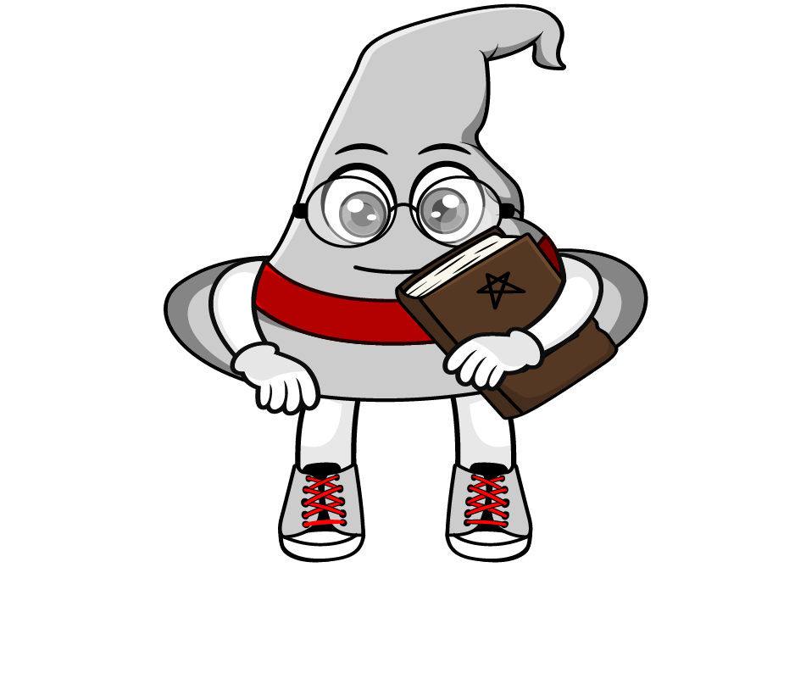
True or False
1kg + 200g = 300g
False: Can you explain why?

