Slide 1


Lesson 3:
Make a whole with hundredths
www.arithmagicians.com

Slide 2

Get ready to
count up in hundredths
0
1
$\frac{\text{0}}{\text{100}}$
$\frac{\text{10}}{\text{100}}$
$\frac{\text{20}}{\text{100}}$
$\frac{\text{30}}{\text{100}}$
$\frac{\text{40}}{\text{100}}$
$\frac{\text{50}}{\text{100}}$
$\frac{\text{60}}{\text{100}}$
$\frac{\text{70}}{\text{100}}$
$\frac{\text{80}}{\text{100}}$
$\frac{\text{90}}{\text{100}}$
$\frac{\text{100}}{\text{100}}$

Slide 3

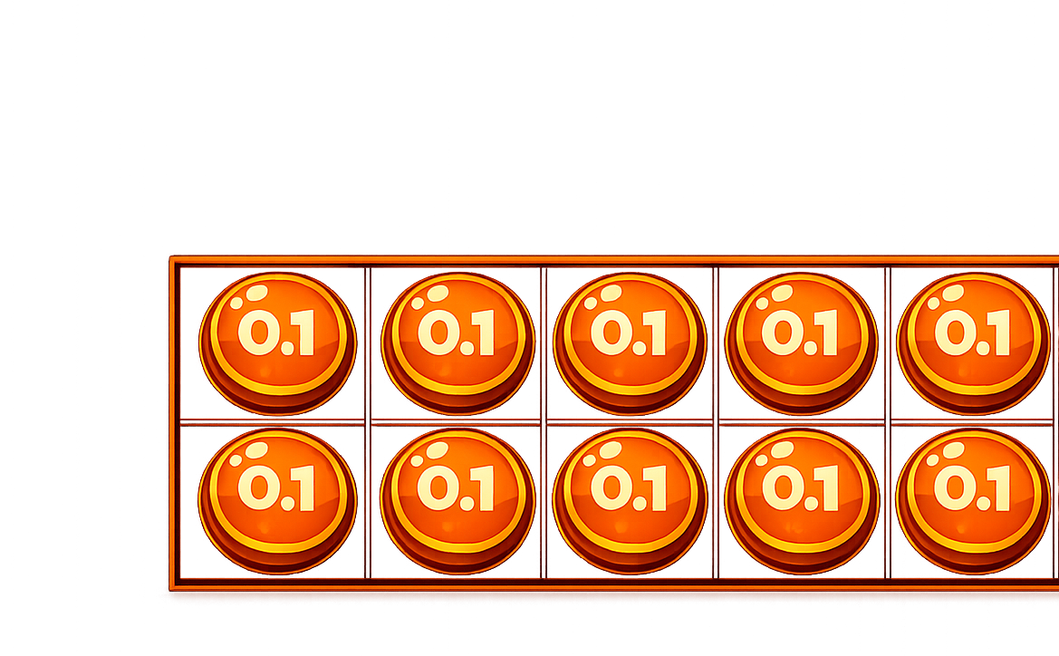

How many more tenths are needed to make one whole?
0.2
0.8 $+$ $=$ 1

Slide 4
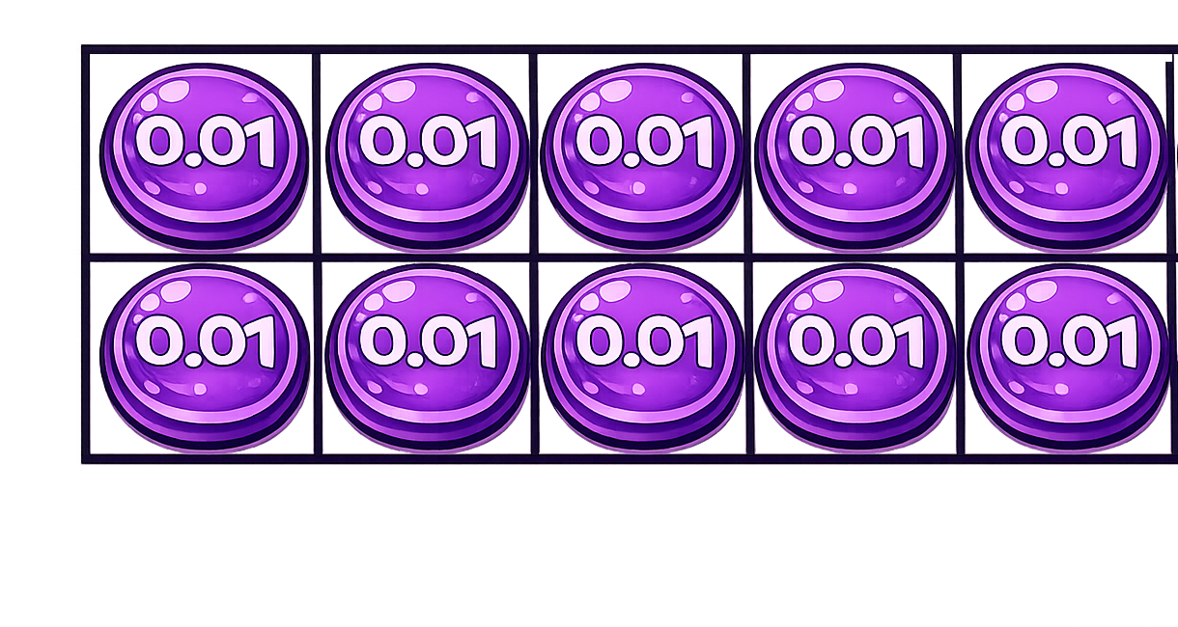
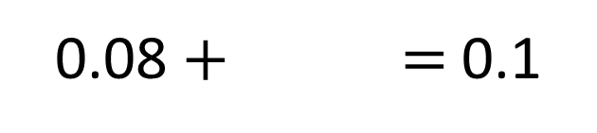
How many more hundredths are needed to make one tenth?
0.08 $+$ $=$ 0.1
0.02

Slide 5
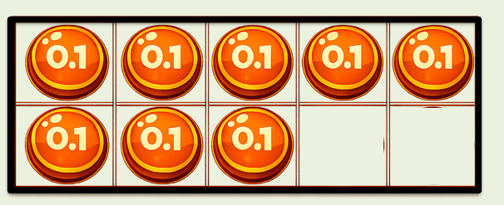
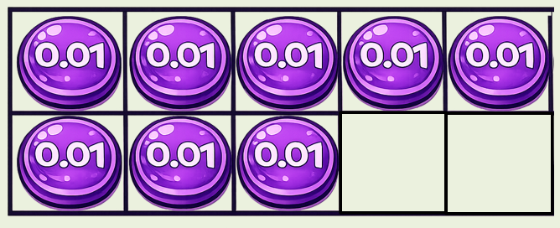
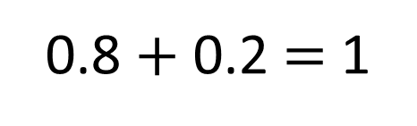
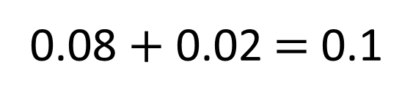
0.8 $+$ 0.2 $=$ 1
0.08 $+$ 0.02 $=$ 0.1
What’s the same about the calculations?
What is different?

Slide 6



The square represents 1 whole.
hundredths
Each column represents 10 _________.
hundredths
Each row represents 10 _______ .
How much of the whole is shaded?
Fraction | Decimal
$$\frac{\text{2}\text{6}}{\text{100}}$$
0.26
How much needs to be shaded
to fill the whole?
Fraction | Decimal
$\frac{\text{7}\text{4}}{\text{1}\text{00}}$
0.74

Slide 7


Your Turn
Complete the part-whole models.
A
1
B
1
0.76
?
?
0.24
0.99
0.01
C
D
1
?
1
0.95
0.05
?
0.35
0.65

Slide 8



Here is a hundred square.
Which statement is correct?
The image shows 44 hundredths
0.44 of the hundred square is shaded.
4 tenths and 4 hundredths of the square is shaded
0.04 of the hundred square is shaded.

