Slide 1

Lesson 4:
Subtract 2 from
any number
www.arithmagicians.com

Slide 2


-1
-1
-1
-1
-1
-1
-1
-1
-1
-1
30
31
32
33
34
35
36
37
38
39
40
Get ready to count back in 1s

Slide 3

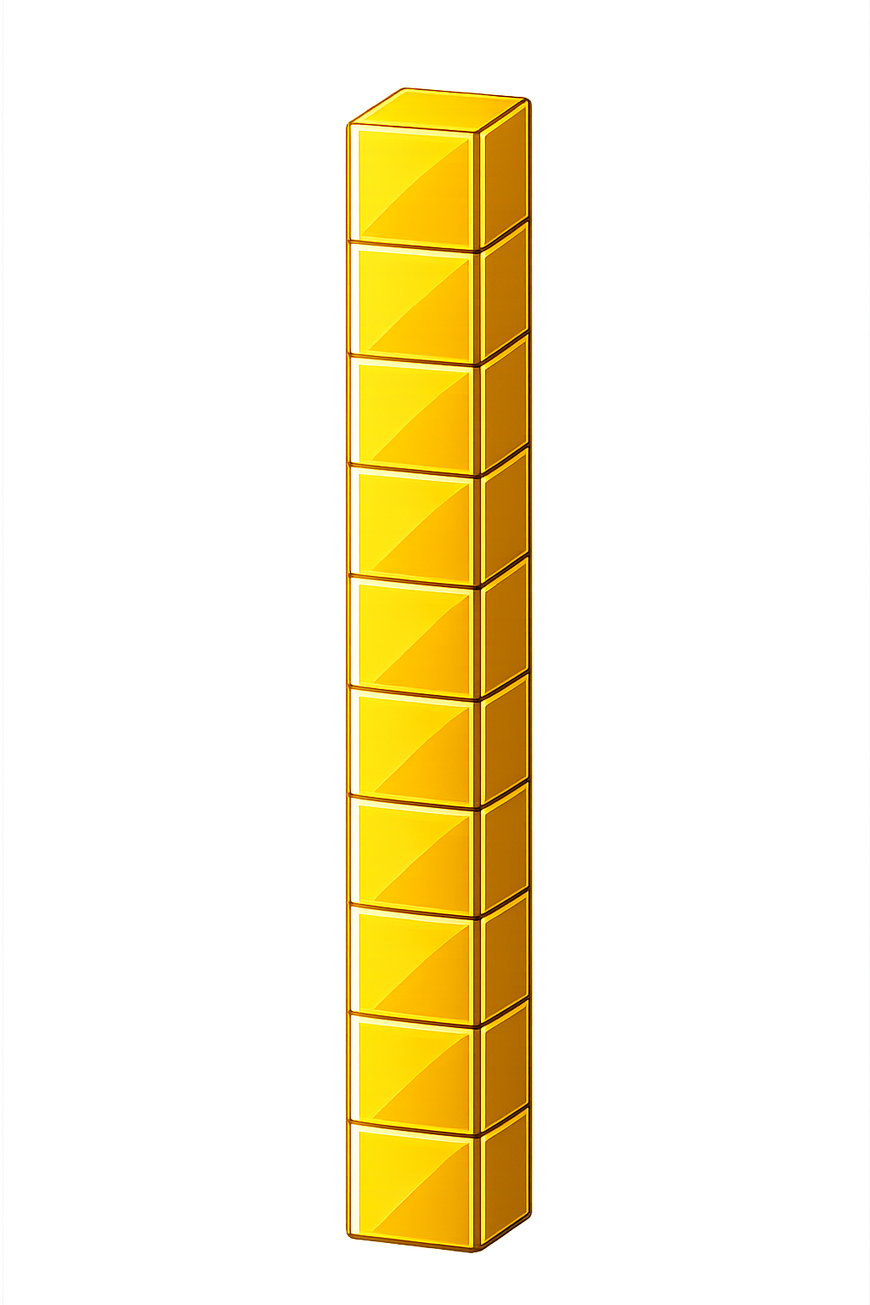

What number is shown below?
43
41
- 2 = ?

Slide 4
What number is shown below?
We exchange one ten for ten ones.
What happens if there are not enough ones to take away 2?
21
19
- 2 = ?

Slide 5

60
54
55
56
57
58
?
?
61
62
63
64
59
2
61
-
=
59

Slide 6


Your Turn
20 - 2 = ?
18
50
2) 52 - 2 = ?
59
3) 61 - 2 = ?
31
4) ? - 2 = 29
41
5) ? - 2 = 39

Slide 7

True or False
If there are not enough ones to subtract, we exchange 1 ten for 10 ones.
True

