Slide 1


Lesson 4:
Adding capacity in different units (L and ml)
www.arithmagicians.com

Slide 2

Recap:
1000 ml
1 L = ? ml
Tip: Use the diagram to help you

Slide 3
Recap:
1 L = 1000 ml
To change L into ml, ______ by 1000.
multiply
To change ml into L, ______ by 1000.
divide

Slide 4

True or False
3L + 200ml = 203ml
What are the two ways that I can do this?
False:
What should we do before adding different units?
We must convert them into the same units first.

Slide 5

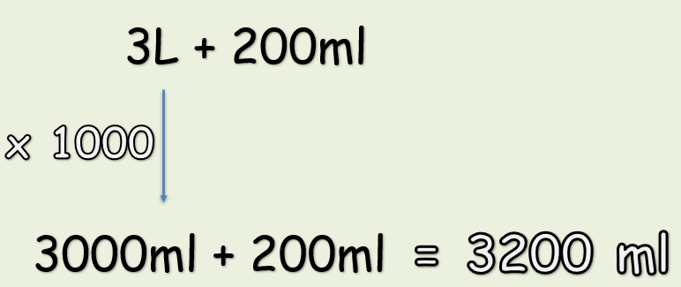
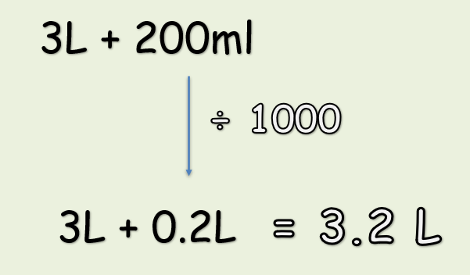
Option 1:
Convert all units into ml
Option 2:
Convert all units into l

Slide 6
Solve:
4L + 75ml = ? ml
x1000
= 4075ml
4000ml + 75ml
First, convert the units into ml. Then add.

Slide 7


Your Turn
1) 4 L + 250 ml = ? ml
4250 ml
6120 ml
2) 120 ml + 6 L = ? ml
3) 8 L + 450 ml = ? L
8.45 L
4) 1500 ml + 2 L = ? ml
3500 ml
5) 1500 ml + 3 L = ? L
4.5 L

Slide 8

True or False
1L + 1000ml = 2L
True

