Slide 1


Lesson 4:
Convert Between
12-Hour and 24-Hour Time
www.arithmagicians.com

Slide 2

24-hour
clock
12-hour
clock
What is the same and different about
3 am on a 12-hour digital clock and a
24-hour digital clock?
Midnight
00:00
12:00
am
01:00
1:00 am
02:00
2:00 am
03:00
3:00 am
04:00
4:00 am
05:00
5:00 am
06:00
6:00 am
07:00
7:00 am
08:00
8:00 am
09:00
9:00 am
10:00
10:00 am
11:00
11:00 am
Midday
12:00
12:00
pm
13:00
1:00 pm
14:00
2:00 pm
15:00
3:00 pm
16:00
4:00 pm
17:00
5:00 pm
18:00
6:00 pm
19:00
7:00 pm
20:00
8:00 pm
21:00
9:00 pm
22:00
10:00 pm
23:00
11:00 pm
Midnight
00:00
12:00 am

Slide 3

24-hour
clock
12-hour
clock
am used in 12-hour digital time.
Midnight
00:00
12:00
am
01:00
1:00 am
02:00
2:00 am
03:00
3:00 am
04:00
4:00 am
05:00
5:00 am
06:00
6:00 am
07:00
7:00 am
08:00
8:00 am
Both have a 3 in the hours and zero minutes.
09:00
9:00 am
10:00
10:00 am
11:00
11:00 am
Midday
12:00
12:00
pm
13:00
1:00 pm
14:00
2:00 pm
15:00
3:00 pm
16:00
4:00 pm
17:00
5:00 pm
18:00
6:00 pm
19:00
7:00 pm
20:00
8:00 pm
In 24-hour time, the zero shows it is before midday.
21:00
9:00 pm
22:00
10:00 pm
23:00
11:00 pm
Midnight
00:00
12:00 am

Slide 4
24-hour
clock
12-hour
clock
Midnight
00:00
12:00
am
01:00
1:00 am
What is the same and different about 2 pm on a 12-hour digital clock and a 24-hour digital clock?
02:00
2:00 am
03:00
3:00 am
04:00
4:00 am
05:00
5:00 am
06:00
6:00 am
07:00
7:00 am
08:00
8:00 am
09:00
9:00 am
10:00
10:00 am
11:00
11:00 am
Midday
12:00
12:00
pm
13:00
1:00 pm
14:00
2:00 pm
15:00
3:00 pm
16:00
4:00 pm
17:00
5:00 pm
18:00
6:00 pm
19:00
7:00 pm
20:00
8:00 pm
21:00
9:00 pm
22:00
10:00 pm
23:00
11:00 pm
Midnight
00:00
12:00 am

Slide 5
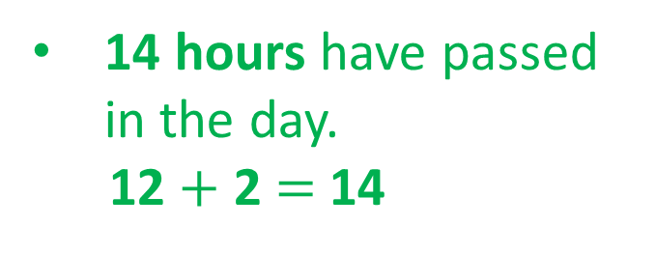
24-hour
clock
12-hour
clock
pm used in 12-hour digital time.
Midnight
00:00
12:00
am
01:00
1:00 am
02:00
2:00 am
03:00
3:00 am
04:00
4:00 am
05:00
5:00 am
06:00
6:00 am
07:00
7:00 am
08:00
8:00 am
09:00
9:00 am
Both have zero minutes.
10:00
10:00 am
11:00
11:00 am
Midday
12:00
12:00
pm
13:00
1:00 pm
14:00
2:00 pm
15:00
3:00 pm
16:00
4:00 pm
17:00
5:00 pm
18:00
6:00 pm
19:00
7:00 pm
14 hours have passed in the day.
12 $+$ 2 $=$ 14
20:00
8:00 pm
21:00
9:00 pm
22:00
10:00 pm
23:00
11:00 pm
Midnight
00:00
12:00 am

Slide 6
Convert Between 12-Hour and 24-Hour Time
12-hour → 24-hour
am: keep the hour the same
example: 7:00 am = 07:00
pm: add 12 to the hour
example: 3:00 pm = 12:00 + 3:00 = 15:00
Special cases:
12:00 pm = 12:00
12:00 am = 00:00

Slide 7


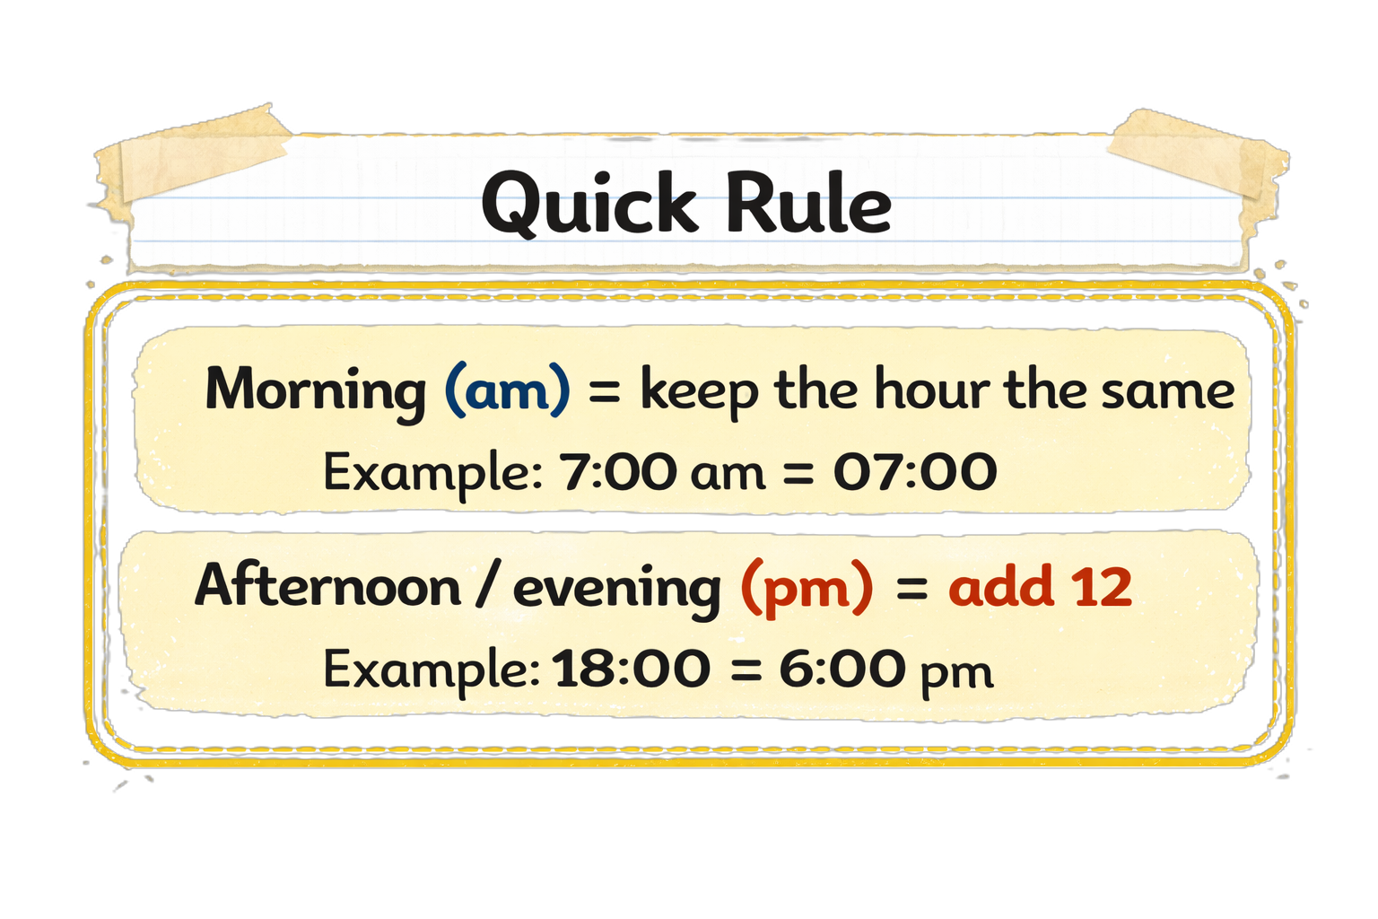
Your Turn
Convert Between
12-Hour and 24-Hour Time
8
08:00 = ? am
16:00 = ? pm
10:00 am = ?
10:00 pm = ?
10:30 pm = ?
4
10:00
22:00
22:30

Slide 8
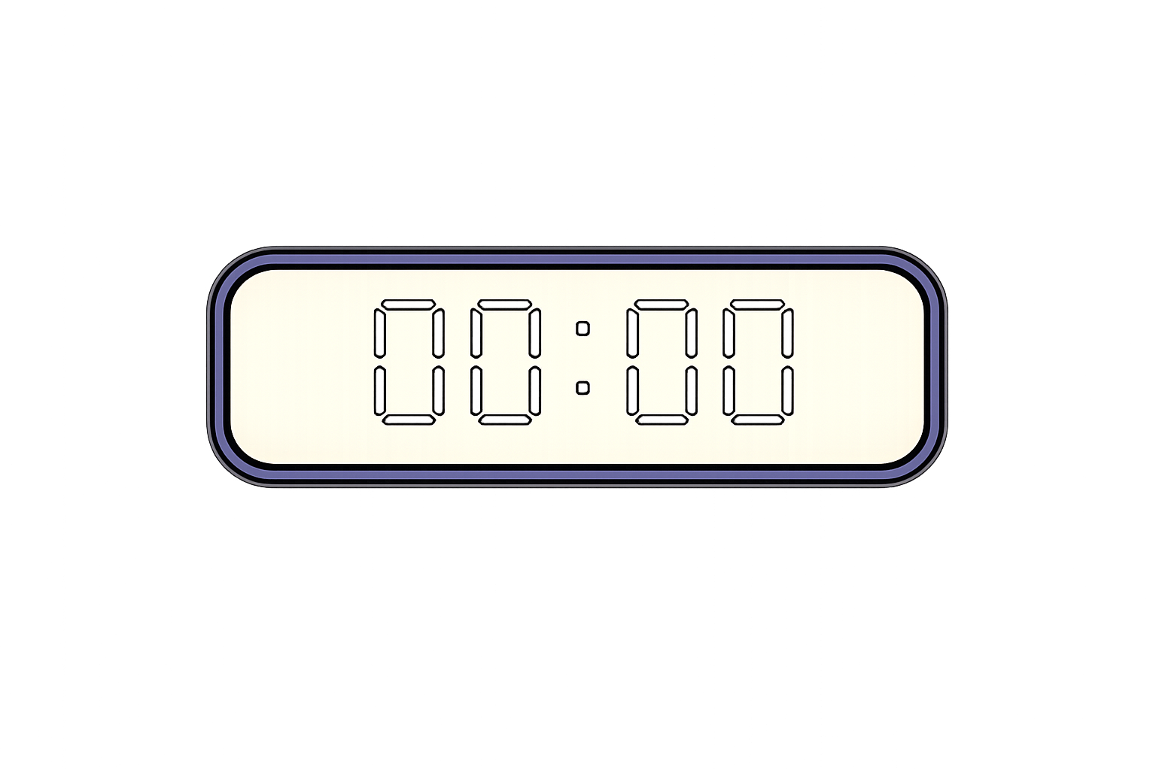

True or False
This is how you write
12 am on
a digital clock
True

