Slide 1


Lesson 4:
Make a whole with hundredths
www.arithmagicians.com

Slide 2

Get ready to
count up in hundredths
0
1
$\frac{\text{0}}{\text{100}}$
$\frac{\text{10}}{\text{100}}$
$\frac{\text{20}}{\text{100}}$
$\frac{\text{30}}{\text{100}}$
$\frac{\text{40}}{\text{100}}$
$\frac{\text{50}}{\text{100}}$
$\frac{\text{60}}{\text{100}}$
$\frac{\text{70}}{\text{100}}$
$\frac{\text{80}}{\text{100}}$
$\frac{\text{90}}{\text{100}}$
$\frac{\text{100}}{\text{100}}$

Slide 3

What is the missing part?
1
1
0.93
0.07
?

Slide 4
What is the missing part?
1
1
?
0.36
0.64

Slide 5

What is the missing part?
?
1
1
$$\frac{99}{100}$$
0.01

Slide 6

Your Turn
How many ways can you complete the part-whole model to make 1 whole?
1
1
?
?
0.01
Can you find at least 4 different examples?

Slide 7
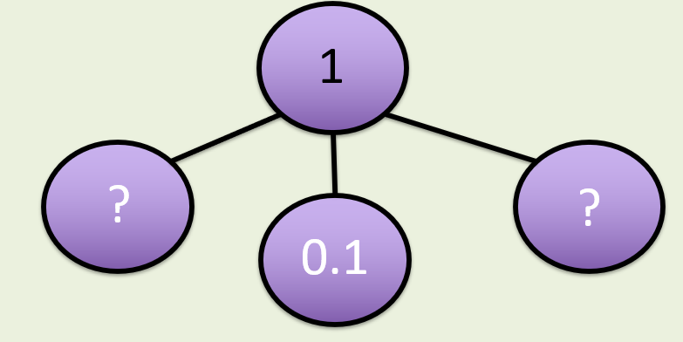
How many ways can you complete the part-whole model?
1
1
0.79
0.2
0.9
0.09
0.01
0.01
1
1
0.59
0.3
0.69
0.4
0.01
0.01

Slide 8



True or False
$\frac{\text{99}}{\text{10}}$
+
0.01
=
1
True

