Slide 1


Lesson 5:
Assess and Review
www.arithmagicians.com

Slide 2

Recap:
10
1 cm = ? mm
Tip: Use the ruler to help you

Slide 3

Recap:
100
1m = ? cm
10 cm
1m
Tip: Use the diagram to help you

Slide 4
Recap:
1000 m
1 km = ? m
100m
Tip: Use the diagram to help you

Slide 5
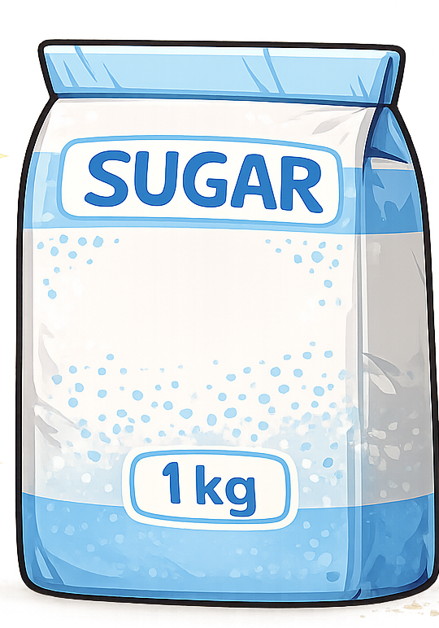
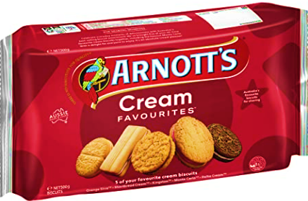
Recap:
1 kg = ? g
1000 g
=
500g
500g
Tip: Use the diagram to help you

Slide 6
Recap:
1000 ml
1 L = ? ml
Tip: Use the diagram to help you

Slide 7


Your Turn
1) 4 L + 250 ml = ? ml
4250 ml
2) 120 m + 8 km = ? km
8.12 km
3) 450 cm + 5 m = ? m
9.5 m
4) 2 kg + 1500 g = ? g
3500 g
3.2 km
5) 2 km + 200 m + 1000 m = ? km

