Slide 1

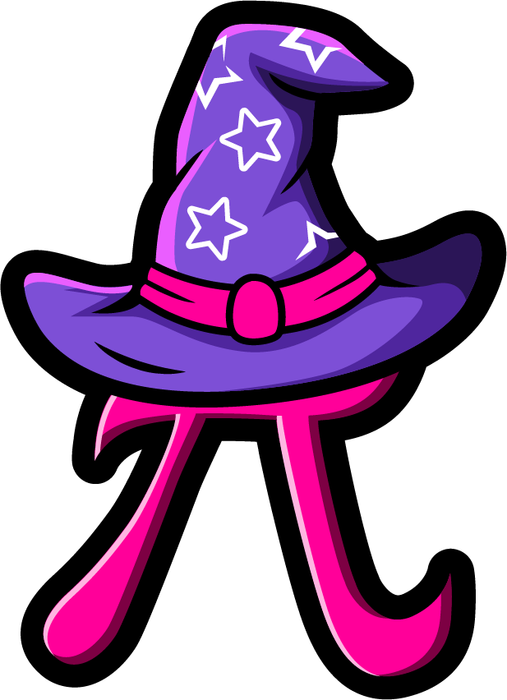
Lesson 5:
Assess and Review
www.arithmagicians.com

Slide 2

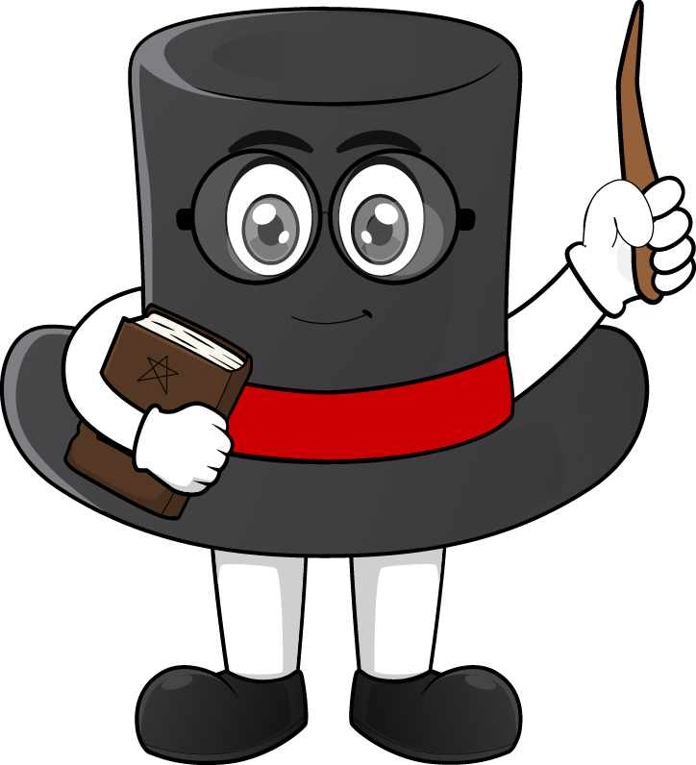
We use am and pm so we know whether the time is in the morning or later in the day.
Key Fact: am = before midday (morning / before lunch) pm = after midday (afternoon, evening / after lunch)
Key Fact: am = before midday
(morning / before lunch) pm = after midday
(afternoon, evening / after lunch)

Slide 3

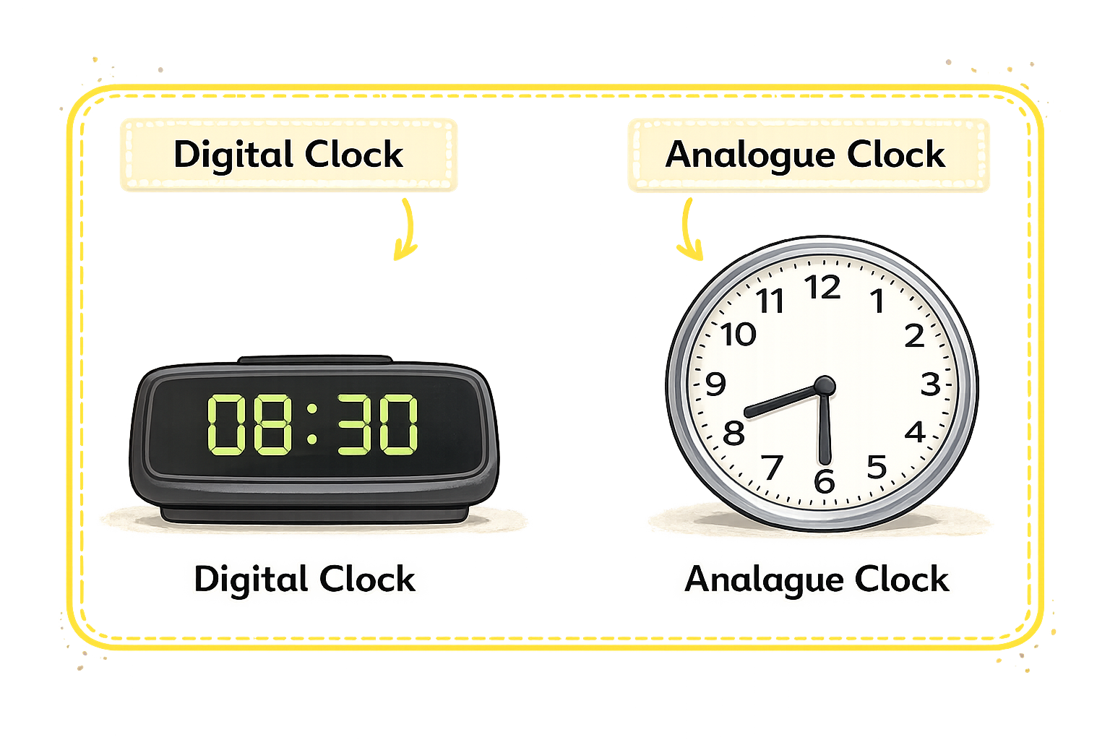
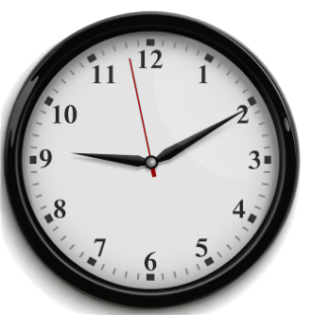

What are these types of clocks called?
?
?

Slide 4
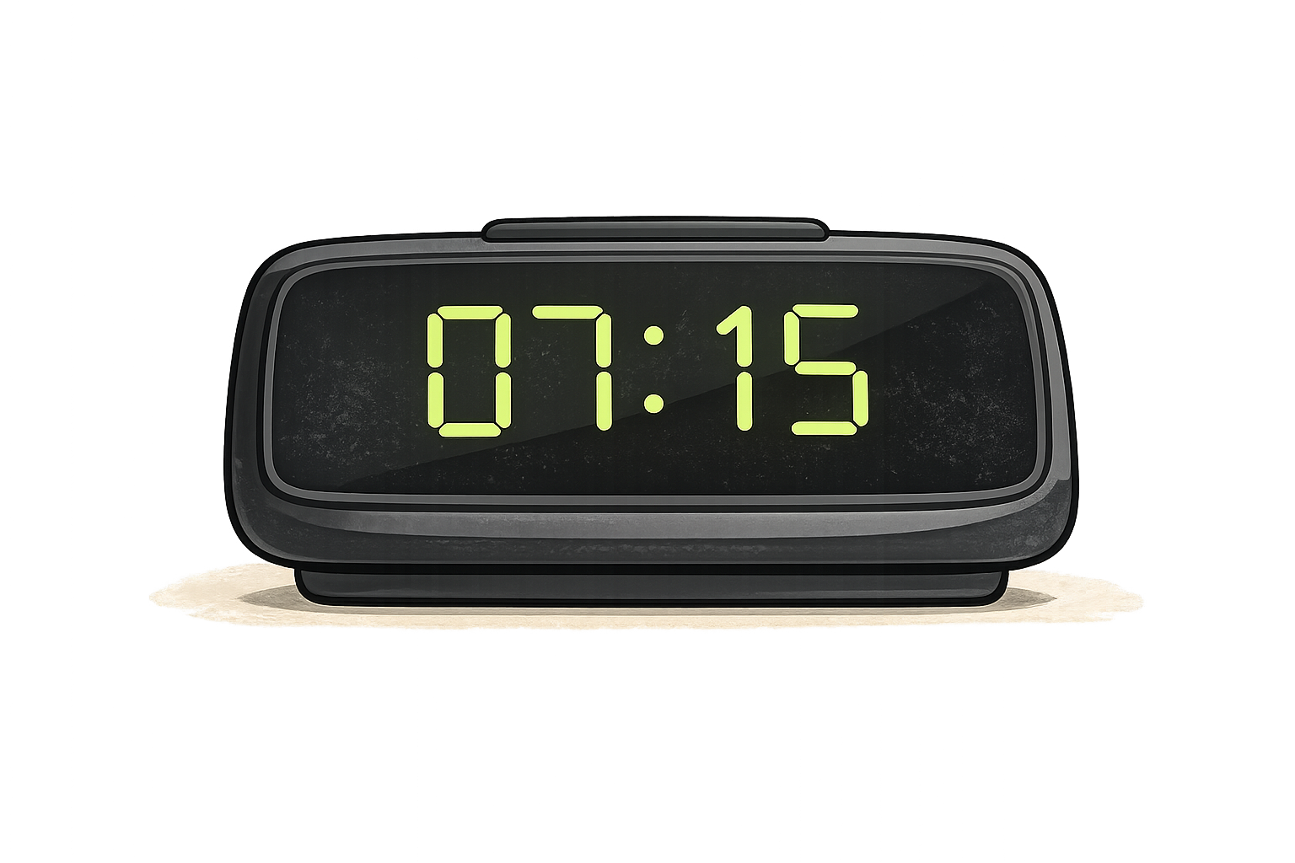
How to read a digital clock
Hour : Minutes
07:15
07 = hour
15 = minutes
Read as: seven fifteen

Slide 5
Convert Between 12-Hour and 24-Hour Time
12-hour → 24-hour
am: keep the hour the same example: 7:00 am = 07:00
pm: add 12 to the hour example: 3:00 pm = 12:00 + 3:00 = 15:00
Special cases: 12:00 pm = 12:00 12:00 am = 00:00

Slide 6


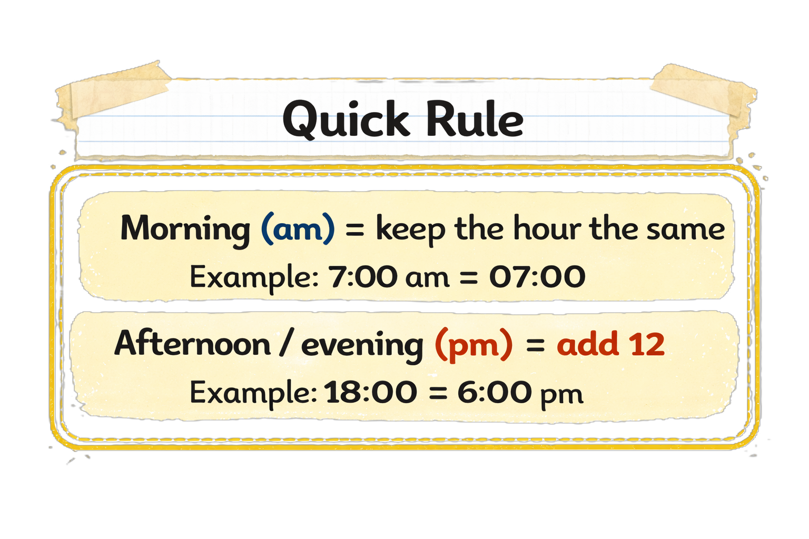
Your Turn
Convert Between
12-Hour and 24-Hour Time
7
07:00 = ? am
19:00 = ? pm
11:00 am = ?
11:00 pm = ?
11:45 pm = ?
7
11:00
23:00
23:45

