Slide 1

Week 3:
Assess & Review
www.arithmagicians.com

Slide 2


-1
-1
-1
-1
-1
-1
-1
-1
-1
-1
20
21
22
23
24
25
26
27
28
29
30
Get ready to count back in 1s

Slide 3

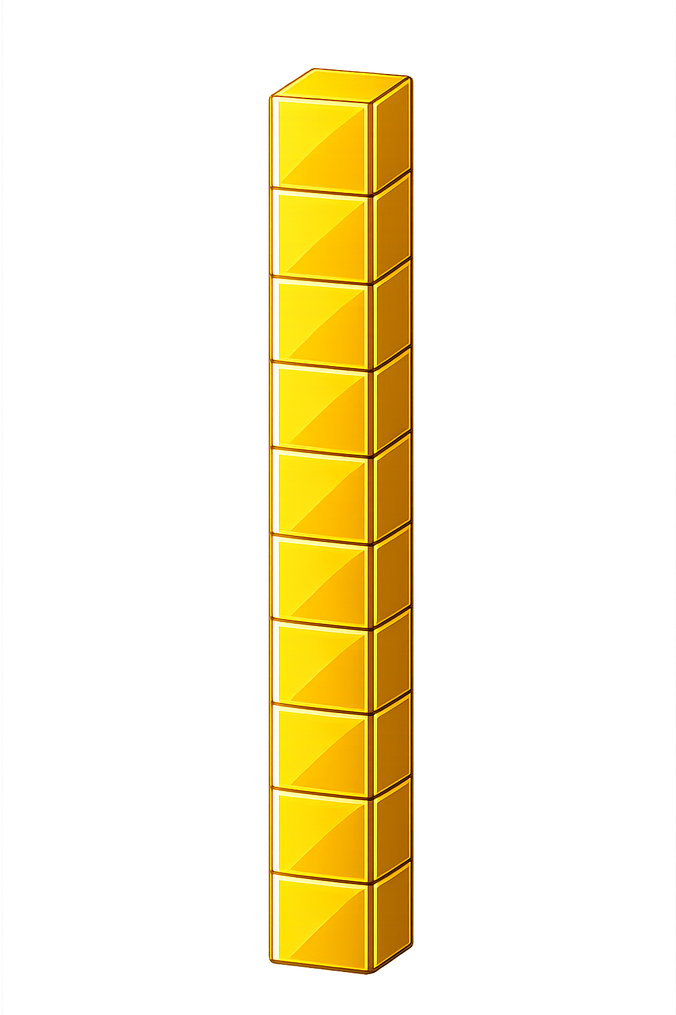

What number is shown below?
We exchange one ten for ten ones.
What happens if we have no ones to remove?
30
29
- 1 = ?

Slide 4
What number is shown below?
We exchange one ten for ten ones.
What happens if there are not enough ones to take away 2?
21
19
- 2 = ?

Slide 5

30
24
25
26
27
28
?
?
31
32
33
34
29
2
31
-
=
29

Slide 6


Your Turn
20 - 1 = ?
19
30
2) 32 - 2 = ?
39
3) 41 - 2 = ?
30
4) ? - 1 = 29
21
5) ? - 2 = 19

