Slide 1

Week 3:
Assess & Review
www.arithmagicians.com

Slide 2

+10
+10
+10
+10
+10
+10
+10
+10
+10
+10
0
10
20
30
40
50
60
70
80
90
100
Get ready to count up in 10s

Slide 3

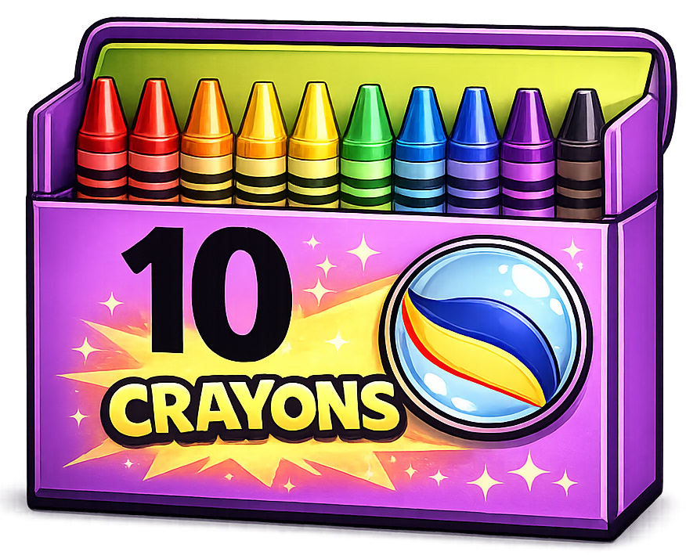
4
There are ____ groups.
4
10
There are ____ equal groups of ____
10
There are ____ in each group.
10
10
10
10
40
____ $+$ ____ $+$ ____ + ___$=$ ____
40
There are ____ altogether.
10
40
____ $×$ ____ $=$ ____
4

Slide 4

True or False
True
2 $×$ 10 $=$ 10 $×$ 2

Slide 5

True
True or False
2 $×$ 5 $=$ 2 $×$ 10 ÷ 2
$=$

Slide 6
Multiplying a number by 5 is the same as multiplying it by ____ and then ________ the answer.
10
halving

Slide 7


Your Turn
1) 5 x 6 =
30
5) 10 x 11 =
110
2) 10 x 4 =
40
6) 5 x 12 =
60
3) 8 x 5 =
40
7) 10 x 12 =
120
4) 10 x 9 =
90
8) 5 x 11 =
55

