Slide 1


Lesson 5:
Assess and Review
www.arithmagicians.com

Slide 2

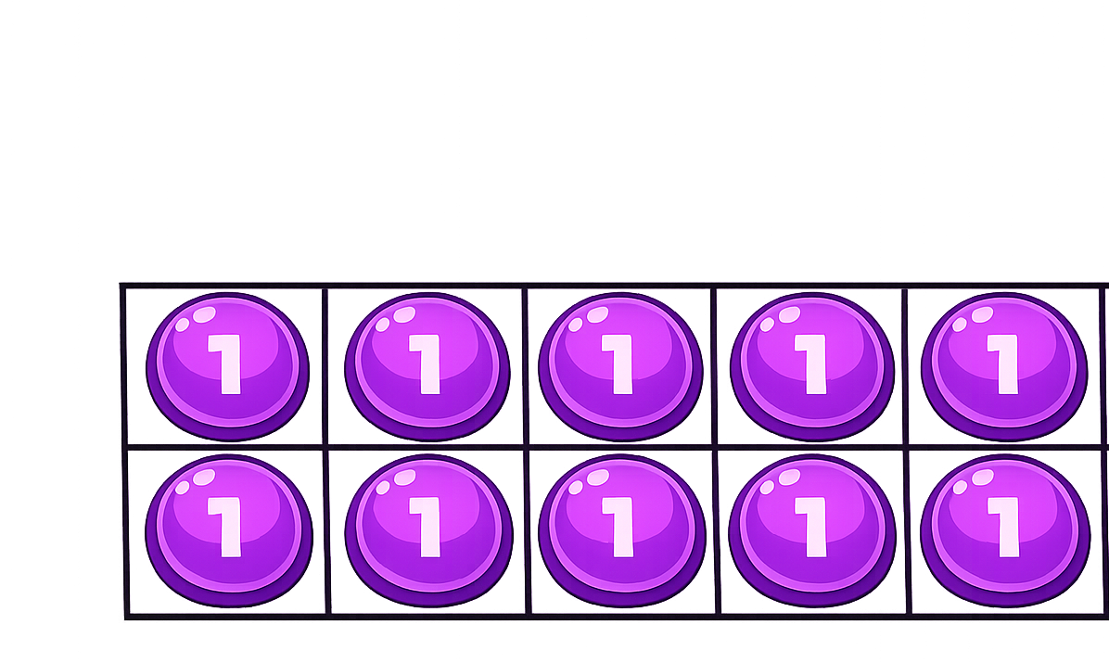

How many more ones are needed to make ten?
2
8 $+$ $=$ 10

Slide 3
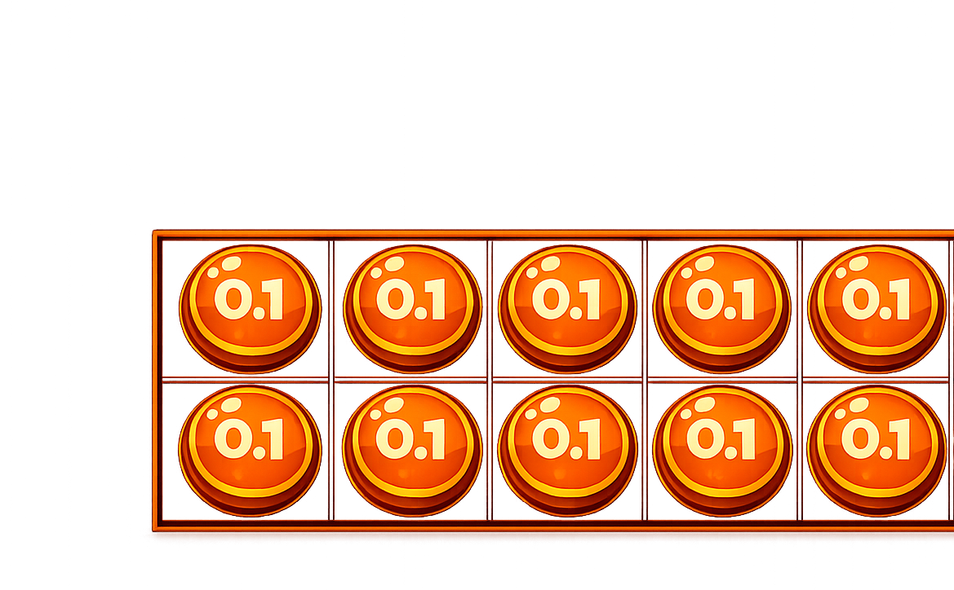
How many more tenths are needed to make one whole?
0.2
0.8 $+$ $=$ 1

Slide 4
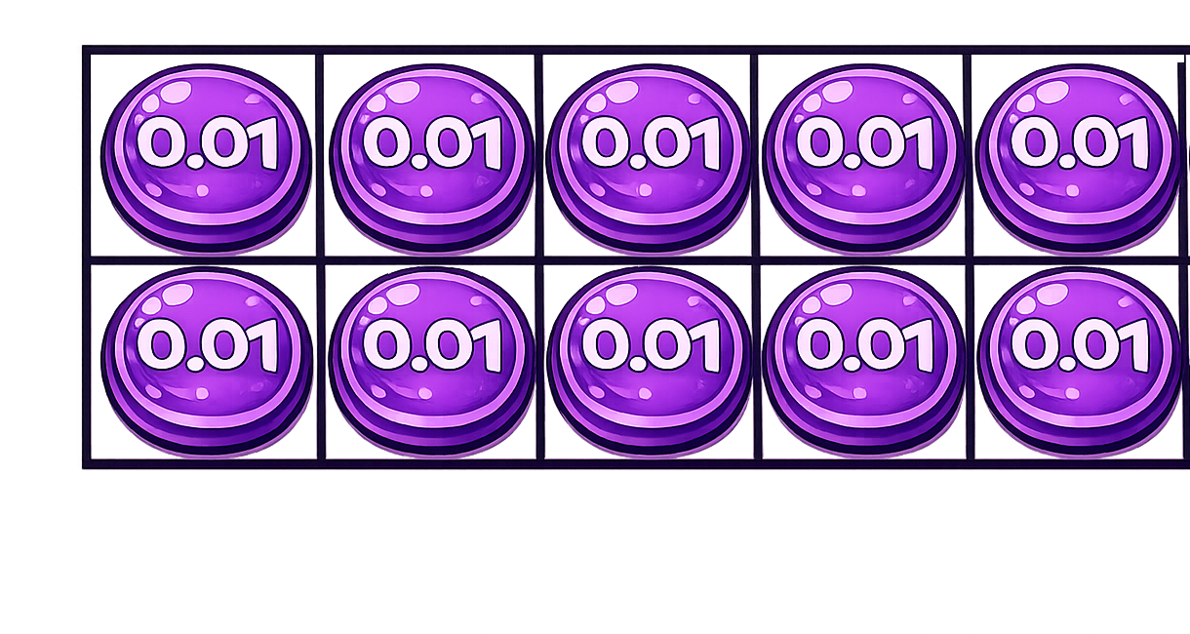
How many more hundredths are needed to make one tenth?
0.08 $+$ $=$ 0.1
0.02

Slide 5


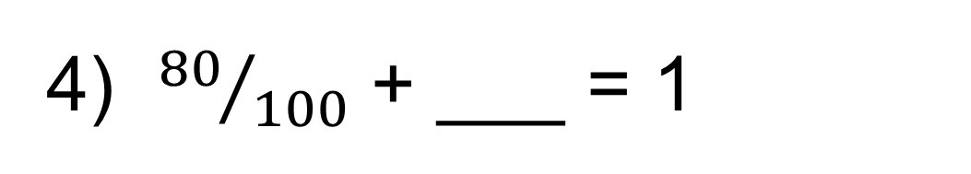
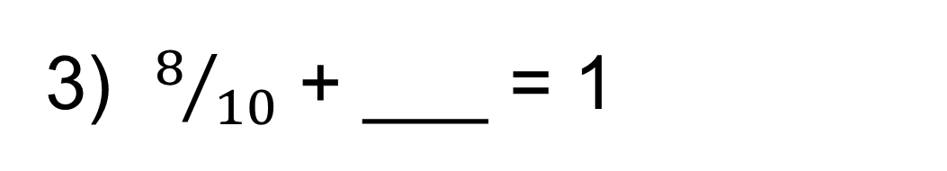
Your Turn
1) 0.6 + ___ = 1
5) 0.54 + ___ = 1
0.4
0.46
2) 0.06 + ___ = 1
6) ___ + 0.99 = 1
0.94
0.01
3) $8/{10}$ + ___ = 1
7) ___ + 0.1 = 1
0.2
0.9
4) ${80}/{100}$ + ___ = 1
8) ___ + 0.01 = 1
0.2
0.99

