Slide 1
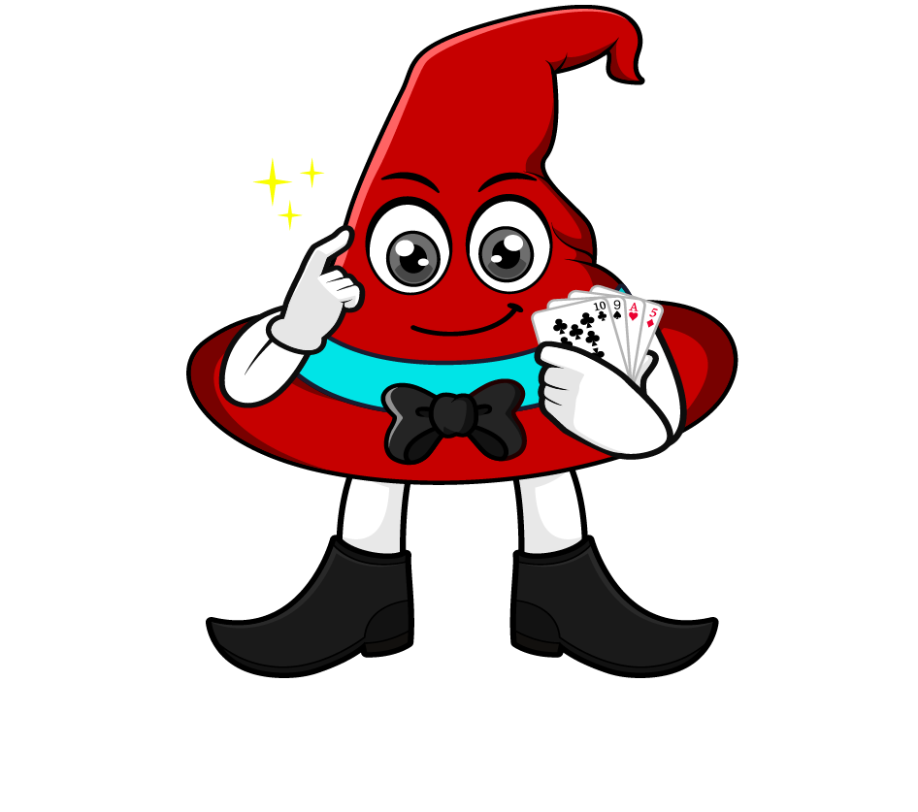
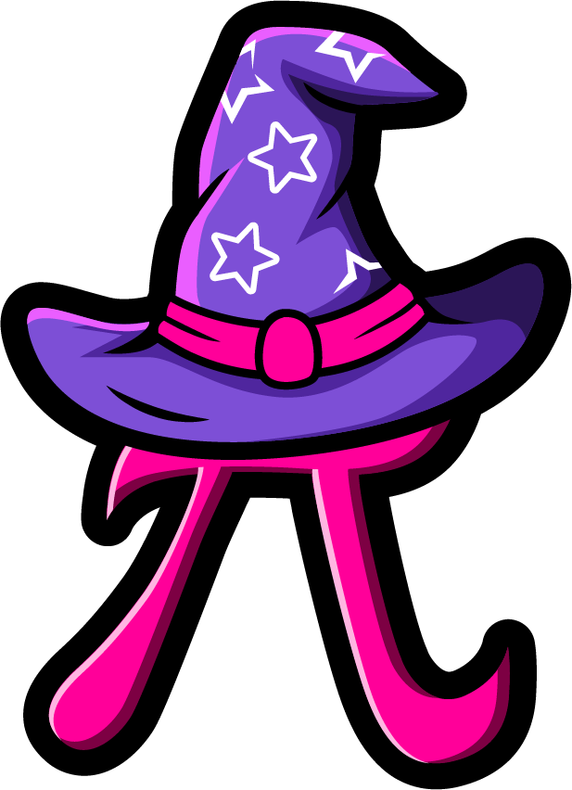
Lesson 1:
Convert units of measure involving fractions
www.arithmagicians.com

Slide 2

Recap:
1 m = ? cm
100 cm
1 kg = ? g
1000 g
1 L = ? ml
1000 ml
1 km = ? m
1000 m

Slide 3



50cm
$\frac{1}{2}$ m = ? cm
I know that:
1m = 100cm
$\frac{1}{2}$ x 100 = 50 cm
Therefore :
100cm
50cm
50cm

Slide 4


750g
$\frac{3}{4}$ kg = ? g
I know that:
1kg = 1000g
$\frac{3}{4}$ x 1000 = 750 g
Therefore :
1000g
250g
250g
250g
250g

Slide 5



200m
$\frac{1}{5}$ km = ? m
I know that:
1km = 1000m
Therefore :
$\frac{1}{5}$ x 1000 = 200 m
1000m
200m
200m
200m
200m
200m

Slide 6






Your Turn
500 m
a) $\frac{1}{2}$ km = ? m
25 cm
b) $\frac{1}{4}$ m = ? cm
600 g
c) $\frac{3}{5}$ kg = ? g
400 ml
d) $\frac{4}{10}$ L = ? ml

Slide 7
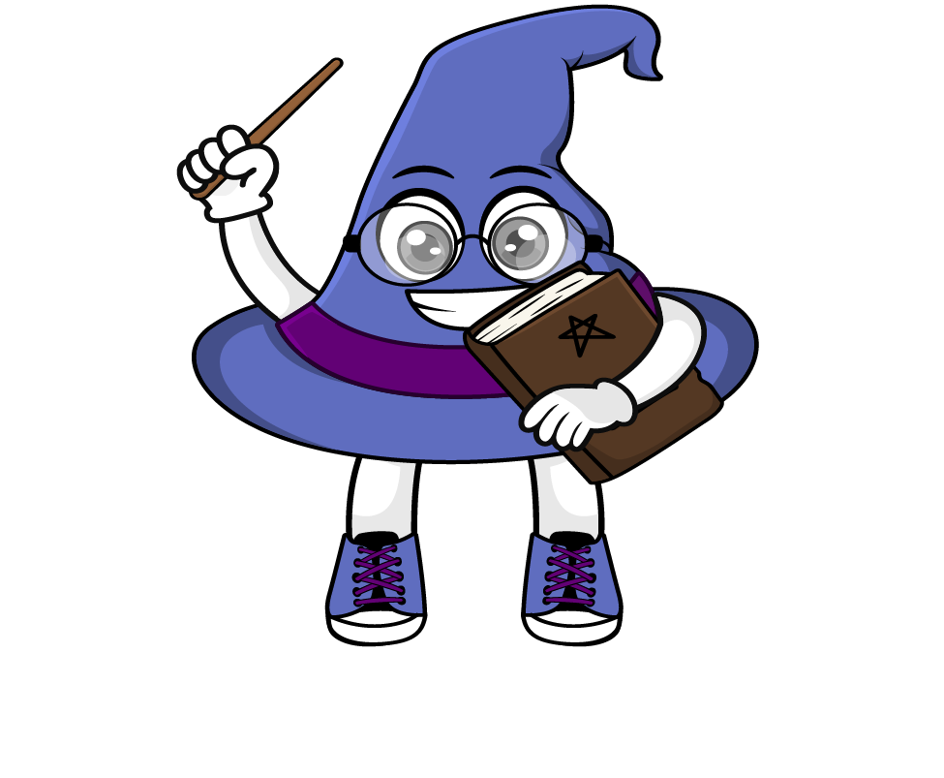
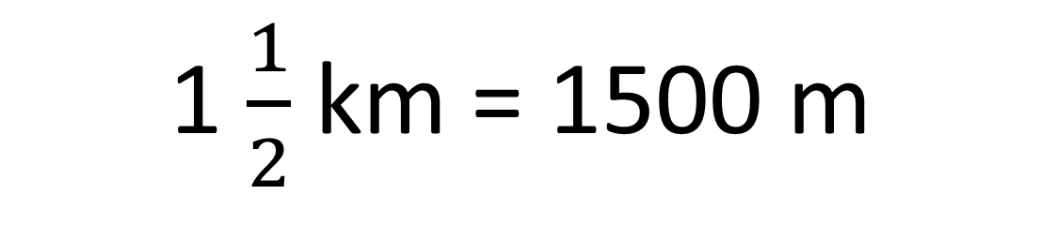
True or False
1 $\frac{1}{2}$ km = 1500 m
True

