Slide 1
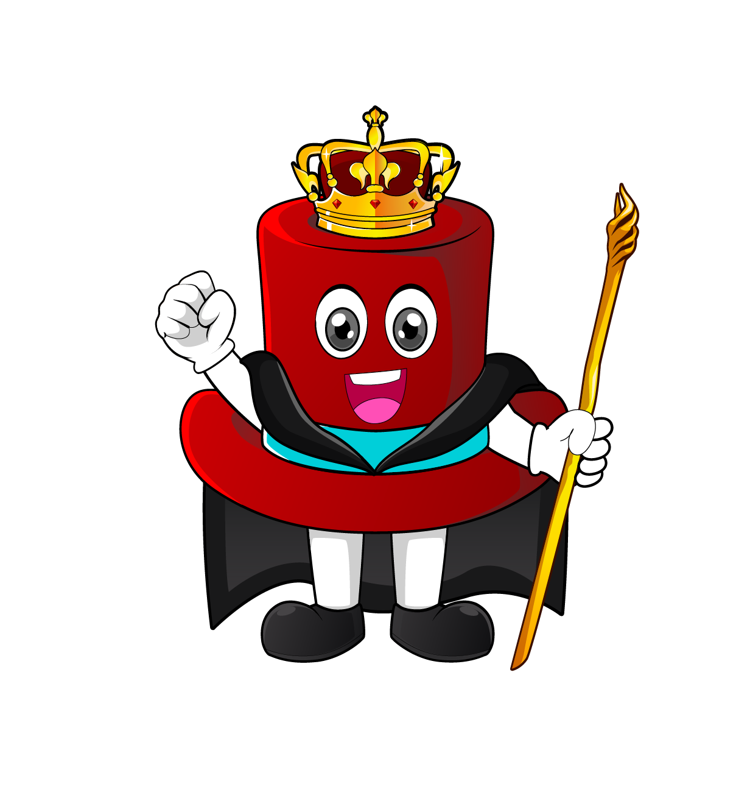

Lesson 1:
Years, months and days
www.arithmagicians.com

Slide 2

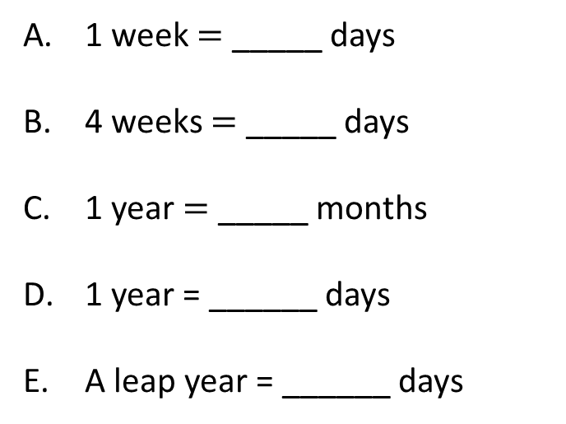
Days, Weeks, Months
7
1 week $=$ _____ days
4 weeks $=$ _____ days
1 year $=$ _____ months
1 year = ______ days
A leap year = ______ days
28
12
365
366

Slide 3

What is a leap year?
Usually, February has 28 days.
In a leap year, it has 29 days.
A year has 365 days.
Every 4 years there is a leap year.
A leap year has one extra day
 |  |  | Leap year |  |  |  | Leap year
365 days | 365 days | 365 days | 366 days | 365 days | 365 days | 365 days | 366 days

Slide 4
Month | Number of days
January
February
March
April
May
June
July
August
September
October
November
December
How can we remember how many days there are in each month.
31
28 or 29
31
30
31
30
31
31
30
31
30
31

Slide 5
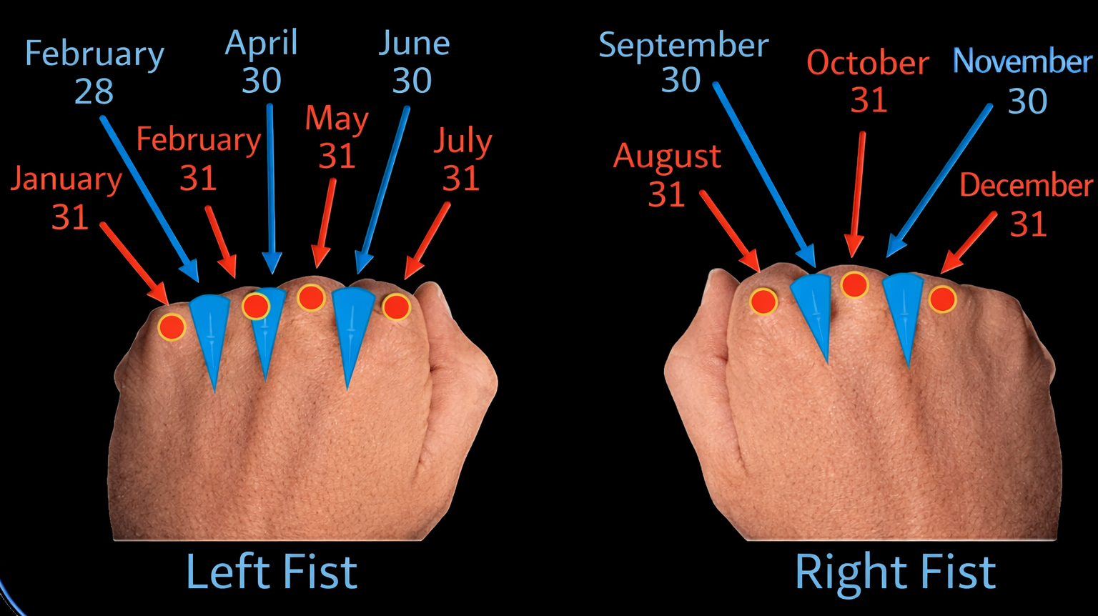
Left Hand
Month | Position | Days
January | Knuckle | 31
February | Gap | 28 / 29
March | Knuckle | 31
April | Gap | 30
May | Knuckle | 31
June | Gap | 30
July | Knuckle | 31
One way is to
use your knuckles
March
Right Hand
Month | Position | Days
August | Knuckle | 31
September | Gap | 30
October | Knuckle | 31
November | Gap | 30
December | Knuckle | 31

Slide 6
Or you can use this poem:
30 days has September, April, June and November. All the rest have 31, Except February alone, And that has 28 days And 29 in each leap year.

Slide 7


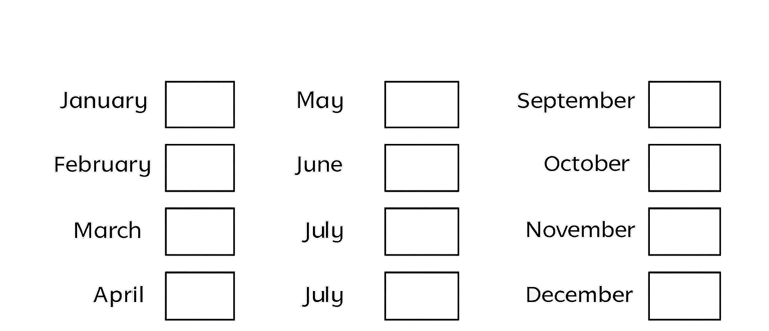

Your Turn
How many days are in each month
31
31
30
28 or 29
30
31
31
31
30
30
31
31

Slide 8

True or False
There are exactly 4 weeks in a month
False:
Can you explain why?

