Slide 1
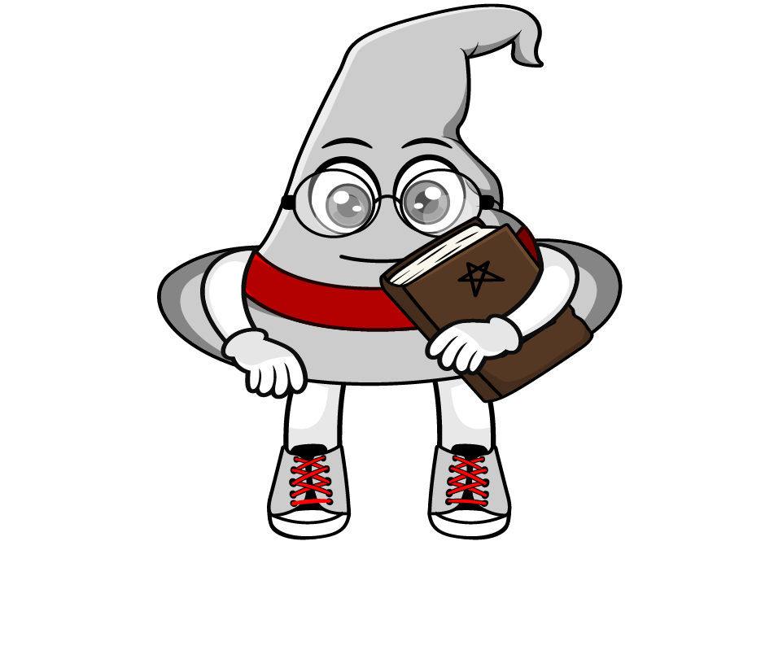

Lesson 2:
Convert units of measure involving fractions
www.arithmagicians.com

Slide 2

Recap:
1 cm = ? mm
10 mm
1 m = ? cm
100 cm
1 kg = ? g
1000 g
1 L = ? ml
1000 ml
1 km = ? m
1000 m

Slide 3



150cm
1 $\frac{1}{2}$ m = ? cm
I know that :
1m = 100cm
$\frac{1}{2}$ x 100 = 50 cm
Therefore :
So :
100 cm + 50 cm = 150cm
100cm
50cm
50cm

Slide 4


2750g
2 $\frac{3}{4}$ kg = ? g
I know that:
1kg = 1000g
$\frac{3}{4}$ x 1000 = 750 g
Therefore :
So :
2000 g + 750 g = 2750g
1000g
250g
250g
250g
250g

Slide 5



4200m
4 $\frac{1}{5}$ km = ? m
I know that:
1km = 1000m
Therefore :
$\frac{1}{5}$ x 1000 = 200 m
So :
4000 m + 200 m = 4200m
1000m
200m
200m
200m
200m
200m

Slide 6






Your Turn
2500 m
a) 2 $\frac{1}{2}$ km = ? m
175 cm
b) 1 $\frac{3}{4}$ m = ? cm
2600 g
c) 2 $\frac{3}{5}$ kg = ? g
5600 ml
d) 5 $\frac{6}{10}$ L = ? ml

Slide 7


True or False
3 $\frac{1}{2}$ kg = 350 g
False

