Slide 1


Lesson 2:
Tell The Time To 5 Minutes
www.arithmagicians.com

Slide 2

+5
+5
+5
+5
+5
+5
+5
+5
+5
+5
0
5
10
15
20
25
30
35
40
45
50
Get ready to count up in 5s

Slide 3

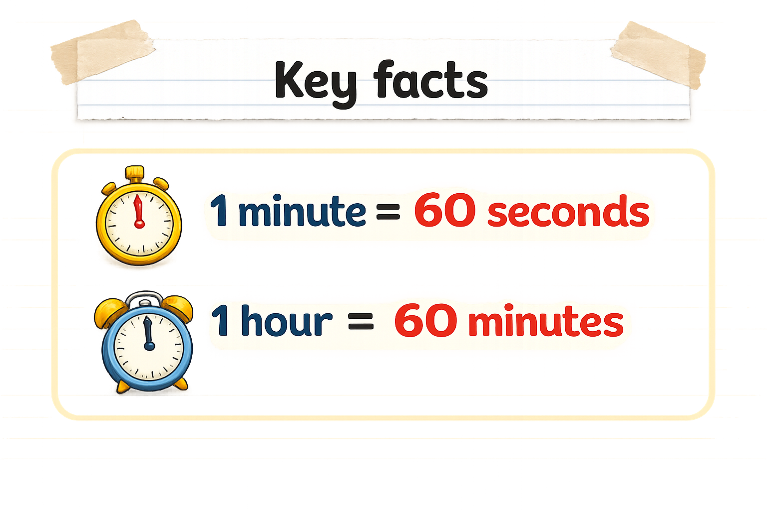
Recap:
?
?

Slide 4
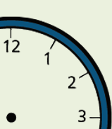

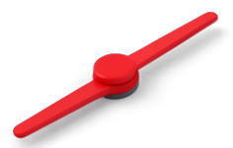
Key Time Words
Minute Hand
The long hand that shows how many minutes have passed.
Hour Hand
The short hand that points to the main hour.
5- minute interval
The gap between each number on the clock.

Slide 5

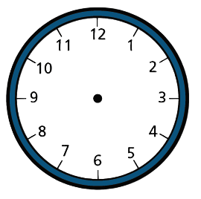
Each number on the clock face represents
5 minutes.
When the big hand points to 1,
it is 5 minutes past.
When it points to 2, it is 10 minutes past
When it points to 3, it is 15 minutes past
(or quarter past).
When it points to 6, it is 30 minutes past
(or half past).
When it points to 9, it is 45 minutes past
(or quarter to).

Slide 6


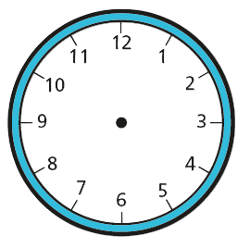
Your Turn
Write down the time shown in words
A
B
C
D
20 minutes past 5
5 minutes
past 5
quarter to 6
quarter past 5

Slide 7
True or False
The time shown is
1 minute past 3
False

