Slide 1


Lesson 2:
Quarters as decimals
www.arithmagicians.com

Slide 2



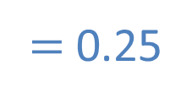

What fraction is shown in the representation?
$=$ $\frac{?}{100}$
$\frac{\text{1}}{\text{4}}$
$=$ $\frac{25}{100}$
$=$ 0.25

Slide 3
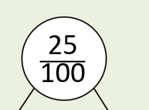
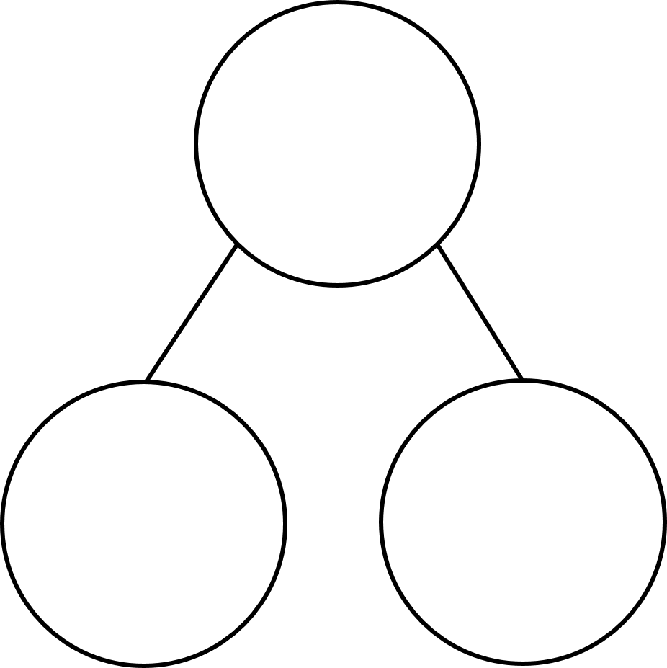





What fraction is shown in the representation?
$\frac{\text{25}}{\text{100}}$
0.25
$\frac{\text{20}}{\text{100}}$
$\frac{\text{5}}{\text{100}}$
$\frac{\text{2}}{\text{10}}$
0.05
0.2

Slide 4


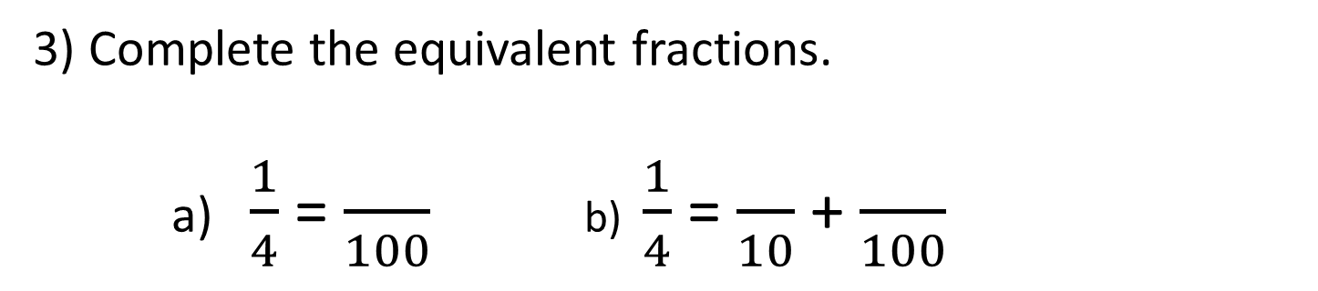
Your Turn
1) How many hundredths are shaded?
25
3) Complete the equivalent fractions.
a) $\frac{1}{4}$ = $\frac{}{100}$ b) $\frac{1}{4}$ = $\frac{}{10}$ + $\frac{}{100}$
25
2
5
3) Write ¼ as a decimal:
0.25

Slide 5


True or False
>
¼ 0.25
False: Can you explain why?

