Slide 1
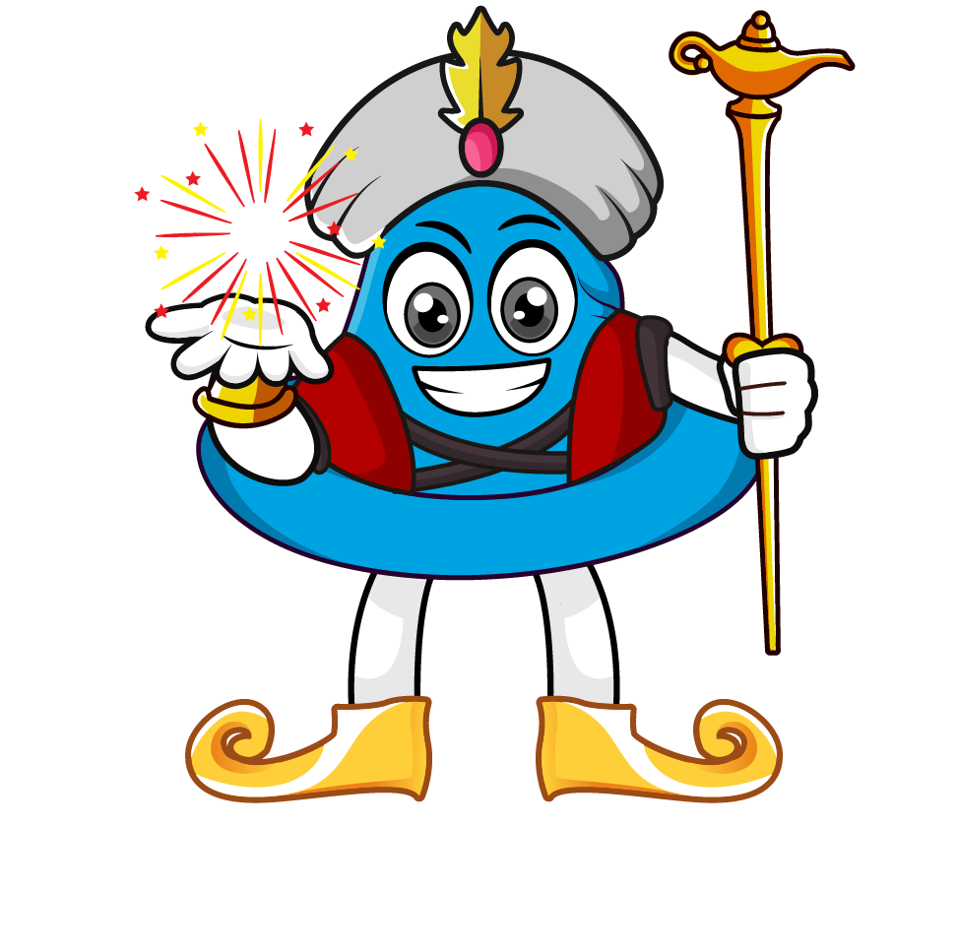
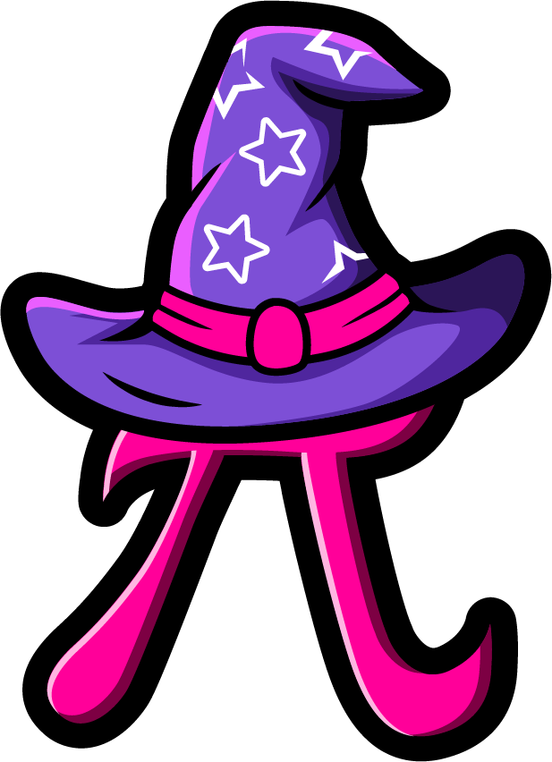
Lesson 3:
Convert units of measure involving fractions
www.arithmagicians.com

Slide 2

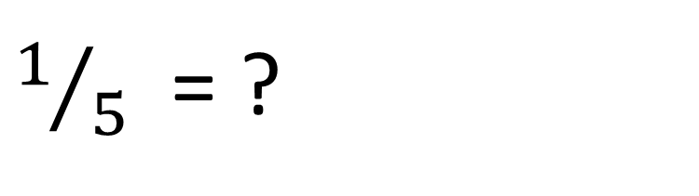
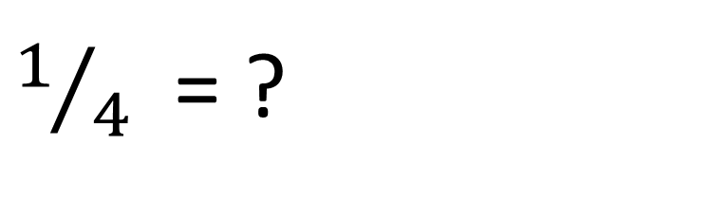
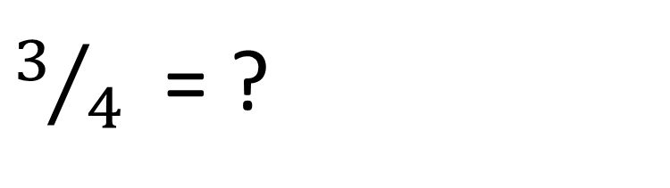
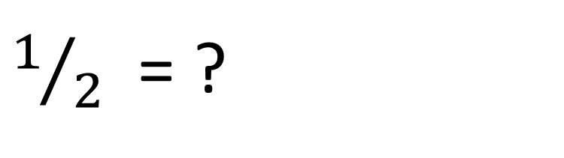
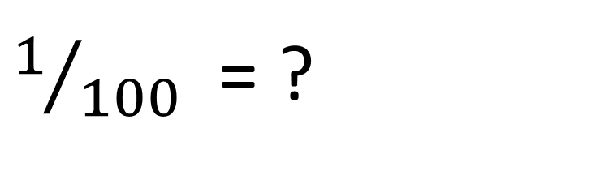
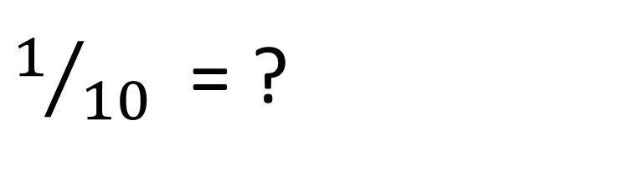
Recap:
Convert the fractions
into a decimal.
$1/2$ = ?
$1/5$ = ?
0.5
0.2
$1/4$ = ?
$1/{10}$ = ?
0.25
0.1
$3/4$ = ?
$1/{100}$ = ?
0.75
0.01

Slide 3


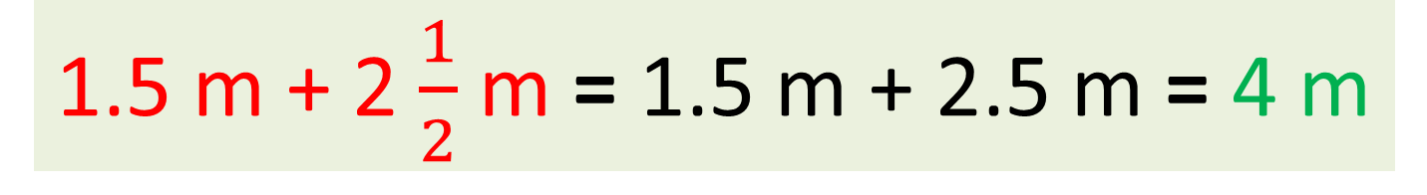
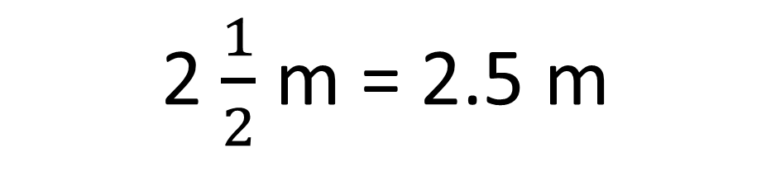

4m
1.5 m + 2 $\frac{1}{2}$ m = ? m
First, convert the mixed number into a decimal
Now add them all up.
2 $\frac{1}{2}$ m ​= 2.5 m
1.5 m + 2 $\frac{1}{2}$ m = 1.5 m + 2.5 m = 4 m

Slide 4
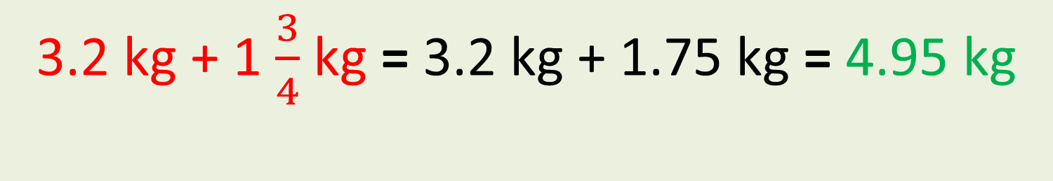
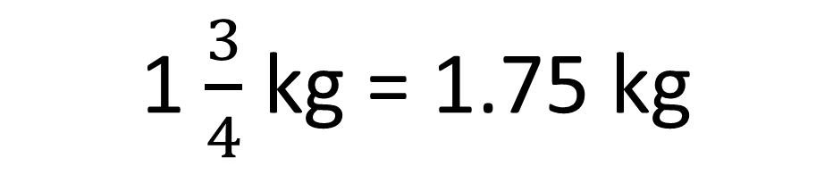

4.95kg
3.2 kg + 1 $\frac{3}{4}$ kg = ? kg
First, convert the mixed number into a decimal
Now add them all up.
1 $\frac{3}{4}$ kg ​= 1.75 kg
3.2 kg + 1 $\frac{3}{4}$ kg = 3.2 kg + 1.75 kg = 4.95 kg

Slide 5

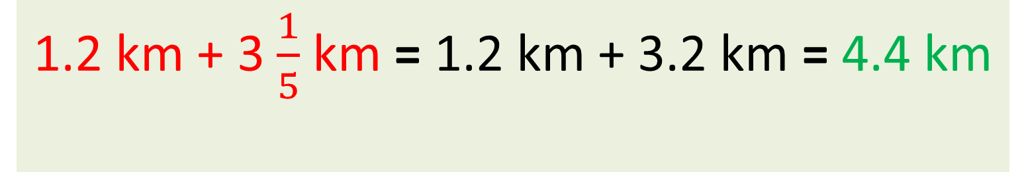
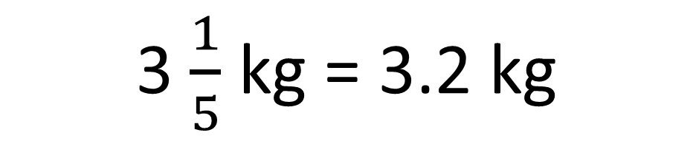

4.4 km
1.2 km + 3 $\frac{1}{5}$ km = ? km
First, convert the mixed number into a decimal
Now add them all up.
1.2 km + 3 $\frac{1}{5}$ km = 1.2 km + 3.2 km = 4.4 km
3 $\frac{1}{5}$ kg ​= 3.2 kg

Slide 6


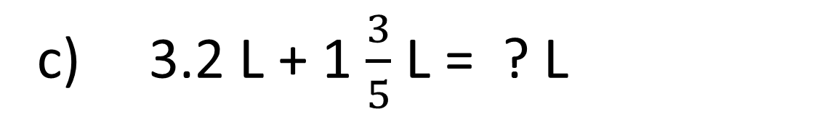
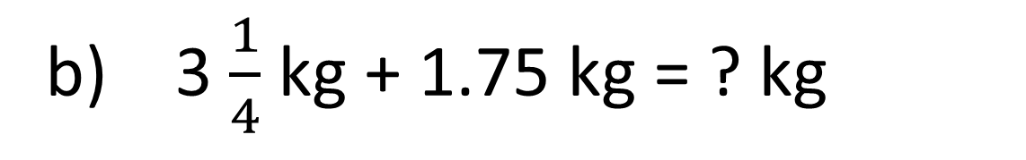
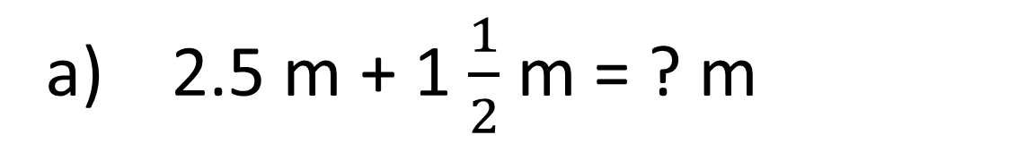
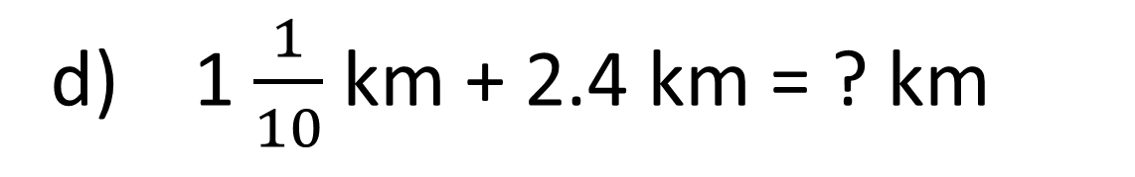
Your Turn
4 m
a) 2.5 m + 1 $\frac{1}{2}$ m = ? m
5 kg
b) 3 $\frac{1}{4}$ kg + 1.75 kg = ? kg
4.8 L
c) 3.2 L + 1 $\frac{3}{5}$ L = ? L
3.5 km
d) 1 $\frac{1}{10}$ km + 2.4 km = ? km

Slide 7
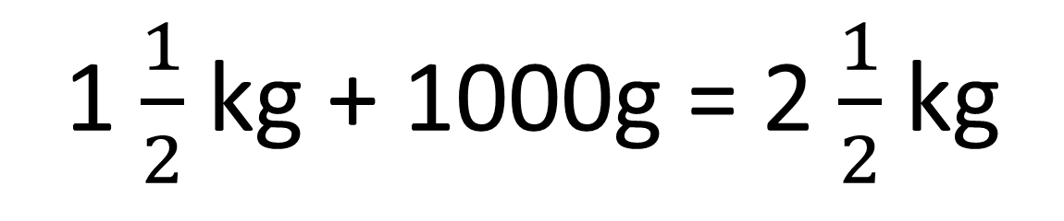
True or False
1 $\frac{1}{2}$ kg + 1000g = 2 $\frac{1}{2}$ kg
True

