Slide 1


Lesson 3:
Quarters as decimals
www.arithmagicians.com

Slide 2



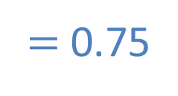

What fraction is shown in the representation?
$=$ $\frac{?}{100}$
$\frac{\text{3}}{\text{4}}$
$=$ $\frac{75}{100}$
$=$ 0.75

Slide 3
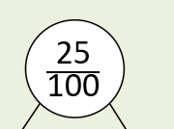
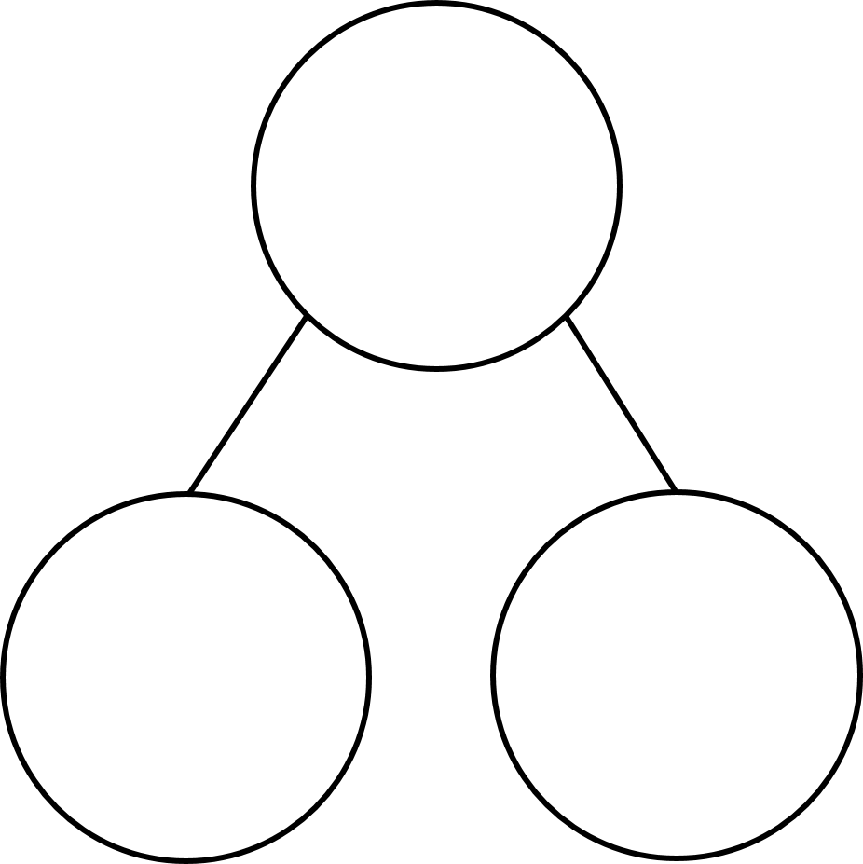





What fraction is shown in the representation?
$\frac{\text{75}}{\text{100}}$
0.75
$\frac{\text{70}}{\text{100}}$
$\frac{\text{5}}{\text{100}}$
$\frac{\text{7}}{\text{10}}$
0.05
0.7

Slide 4


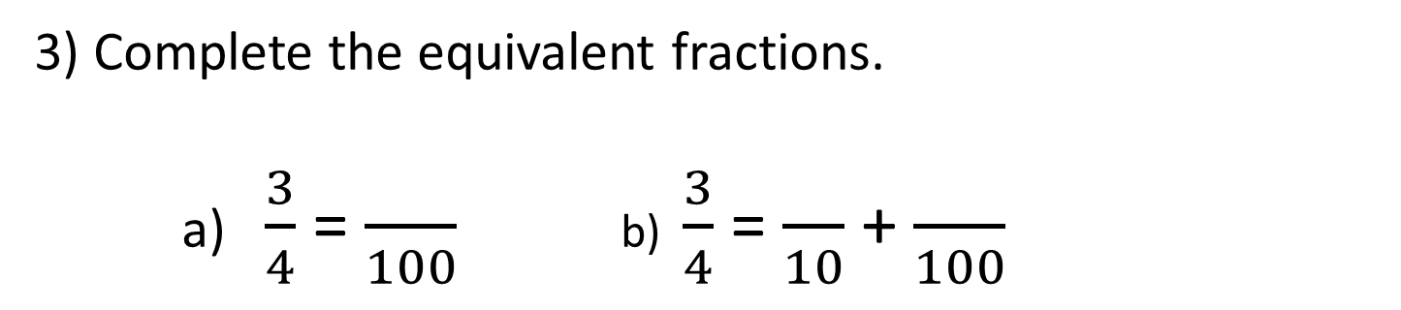
Your Turn
1) How many hundredths are shaded?
75
3) Complete the equivalent fractions.
a) $\frac{3}{4}$ = $\frac{}{100}$ b) $\frac{3}{4}$ = $\frac{}{10}$ + $\frac{}{100}$
75
7
5
3) Write ¾ as a decimal:
0.75

Slide 5


True or False
<
0.75 ¾
False: Can you explain why?

