Slide 1

Lesson 4:
1 more, 1 less
www.arithmagicians.com

Slide 2


-1
-1
-1
-1
-1
-1
-1
-1
-1
-1
30
31
32
33
34
35
36
37
38
39
40
Get ready to count back in 1s

Slide 3


The banana costs 1p more.
What is the new price of the banana?
1 | 2 | 3 | 4 | 5 | 6 | 7 | 8 | 9 | 10
11 | 12 | 13 | 14 | 15 | 16 | 17 | 18 | 19 | 20
21 | 22 | 23 | 24 | 25 | 26 | 27 | 28 | 29 | 30
31 | 32 | 33 | 34 | 35 | 36 | 37 | 38 | 39 | 40
41 | 42 | 43 | 44 | 45 | 46 | 47 | 48 | 49 | 50
51 | 52 | 53 | 54 | 55 | 56 | 57 | 58 | 59 | 60
61 | 62 | 63 | 64 | 65 | 66 | 67 | 68 | 69 | 70
71 | 72 | 73 | 74 | 75 | 76 | 77 | 78 | 79 | 80
81 | 82 | 83 | 84 | 85 | 86 | 87 | 88 | 89 | 90
91 | 92 | 93 | 94 | 95 | 96 | 97 | 98 | 99 | 100
39p
40p

Slide 4

The apple costs 1p less.
What is the new price of the apple?
1 | 2 | 3 | 4 | 5 | 6 | 7 | 8 | 9 | 10
11 | 12 | 13 | 14 | 15 | 16 | 17 | 18 | 19 | 20
21 | 22 | 23 | 24 | 25 | 26 | 27 | 28 | 29 | 30
31 | 32 | 33 | 34 | 35 | 36 | 37 | 38 | 39 | 40
41 | 42 | 43 | 44 | 45 | 46 | 47 | 48 | 49 | 50
51 | 52 | 53 | 54 | 55 | 56 | 57 | 58 | 59 | 60
61 | 62 | 63 | 64 | 65 | 66 | 67 | 68 | 69 | 70
71 | 72 | 73 | 74 | 75 | 76 | 77 | 78 | 79 | 80
81 | 82 | 83 | 84 | 85 | 86 | 87 | 88 | 89 | 90
91 | 92 | 93 | 94 | 95 | 96 | 97 | 98 | 99 | 100
69p
70p

Slide 5

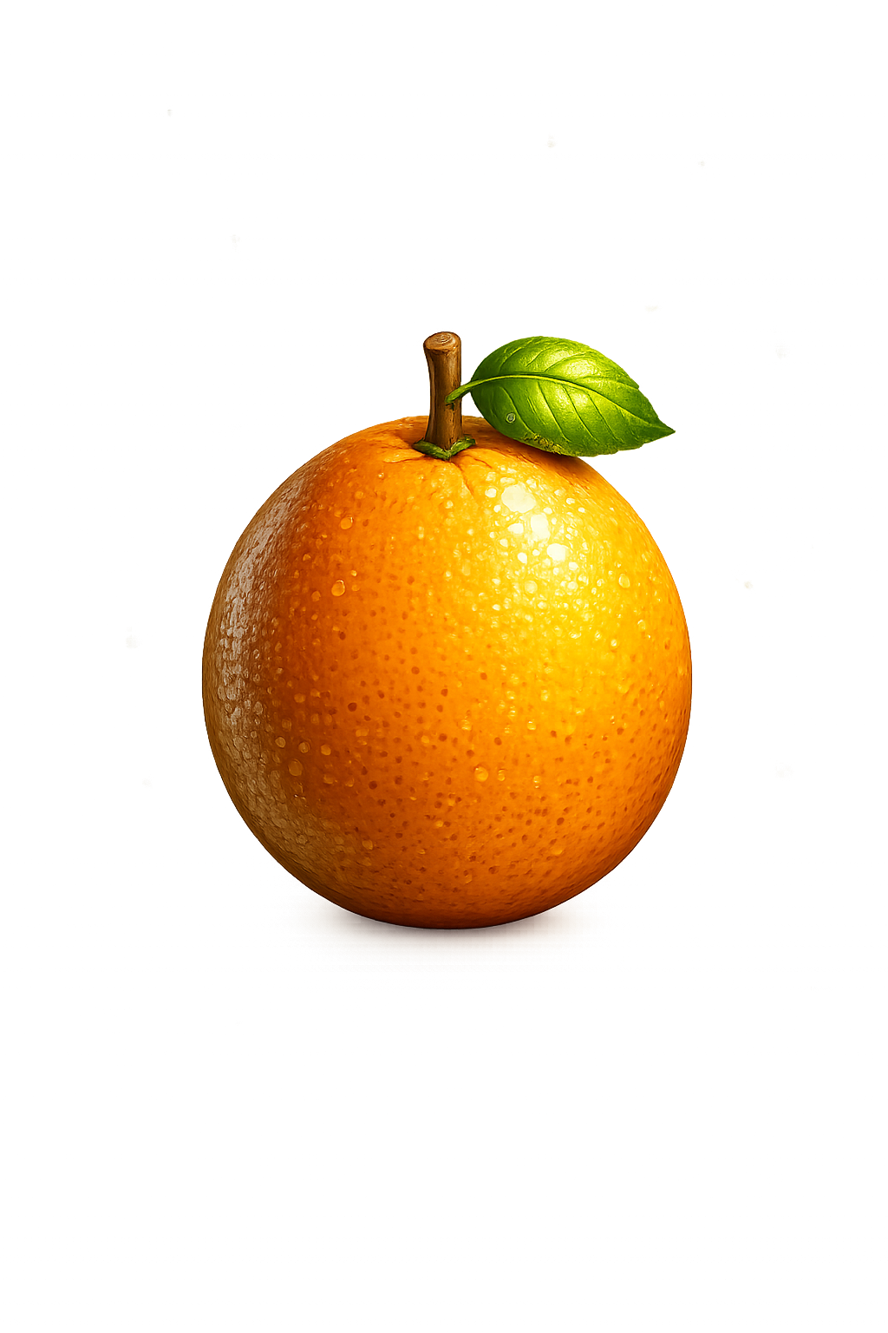
The orange costs 1p more.
What is the new price of the orange?
1 | 2 | 3 | 4 | 5 | 6 | 7 | 8 | 9 | 10
11 | 12 | 13 | 14 | 15 | 16 | 17 | 18 | 19 | 20
21 | 22 | 23 | 24 | 25 | 26 | 27 | 28 | 29 | 30
31 | 32 | 33 | 34 | 35 | 36 | 37 | 38 | 39 | 40
41 | 42 | 43 | 44 | 45 | 46 | 47 | 48 | 49 | 50
51 | 52 | 53 | 54 | 55 | 56 | 57 | 58 | 59 | 60
61 | 62 | 63 | 64 | 65 | 66 | 67 | 68 | 69 | 70
71 | 72 | 73 | 74 | 75 | 76 | 77 | 78 | 79 | 80
81 | 82 | 83 | 84 | 85 | 86 | 87 | 88 | 89 | 90
91 | 92 | 93 | 94 | 95 | 96 | 97 | 98 | 99 | 100
30p
31p

Slide 6
What do you notice?
39
1 more
40
89
1 more
90
When a number ends in _____ ,
1 more takes you to the next ____.
9
ten

Slide 7
What do you notice?
50
1 less
49
30
1 less
29
When a number ends in ___,
1 less takes you to a number ending in ___.
0
9

Slide 8


Your Turn
39
a) 1 more than ____ is 40
b) 1 less than ____ is 29
c) 1 more than ____ is 70
d) 1 less than ____ is 49
30
69
50

Slide 9
True or False
1 more than a number ending in 9 always ends in 0.
True

