Slide 1


Lesson 4:
Halves and quarters as decimals
www.arithmagicians.com

Slide 2

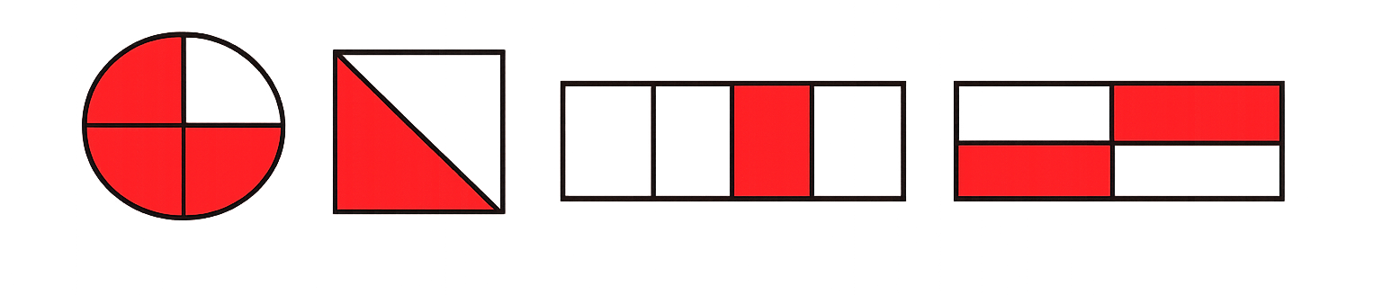
Which image has 0.25 shaded?
A
B
C
D

Slide 3
Which image has 0.75 shaded?
A
B
C
D

Slide 4
Which images have 0.5 shaded?
A
B
C
D

Slide 5

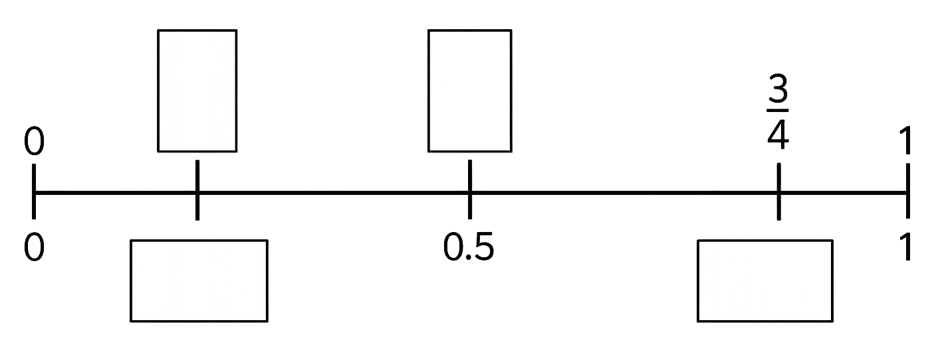
Complete the missing fractions and decimals on the number line.
¼
½
A
C
0
0
0.5
B
D
0.25
0.75

Slide 6


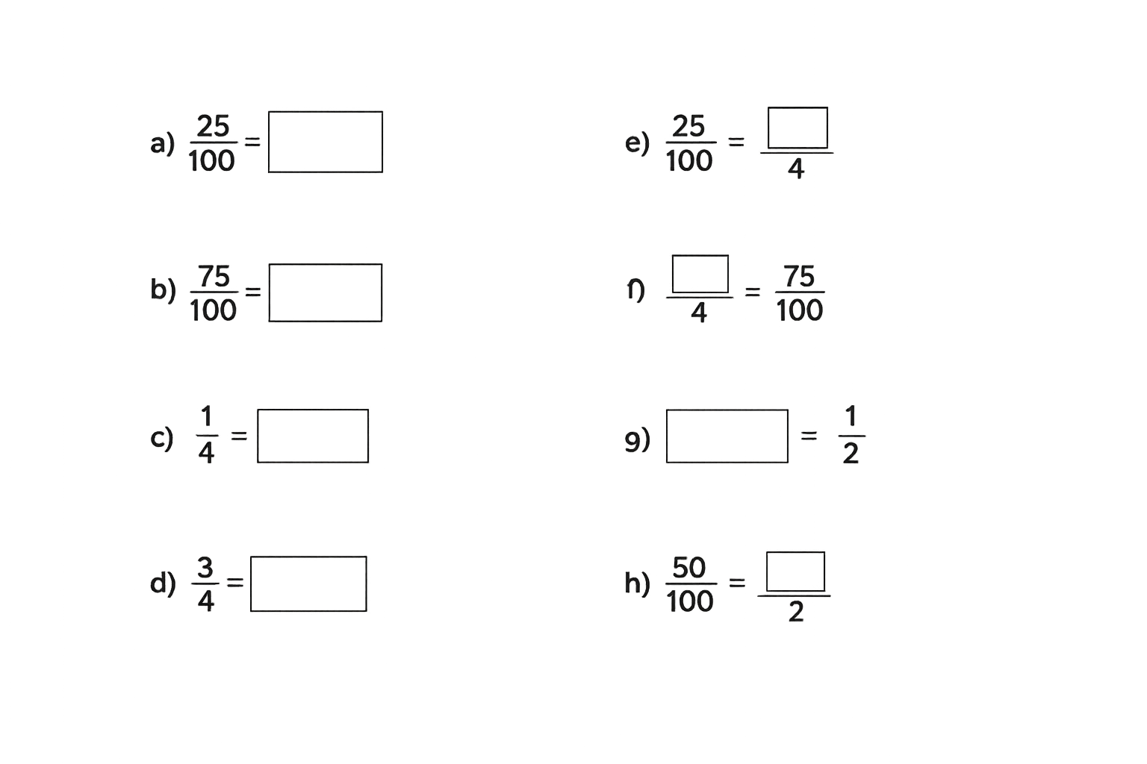
Your Turn
Complete the equivalent fractions and decimals.
1
0.25
3
0.75
f)
0.25
0.5
0.75
1

Slide 7


True or False
$\frac{50}{100}$ > $\frac{3}{4}$
False: Can you explain why?

