Slide 1


Lesson 5:
Assess and Review
www.arithmagicians.com

Slide 2

Days, Weeks, Months
7
1 week $=$ _____ days
4 weeks $=$ _____ days
1 year $=$ _____ months
1 year = ______ days
A leap year = ______ days
28
12
365
366

Slide 3

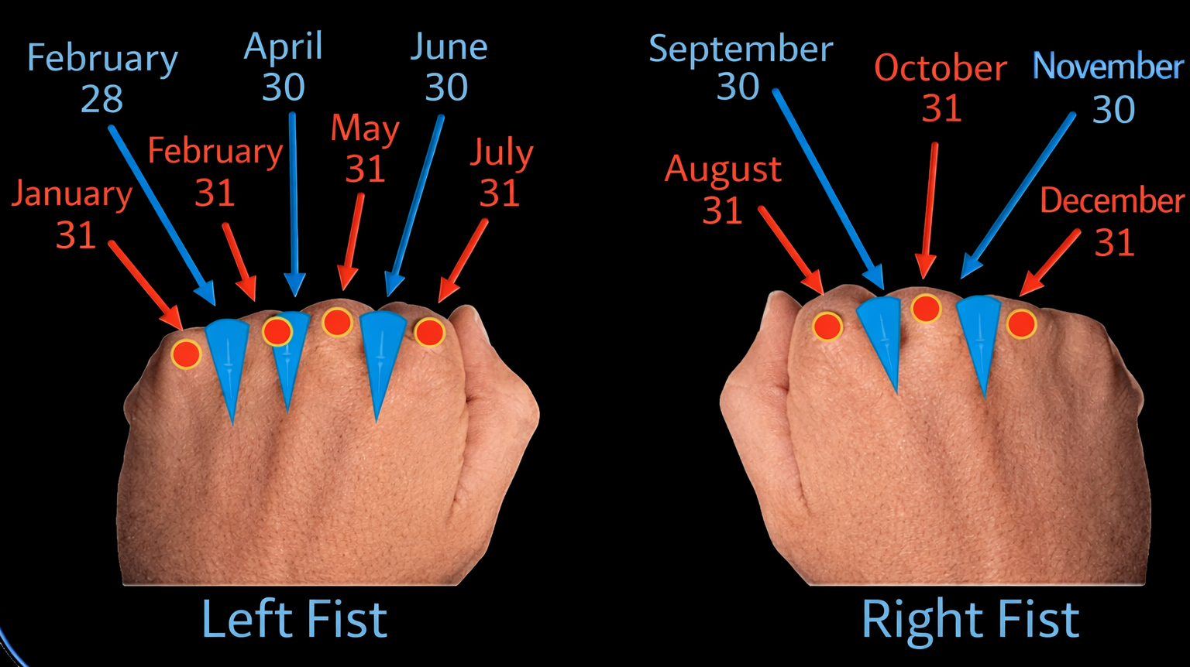
Left Hand
Month | Position | Days
January | Knuckle | 31
February | Gap | 28 / 29
March | Knuckle | 31
April | Gap | 30
May | Knuckle | 31
June | Gap | 30
July | Knuckle | 31
One way is to
use your knuckles
March
Right Hand
Month | Position | Days
August | Knuckle | 31
September | Gap | 30
October | Knuckle | 31
November | Gap | 30
December | Knuckle | 31

Slide 4


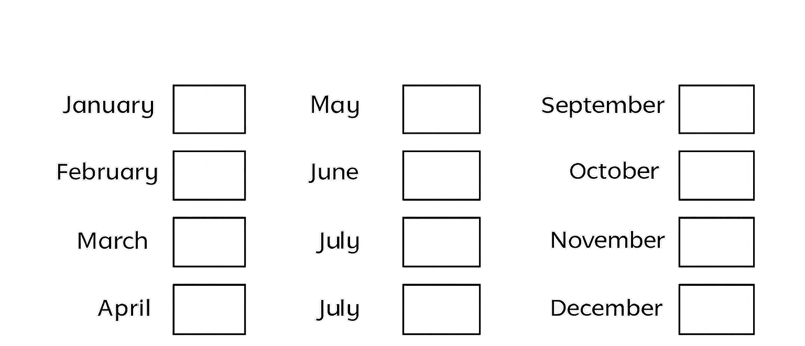

Your Turn
How many days are in each month
31
31
30
28 or 29
30
31
31
31
30
30
31
31

