Slide 1


Lesson 5:
Assess and Review
www.arithmagicians.com

Slide 2

What fraction is shown in the representation?
$\frac{\text{1}}{\text{2}}$
$$= \frac{?}{10}$$
$=$ $\frac{?}{100}$
$$= \frac{?}{10}$$
$$= \frac{?}{100}$$
$=\frac{\text{5}}{\text{10}}$
$=\frac{\text{50}}{\text{100}}$
$\frac{\text{1}}{\text{2}}$
$=\frac{\text{5}}{\text{10}}$
$=\frac{\text{50}}{\text{100}}$
$\frac{\text{1}}{\text{2}}$
$=\frac{\text{5}}{\text{10}}$
$=\frac{\text{50}}{\text{100}}$
0.5
$=$ ?

Slide 3
What fraction is shown in the representation?
$=$ $\frac{?}{100}$
$\frac{\text{1}}{\text{4}}$
$=$ $\frac{25}{100}$
$=$ 0.25

Slide 4
What fraction is shown in the representation?
$=$ $\frac{?}{100}$
$\frac{\text{3}}{\text{4}}$
$=$ $\frac{75}{100}$
$=$ 0.75

Slide 5


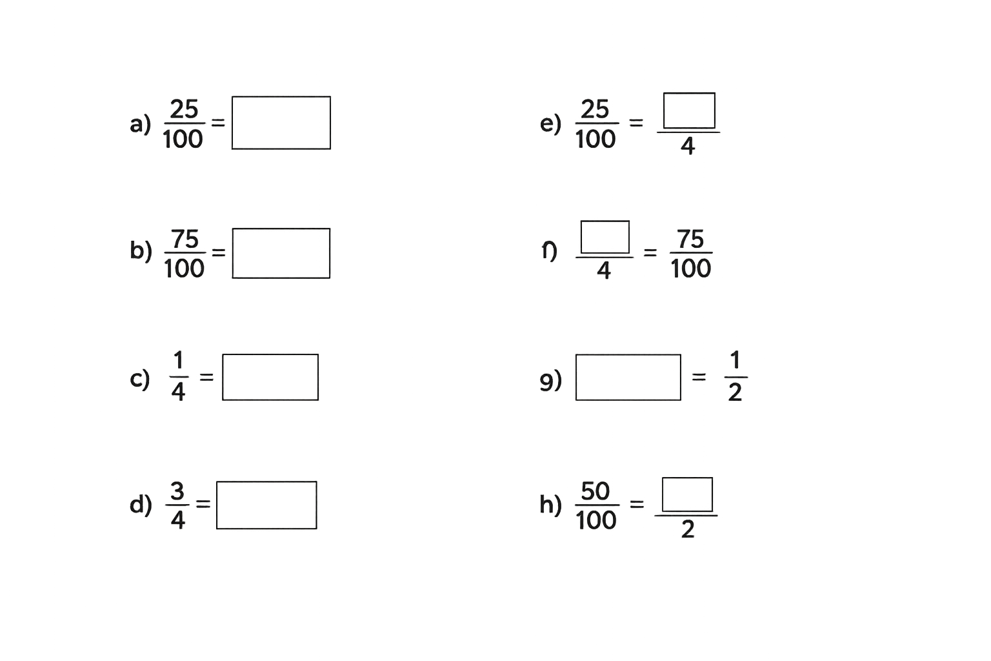
Your Turn
1
0.25
a)
e)
3
b)
f)
0.75
c)
0.5
g)
0.25
1
0.75
d)
h)

Slide 6

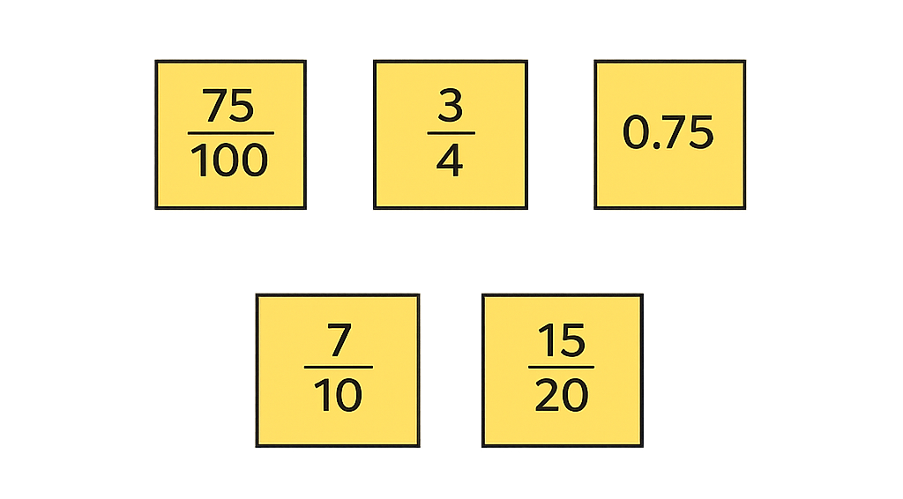
Which is the odd one out?
Explain your thinking.

